Slide 1
NRG Oncology/RTOG 0848:
A Phase II-R and a Phase III Trial Evaluating Both Erlotinib (Ph II-R) and Chemoradiation (Ph III) as Adjuvant Treatment for Patients with Resected Head of Pancreas Adenocarcinoma
Ross A. Abrams, M.D.
Webinar June 23, 2017

Slide 2
NRG/RTOG 0848: Study Objectives
    Phase IIR: Erlotinib Question – To determine whether the addition of erlotinib to gemcitabine adjuvant chemotherapy shows a signal for improved survival as compared to gemcitabine alone following R0 or R1 resection of head of pancreas adenocarcinoma
    Phase III: Radiation Question (still accruing) – To determine whether the use of concurrent chemoradiation following adjuvant chemotherapy further enhances overall survival, for patients without evidence of progressive disease after 5 months of adjuvant chemotherapy.

Slide 3
Study Chairs
Radiation Oncology
Ross A. Abrams, M.D. (Principal Investigator) NRG Oncology
William Regine, M.D. NRG Oncology
Karyn A. Goodman, M.D. NRG Oncology
Anuradha Bapsi Chakravarthy, M.D. ECOG-ACRIN
Medical Oncology
Howard Safran, M.D. NRG Oncology
Malcolm Moore, M.D. NRG Oncology
Philip A Philip, M.D., Ph.D., F.R.C.P. SWOG
Eileen O’Reilly, MD Alliance
Surgical Oncology
Adam Berger, M.D. NRG Oncology
Andrew M. Lowy, M.D. SWOG
Medical Physics
Michael Gillin, Ph.D. NRG Oncology
Translational Research
Chandan Guha, M.D., Ph.D. NRG Oncology
Quality of Life
Lisa Kachnic, M.D. NRG Oncology
Pathology
Jining Feng, M.D., Ph.D. SWOG

Slide 4
TOPICS
BACKGROUND
PROTOCOL BASICS
  ORIGINAL
  CHANGES
  REASON FOR CHANGES
IS THIS RANDOMIZATION TO ± RADIATION ETHICAL, IMPORTANT?

Slide 5
Background: Adjuvant trials at time of
RTOG 0848 conception (2008)
GITSG: Adjuvant RT + 5-FU helpful. (1985)
ESPAC 1: Adjuvant RT + 5-FU not helpful. (2001, 2004)
CONKO-001: Adjuvant gemcitabine improved median OS vs. observation: 22.8 vs. 20.2 months, (p=0.005). (2007)
NCIC: Erlotinib + gemcitabine improves median survival (6.4 vs. 5.9 months) and 1-year survival (17% vs. 24%) and compared to gemcitabine alone. (2007)
HOPKINS: Adjuvant RT+5FU helpful (908 pts) (2008)
Mayo: Adjuvant RT + 5FU helpful (472 patients)(2008)

Slide 6
RTOG 0848: Original Schema (2008)
FIRST RANDOMIZATION
S
T
R
A
T
I
F
Y
Nodal Status:
1: involved
2: uninvolved
CA19-9 result:
1: ≤ 90
2: > 90 – 180
Surgical margins:
1: positive (R1)
2: negative (R0)
R
A
N
D
O
M
I
Z
E
Arm 1:
Gemcitabine X 5 cycles
Arm 2:
Gemcitabine + Erlotinib x 5 cycles
Evaluate to Confirm No Progression
If no progression, then:
S
T
R
A
T
I
F
Y
First Randomization Treatment Arm:
1. Arm 1 gemcitabine vs.
2. Arm 2 gemcitabine + erlotinib
SECOND RANDOMIZATON
For Non-Progressing Patients
R
A
N
D
O
M
I
Z
E
Arm 3:
1cycle of chemotherapy
Arm 4:
1 cycle of chemotherapy followed by XRT with either capecitabine or 5-FU

Slide 7
RTOG 0848: Key Eligibility
Pancreatic head adenocarcinoma managed with a potentially curative resection (removal of all gross tumor), microscopic margin positivity allowed.
Stage T1-3, N0-1, M-0
CA19-9 ≤ 180 units/mL
ANC ≥ 1,500 cells/mm³ , platelets ≥ 100,000 cells/mm³, serum total bilirubin ≤ 2x ULN, creatinine < 2x ULN, SGOT ≤ 2.5 ULN
CT of abdomen and chest CT/x-ray

Slide 8
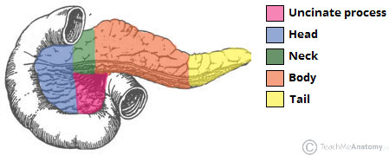
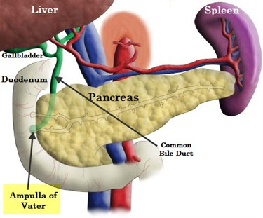
ANATOMY PANCREATIC HEAD REGION
YES
YES
YES
NO
NO
ORGANS OF PERIAMPULLARY REGION
ONLY PANCREAS ELIGIBLE

Slide 9
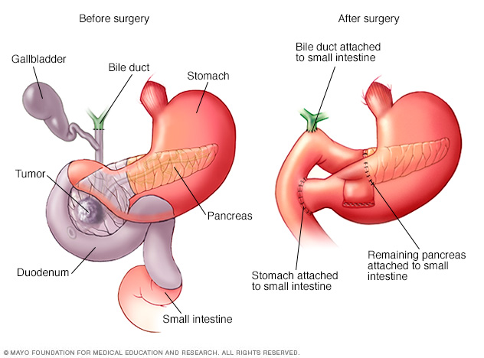
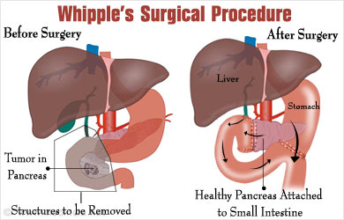
PANCREATICODUODENECTOMY
“WHIPPLE”

Slide 10
RTOG 0848: Original Statistical Assumptions
    Overall Sample Size (n=950)
    Based on 640 pts needed for RT question primary endpoint
    25% progress prior to RT randomization
    RT Question – Primary Endpoint:
    Provide 90% power to detect increase MST from 17 to 22.5 months (HR=0.75), with 1-sided α = 0.05.
    Still accruing to RT question
    Erlotinib Question – Primary Endpoint:
    856 eligible pts (up to 10% of 950 ineligible)
    Provide 90% power to detect increase MST from 22 to 28 months (HR=0.79), with 1-sided α = 0.05.
MST = median survival time

Slide 11
Major Amendment #1 (2014)
AFTER LAP07 Trial
  Evaluated induction single agent gemcitabine (gem) vs gem + erlotinib in locally advanced pancreatic cancer
  OS: 16.5 mths for gem and15.3 mths for gem + erlotinib
  Stopped erlotinib randomization
  Design Revision for Erlotinib Question
    Changed erlotinib question to a phase IIR study for analysis
    1-sided alpha of 0.15, with analysis at 200 events (deaths)
    80% power to detect a signal for an increase in MST from 22 to 28.8 months (HRs = 0.76)
    90% power to detect a signal for an increase in MST from 22 to 30.6 months (HRs = 0.72)
MST = median survival time

Slide 12
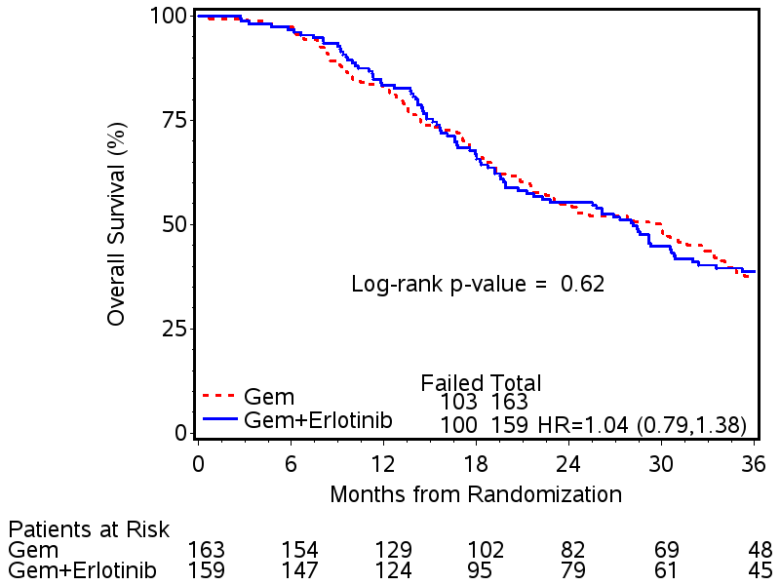
RTOG 0848: Overall Survival by Treatment Arm
83% (78%, 89%)
83% (77%, 89%)
55% (47%, 63%)
55% (47%, 63%)
39% (31%, 47%)
38% (30%, 45%)
ASCO 2017
HR = Hazard Ratio [Gemcitabine+Erlotinib/Gemcitabine]

Slide 13
Major Amendment #2 (2016)
INCREASED CHEMOTHERAPY OPTIONS/TIMING
Allowable agents: gemcitabine, nab-paclitaxel, oxaliplatin, fluoropyrimidine (including capecitabine), or irinotecan
  Delivered per institutional standard
  Note: As before, patients may still receive gemcitabine alone
  Up to 3 months of chemotherapy may begin prior to registration (step 1)
    Note: As before, patients may still be registered before starting chemotherapy
    Randomization to ± radiotherapy still occurs after the 5th month of chemotherapy (step 2)

Slide 14
RTOG 0848: Current Schema
FIRST STEP:
ADJUVANT SYSTEMIC TREATMENT
Note: Up to 3 months of chemotherapy may be initiated prior to registration
R
E
G
I
S
T
E
R
Arm 1: Gemcitabine alone or combination chemotherapy x 5 months
Arm 2:
Gemcitabine + Erlotinib x 5 cycles (Arm 2 closed to accrual effective 4/02/14)
Evaluate To Confirm No Progression
If no progression, then:
SECOND STEP:
RT RANDOMIZATION
For Non-Progressing Patients
Nodal Status:
involved
Uninvolved
S
T
R
A
T
I
F
Y
CA19-9 Result:
≤ 90
> 90 – 180
R
A
N
D
O
M
I
Z
E
Arm 3:
1 month of gemcitabine or combination chemotherapy
Surgical Margins:
positive (R1)
negative (R0)
Arm 4:
1 month of gemcitabine or combination chemotherapy followed by XRT with either capecitabine or 5-FU
Adjuvant Systemic Treatment:
Gemcitabine alone
FOLFIRINOX or mFOLFIRINOX
Non-oxaliplatin gemcitabine combinations

Slide 15
Is the RT randomization ethical and why is it important to answer the RT question?
Data suggests benefit, therapeutic benefit is hard to achieve in pancreatic cancer, can’t afford to incorrectly abandon an effective therapy
CONKO 001 did not test or use XRT
ESPAC-1 trial flawed
RTOG 0848 eliminates inappropriate XRT
RTOG 9704 demonstrates survival benefit of correctly delivered XRT
In two randomized trials of locally advanced disease:
  ECOG 4201 - XRT showed benefit
  LAP 07 - XRT shown not to be harmful; equivalent to continuing chemo
  Trial endorsed by GI experts of Pancreas Task Force and GI Steering Committee

Slide 16
Papers Supporting Use of Radiotherapy (1)
1: Lim YJ, Kim K, Chie EK, Kim B, Ha SW. Role of Adjuvant Radiotherapy in
Left-Sided Pancreatic Cancer-Population-Based Analysis with Propensity Score
Matching. J Gastrointest Surg. 2015 Dec;19(12):2183-91.
2: Sugawara A, Kunieda E. Effect of adjuvant radiotherapy on survival in resected
pancreatic cancer: a propensity score surveillance, epidemiology, and end results
database analysis. J Surg Oncol. 2014 Dec;110(8):960-6.
3: Mellon EA, Springett GM, Hoffe SE, Hodul P, Malafa MP, Meredith KL, Fulp WJ,
Zhao X, Shridhar R. Adjuvant radiotherapy and lymph node dissection in pancreatic
cancer treated with surgery and chemotherapy. Cancer. 2014 Apr 15;120(8):1171-7.
4: Kooby DA, Gillespie TW, Liu Y, Byrd-Sellers J, Landry J, Bian J, Lipscomb J.
Impact of adjuvant radiotherapy on survival after pancreatic cancer resection: an
appraisal of data from the national cancer data base. Ann Surg Oncol. 2013
Oct;20(11):3634-42. doi: 10.1245/s10434-013-3047-x. Epub 2013 Jun 15.
5: Hall WA, Colbert LE, Liu Y, Gillespie T, Lipscomb J, Hardy C, Kooby DA, Prabhu
RS, Kauh J, Landry JC. The influence of adjuvant radiotherapy dose on overall
survival in patients with resected pancreatic adenocarcinoma. Cancer. 2013 Jun
15;119(12):2350-7. doi: 10.1002/cncr.28047. Epub 2013 Apr 26.
6: Opfermann KJ, Wahlquist AE, Garrett-Mayer E, Shridhar R, Cannick L, Marshall
DT. Adjuvant radiotherapy and lymph node status for pancreatic cancer: results of
a study from the Surveillance, Epidemiology, and End Results (SEER) Registry
Data. Am J Clin Oncol. 2014 Apr;37(2):112-6.

Slide 17
Papers Supporting Use of Radiotherapy (2)
7: Berger AC, Winter K, Hoffman JP, Regine WF, Abrams RA, Safran H, Freedman GM,
Benson AB 3rd, Macdonald J, Willett CG. Five year results of US intergroup/RTOG
9704 with postoperative CA 19-9 ≤90 U/mL and comparison to the CONKO-001 trial.
Int J Radiat Oncol Biol Phys. 2012 Nov 1;84(3)
8: Loehrer PJ Sr, Feng Y, Cardenes H, Wagner L, Brell JM, Cella D, Flynn P,
Ramanathan RK, Crane CH, Alberts SR, Benson AB 3rd. Gemcitabine alone versus
gemcitabine plus radiotherapy in patients with locally advanced pancreatic
cancer: an Eastern Cooperative Oncology Group trial. J Clin Oncol. 2011 Nov
1;29(31):4105-12.
9: Van Laethem JL, Hammel P, Mornex F, Azria D, Van Tienhoven G, Vergauwe P,
Peeters M, Polus M, Praet M, Mauer M, Collette L, Budach V, Lutz M, Van Cutsem E,
Haustermans K. Adjuvant gemcitabine alone versus gemcitabine-based
chemoradiotherapy after curative resection for pancreatic cancer: a randomized
EORTC-40013-22012/FFCD-9203/GERCOR phase II study. J Clin Oncol. 2010 Oct
10;28(29):4450-6.
10: McDade TP, Hill JS, Simons JP, Piperdi B, Ng SC, Zhou Z, Kadish SP,
Fitzgerald TJ, Tseng JF. A national propensity-adjusted analysis of adjuvant
radiotherapy in the treatment of resected pancreatic adenocarcinoma. Cancer. 2010
Jul 1;116(13):3257-66.
11: Moody JS, Sawrie SM, Kozak KR, Plastaras JP, Howard G, Bonner JA. Adjuvant
radiotherapy for pancreatic cancer is associated with a survival benefit
primarily in stage IIB patients. J Gastroenterol. 2009;44(1):84-91

Slide 18
Contact Information
Ross A. Abrams, MD
Rush University Medical Center
500 S. Paulina, Atrium Bld, Suite 013
Chicago IL 60612-3833
Phone: 312-942-5751
Email: Ross_a_abrams@rush.edu
Ross_a_abrams@rush.edu

Slide 19

THANK YOU!
QUESTIONS?

