Slide 1
NRG Oncology NCORP
PIs
Deborah Watkins Bruner, RN, PhD, FAAN
Joan Walker, MD
Larry Wickerham, MD

Slide 2
NRG NCORP PIs
Bruner/Walker/Wickerham
NRG NCORP Exec Committee
NCORP Pis Bruner/Walker/Wickerham, NRG Oncology Pis Curran/DeSaia/Wolmark
NRG Oncology Stats PI Costantino
NRG NCORP Steering Committee
NCORP PIs, Stats, Comm Co-chairs, Community Physician, Pt Advocates
Cancer Prevention & Control (CPC)
Chair Kachnic
Symptom Mgmt
  Neurotoxicity
  Cardiotoxicity
  Lymphedema
  Inflammation
Prevention
Survivorship
Cancer Care Delivery (CCD)
Co-chairs
Ritzwoller/Hudson
Data infrastructure
Process of Care
Outcome Assessment
Health Disparities*
Tri-chairs
Brown/Cook/ Yeager
Cultural Competency
Minority Recruitment
Elderly
PCOR*
Tri-chairs
Ganz/Movsas
Wenzel
PROs tx trials
Consult on PROs CPC, CCD, health disparities trials
Comparative Effectiveness
*Dotted line around Health Disparities & PCOR indicate they are cross-
cutting committees (shared resources) across both CTEP and NCORP grants.
Notes:
NCORP Structure
*Dotted line around PCOR (and comparative effectiveness) and Health Disparities indicate they are cross-cutting committees (shared resources) across both CTEP grant and NCORP grant. These Committee chairs are funded on Operations (CTEP) grant….however the PRO endpoints (including comparative effectiveness endpoints) on treatment trials are paid out of NCORP grant (this is the NCI mandate) and resources must be overseen by NCORP leadership.

Slide 3
CPC Core Grant Aims and Priorities
Cancer prevention research, women’s health & neurocognitive symptom management have been focused, but all concepts welcome
Cancer control research with four symptomatic management themes of neurotoxicity, cardiotoxicity, lymphedema, and inflammation (including cancer-related fatigue) are prioritized
Survivorship and palliative care interventions
Cancer disparity research, in collaboration with our Health Disparities Research (HDR) Program
Notes:
I WOULD READ ALL THIS

Slide 4
NCORP Concept Review Process
Concepts considered for NCORP formal concept review have been presented and supported by the relevant NCORP committee (CCDR, CPC); NRG disease site committee (recommended, but not mandatory) and seen by NRG statistician to comment on potential sample size.
Concepts are distributed and assigned to appropriate reviewers for content, PROs, TRP, Stats, pt advocate, community feasibility and will obtain written comments
At NCORP steering committee face-to-face meeting (or conference call), PI may introduce study in a few sentences, no slides permitted. Reviewers will present comments and recommendations.
Call for concepts will be sent to all NCORP
Committees with submission deadline.
Concepts meeting the requirements above are submitted to on the NCORP concept submission form.
Approval
Revise and Resubmit
Disapproval
If approved, present to NRG Research Strategy Committee/CPAC, upon approval submit to NCI submission
Revise proceed through re-review as above
End

Slide 5
Cancer Prevention and Control Trials
 | Study No | Disease Site | Description | Date Activated | Target Accrual | Total Accrual | CCOP/NCORP accrual (%) | Target Monthly Accrual | Expected Closure Date
GOG | 225 | Ovary | Diet and physical activity | 6/18/12 | 1150 | 1159 | 21% | 17 | July 2018
 | 237 | Cervix | CA-IX, P16, markers & HPV in dx of AGC | 2/9/09 | 1200 total 325 Japan 325 Korea 540 US | 903 total 325 Japan 321 US 257 Korea | <1% | 11 | Japan – closed 2016 US – ~4.5 years Korea –closed 2018
RTOG | 278 | Cervix | before/after non-radical surgery Physical fx & QOL | 10/1/12 | 220 | 165 | <1% | 5 | December 2020
NRG | CC001 | Brain | Memantine and WBRT +/- HA | 7/13/15 | 510 | 486 | 79(16%) | 9 | Closed Feb 2018
 | CC003 | Lung | Seamless Ph II/III PCI vs. PCI with hippocampal sparing | 12/7/15 | 172 (II) 302 (III) | 176 | 40(23%) | 6 | Ph II Closed on Oct 13th
 | CC004 | Breast, GYN | Ph II double-blinded Bupropion | 5/31/17 | 234 | 75 | 26(100%) | 10* | N/A Amendment 2 just approved
 | S0820 | Colon | Adenoma and Secondary Prevention Trial |  | 480 | 198 20 NRG |  |  | NRG is a Champion for this trial

Slide 6
Status of Developing CPC/CCDR Concepts
NRG-CC005 National Trial of Surveillance Colonoscopy (R. Schoen)*
A Three-Arm Cohort Study of Salpingectomy to Reduce the Risk of High Grade Serous Carcinoma among Premenopausal BRCA1 Carriers (D. Levine)#
A Randomized Trial of IADL-adjusted Dosing versus Standard of Care of Dosing for Pegylated Liposomal Doxorubicin every 28 Days with Bevacizumab 10 mg/kg every 2 Weeks in Elderly Women with Recurrent Ovarian Cancer (D. Chase)#
Adaptive Intervention for Tobacco Cessation in Women prior to Radiation Therapy (T. Crane)##
NRG-CC007CD: Increasing the Dose of Survivorship Care Planning in Prostate Cancer Survivors Who Receive Androgen Deprivation Therapy (R. Chen) – CCDR Trial
* Full protocol approved by NCI DCP, pending funding & approval by CIRB
** Concept submitted to DCP June 12, 2018
# Pending submission to DCP
## NCORP Steering approved 7/13/17; pending R01 review June 2018

Slide 7
CPC Concepts Being Discussed by CPC Committee at Live Meeting
Utility of GnRH analogs to protect ovarian reserve for women undergoing chemotherapy (H. Burks, L. Landrum)
  Submitted for NCORP concept review on July 12, 2018
PrEvention of Falls among OldeR Multiethnic cANcEr patients at risk for chemotherapy induced peripheral neuropathy (PErFORM ANEw)
  Concept reviewed by CPC in May and July
Impact of Sentinel Lymph Node Mapping on Lymphedema and Health Related Quality of Life in Endometrial Cancer (E. Tanner)
  Concept reviewed by CPC in 2017; currently being revised

Slide 8
Cancer Care Delivery Trials
One concept approved and protocol (revision) is currently under review at NCI.
  NRG-CC007CD: Increasing The Dose Of Survivorship Care Planning In Prostate Cancer Survivors Who Receive Androgen Deprivation Therapy. Ron Chen, MD, PI.
Two other protocols were reviewed by the NCI SC, but were disapproved.
Two CCDR pilots are underway and several other concepts are in development.

Slide 9
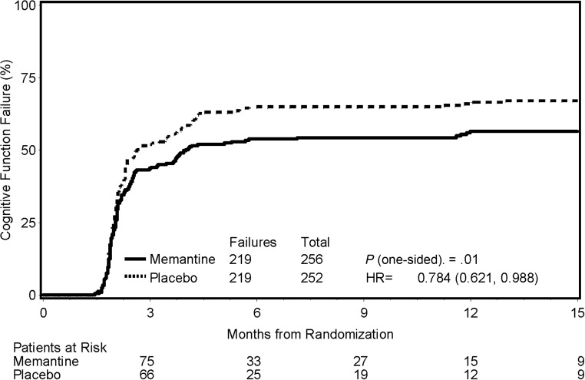
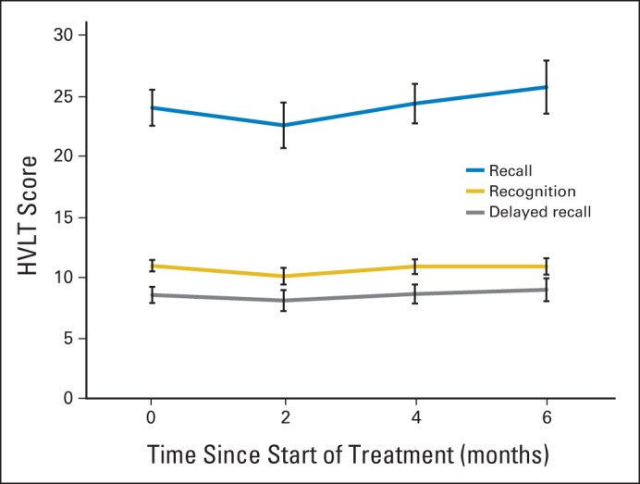
Examples of NCORP Outcomes
Gondi et al. Preservation of memory with conformal avoidance of the hippocampal neural stem-cell compartment during whole-brain radiotherapy for brain metastases (RTOG 0933): A phase II multi-institutional trial.
J Clin Oncol. 2014;32(34):3810-6.
Brown et al. Memantine for the prevention of cognitive dysfunction in patients receiving WBRT (RTOG 0614): A randomized, double-blind, placebo-controlled trial.
Neuro Oncol. 2013;15(10):1429-37.
Cumulative incidence of cognitive function sig. improved In Memantine arm.
Hopkins Verbal Learning Test (HVLT) scores sig. improved over historical controls for 50 pts alive at 6 mos.
HA-WBRT (IMRT) for pts with brain mets associated with sig. prevention of HVLT-R DR decline, compared with prespecified historical controls of WBRT without HA
FACT-BR emotional well being improved over time (P = .042). Other FACT-BR domains and ADL scores remained stable.
Only 4.5% experienced progression in the hippocampal avoidance area vs, historic 8.6%
Sig. neurocog. differences favoring memantine arm for:
COWA scores at 8 (P = .008) and 16 weeks (P = .0041)
TMT-A and MMSE at 24 weeks (P = .0137 and .0038, respectively),
Notes:
The significantly positive findings for both of these intervention were combined/informed the current generations of trials.

Slide 10
Potential Challenges
Lack of pipeline for symptom management agents
Reliable biomarkers to assess cardiotoxicity
PRO Compliance
  Resources for all PRO primary and secondary measures to be in NCI epro
  Specific PRO compliance report cards given to each site
  Funding for centralized PRO data collection for key protocols
Resources for correlative studies
  Radiation QA
  Symptom biomarkers
  Neurocognitive testing

Slide 11
PRO Compliance Working Group
Protocol changes
  Single consent form – which includes consenting to PRO end points
  Require PRO as part of registration (100% baseline)
  Allow administration by surrogate or phone
  Checklist for best practices
Identify poor performing sites
  Direct feedback
  NRG scorecard
  Emphasis in audit
RA/Investigator Education

Slide 12
NRG NCORP CPC/CCDR Pilot Grant Opportunities
Funding can be requested for up to $18,000
Two projects may be funded annually
No carry over funds will be issued
The PI and study team must report to the CPC or CCDR committee chairs by email or telephone at least quarterly.
An interim progress report is due within 6 months and a completed progress report is due at the end of the project period.
Institutions who allow total award to fund research (and waive in-directs) will be given priority.
PILOT projects applications MUST focus on NRG NCORP CPC and CCDR priorities
will provide data that will directly lead to future Phase II-III CPC or CCDR concepts.

Slide 13
NRG NCORP CPC Pilot Grant Opportunities
Date Issued: March 14, 2017 Submission Due Date: May 5, 2017
CPC priorities for funding are:
• Cancer prevention research aimed at identifying and evaluating interventions to reduce the risk and incidence of cancer
• Cancer control research aimed at reducing the incidence and co-morbidity of cancer and its treatment focused on the four symptomatic management themes: neurotoxicity, cardiotoxicity, lymphedema, and inflammation
• Survivorship and palliative care interventions aimed at reducing toxicity and symptom burden, and improving QOL
•Cancer disparity research, in collaboration with our Health Disparities Research (HDR) Program, focused on efforts to increase the participation of minorities and underserved populations in CPC studies
Integral to these priorities, are the establishment of biospecimen repositories for molecular studies.

Slide 14
NRG NCORP CCDR Pilot Grant Opportunities
CCDR priorities for funding are:
• Implementation of guideline-based care: Example: legacy RTOG demonstrated the cost and effectiveness of a single fx schedule for bone metastasis in RTOG 9714. This was included in ASTRO treatment guidelines. However, lack of wide spread adoption has led to selection of this guideline based care as an ASTRO “Choosing Wisely” issue . Further evaluation as to why these guidelines have not been widely implemented could be studied in community oncology practices.
• Patient-reported outcomes (PROs): Studies that seek to include the PRO-CTCAE in NCORP trials and improve compliance and data capture is a priority. Studies that seek to use technology or apps to standardized PROs across EHR, registry, and claims data systems are encouraged.
• Decision-making tools: Implementation of screening, treatment, or palliative care decision aids in community settings.
• Patient navigation: Recently, the Oncology Nursing Society (ONS) defined and validated a set of core competencies for an Oncology Nurse Navigator (ONN) including providing education and resources to facilitate informed decision making, coordination of care to ensure timely access to quality health and psychosocial care, and communication for cancer patients to help overcome healthcare system barriers. Within community oncology programs, it is important to evaluate ONN competencies, with emphasis on their impact on both clinical trial accrual and delivery of quality cancer care, especially in minority and underserved populations.
• Cardiotoxicity
• Survivorship and surveillance

Slide 15
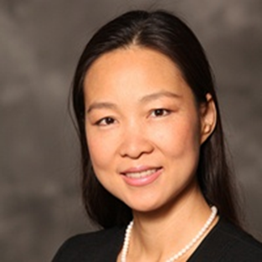

2017 CPC Pilot Grant Awardees Presenting Progress at this Mtg
Canhua Xiao, PhD, MSN; Emory
SNP’s Association with Fatigue and Physical Activity in Head and Neck Cancer Patients: A pilot study for Inflammatory Mechanisms as associated with HPV
Kathleen Sturgeon, PhD; Penn State
Exercise as Medicine: Improved Cancer Control and Management of Cardiotoxicity

Slide 16
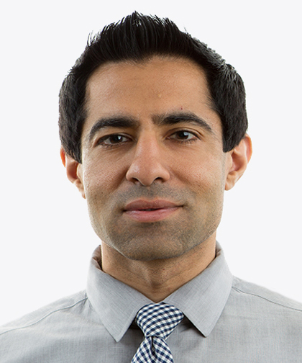
2018 CCDR Pilot Grant Awardee
Nitin Ohri, MD; Montefiore NY
Physical Activity Monitoring to Predict Hospitalization in Advanced Cancer
Patients

Slide 17
NCORP Seeking New Investigators
NRG NCORP seeking to put new investigator liaison on each NCORP Committee
Please apply!!

Slide 18
Additional NRG Opportunity
Collaboration with the International Atomic Energy Agency
Development of eLearning modules for:
  Clinical Trials 101
  Statistical design of clinical trials
  Contouring and Quality Assurance
  Case studies

Slide 19
Navigating NRG as a New Investigator
Alexandra Thomas MD, FACP
NRG Semiannual Meeting
July 12, 2018

Slide 20

Navigating NRG
General Advice
  Clinical trial development
  What is unique about NRG
Practical Tips
  What you can do this meeting

Slide 21






Clinical Trial Development
Very Brief Overview
Initial Concept
  Subcommittee
Review at Disease-Specific Committee
Review at NRG Committees
Finalize concept
Submit to CTEP
First Patient on study

Slide 22


NRG Oncology
Transparent organization
Culture committed to mentorship
If you look, there are a myriad of opportunities

Slide 23

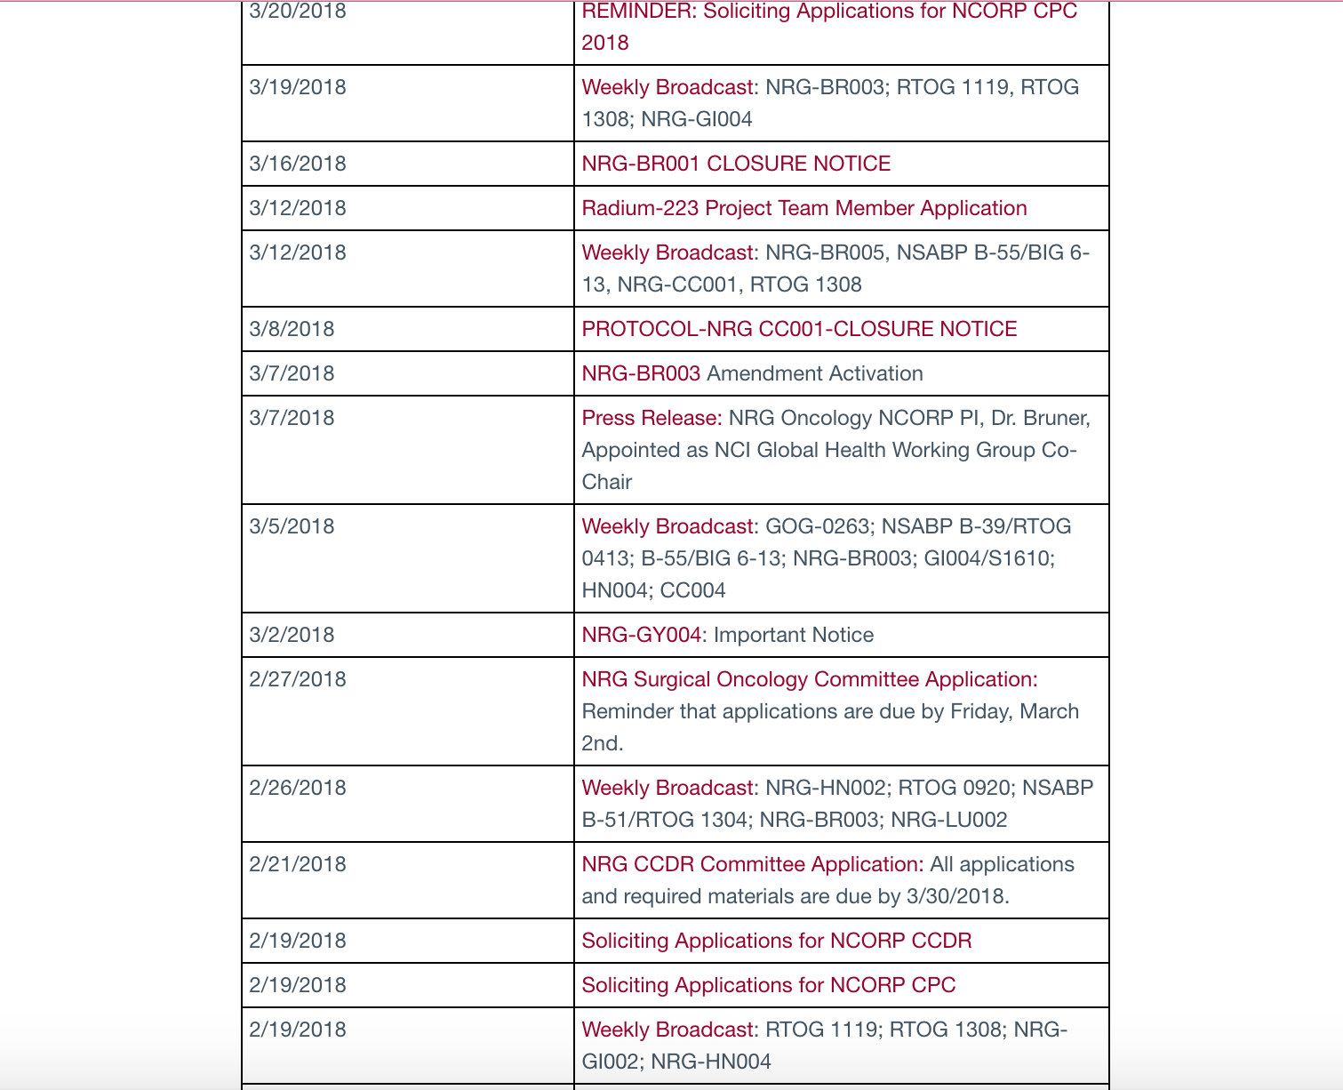
NRG Oncology

Slide 24

NRG Oncology
Meeting size, committee work…
  lend themselves to exposure to role models, thought leaders

Slide 25


X
X
NRG Oncology

Slide 26
NRG Oncology
YES

Slide 27
NRG Oncology
Process of NRG
Get engaged
Ask how you can help
  Committees
  Task forces
  Special projects
    Champions program
    Other opportunities

Slide 28
NRG Oncology
Process of NRG
Be willing to go outside your comfort zone
Learn to fill a need
Pay it forward

Slide 29

Practical Tips
NRG Philadelphia 2018
“Learn about the process of clinical trial development”
“Sit in the back if you are not on the roster and if a side issue comes up offer to help”
“Stick your face in it”

Slide 30


Slide 31


Questions
Alexandra Thomas
althomas@wakehealth.edu
319-530-2923

Slide 32
Clinical Trial Development:
NRG Processes and NCI Requirements
Nancy Soto
Director, Protocol Development
New Investigators - Clinical Trials 101 Education Session
July 12, 2018

Slide 33
Agenda
NRG review process
  Concept and protocol
Role of the Protocol Administrator
Role of the Study Chair
NCI review process

Slide 34
NRG Oncology: Concept Development
Study Chair proposes research idea to Disease Site Committee
Disease Site Committee discusses/approves the proposed study for submission to NRG Research Strategy Committee (RSC)
    If this is an NCORP study it is reviewed by the NRG NCORP concept review committee
  NRG RSC meets quarterly and does a call for new concepts
  Disease Site Chair sends concept and NRG review form to their respective Protocol Development Office for submission to the next RSC
  The NRG review form includes both RT and DI logistical questions

Slide 35
Concept Development - Continued
Protocol Administrator circulates these forms to appropriate committee liaisons for review/comment
  Example of Committees/Sub-committees: Medical Oncology/Pharmacy, Radiation Oncology/Medical Physics
Concept/Review form are finalized with Chair and then submitted to Nancy Soto for inclusion on the RSC Agenda
Disease Site Chair presents developing concept to RSC
RSC members vote on concepts for scientific merit, feasibility and approval.
Developing concepts approved by RSC is then sent to the NRG Concept Prioritization Advisory Committee (CPAC) for prioritization within the NRG Research portfolio.
Protocol Administrator assists Study Chair/Study team with LOI/concept submission to CTEP/DCP.

Slide 36
Concept Development - Continued
Role of the Protocol Administrator:
  Navigates the NCI pathway;
    Is it an LOI or a concept?
    Is there a task force or does it go straight to the Steering Committee?
    Are documents current?
  Coordinates pre-submission call with study Chairs and study team to finalize LOI/concept
  Determines dates for submission and works with the study chair/team to ensure documents are finalized
  Acts as liaison between NCI and NRG study team including leadership
  Submits LOI/concept

Slide 37
NRG Oncology: Protocol Development
Protocol development begins when the LOI/concept has been approved by CTEP/DCP or the Protocol Review Committee
Role of the Protocol Administrator:
  Inserts the text from the NCI-approved LOI or concept into the current NRG protocol template
  Circulates the study-specific protocol template to all Study Chairs, Disease Site Chair, Scientific Core Committees, and HQ departments
  The NRG protocol template includes tools to help Chairs develop certain sections;
    Radiation Therapy Section has an outline to follow.
    Study Assessments and Biospecimen Collections have tables formatted.

Slide 38
Protocol Development - Continued
Role of the Protocol Administrator:
  Edits the master protocol documents and coordinates submission and responses to CTEP/DCP/CIRB through Activation
    Includes coordinating conference calls
    Protocol review walk-throughs
    Works through any protocol logistics prior to activation
    Creates study materials such as flyers or FAQs
    Hosts Study Kick-off, if applicable
  Manages the NCI required timelines

Slide 39
Study Chair Responsibilities
Role of the Study Chair:
  Developing Concept
  Writing Protocol
  Working with the study team to meet the deadlines
  Monitoring the study during its execution
  Reviewing cases for his/her modality
  Responding to headquarters questions
  Analyzing and reporting results

Slide 40
NCI Requirements: Operational Efficiency Working Guidelines (OEWG)
NCI Required timelines for clinical trial development aka the Operational Efficiency Working Guidelines (OEWG):
Phase I/II/IIR: Time from LOI/concept review to protocol activation
  Target: 210 days
  ‘Absolute’ date: 450 days or 15 months
Phase II/III or III: Time from concept review to protocol activation
  Target: 300 days
  ‘Absolute’ date: 540 days or 18 months
*all times in calendar days

Slide 41
NCI Requirements: OEWG
Milestones are tracked; however, the target and absolute deadlines would be the official metrics tracked
The following requirements must be met for Activation:
  date of first site IRB approval or Central IRB’s approval;
  drug is available;
  CRFs are ready;
  IND status obtained.
  All vendor contracts are executed
If the protocol is not activated by the “absolute” date the study will be automatically terminated.
  Extensions can be granted but these are reviewed on a case-by- case basis

Slide 42
NCI Requirements:
Concepts
  Reviewed by Task Force, if applicable
    Comments are advisory
    Outcomes; Favorable or Unfavorable
  Reviewed by Disease-Specific Steering Committee
    3 possible outcomes: Approve, Pending, Disapprove
    Coordinates Calls for discussion of comments
    Comments are addressed as part of written response
LOIs/Protocols
  Reviewed by NCI Protocol Review Committee
    Coordinates Calls for discussion of comments
    Comments are addressed as part of written response

Slide 43
Protocol Development Department
Disease Site | Protocol Administrator
Brain, GI-Non Colorectal, GU, H&N, Lung, NCORP | Fran Bradley, Beth Goldner, Thien Nu Do, Kathryn Okrent, Nancy Soto
Breast, GI-Colorectal & NCORP | Francy Fonzi, Hope Alcorn
GYN: Cervix, Uterine Corpus, Ovary, Developmental Therapeutics, Rare Tumor, NCORP | Kia Neff, Meg Colahan, Nicole Copeland, Sam DiBernardo
NCORP includes Cancer Prevention & Control (CPC) and Cancer Care Delivery Research (CCDR); these trials are done within the respective disease site.

Slide 44
Department of Regulatory Affairs
Teresa Bradley, PhD
Co-Director, Department of Regulatory Affairs (Pittsburgh)
New Investigators - Clinical Trials 101 Education Session
July 12, 2018

Slide 45
Purpose of Presentation
Provide some key points on common Regulatory issues and considerations for New Investigators

Slide 46
Department of Regulatory Affairs
Disease Site | Staff
Brain, GI-Non Colorectal, GU, H&N, Lung, NCORP Philadelphia West | Nancy Soto (Co-director) Erica Field (Manager)
Breast, GI-Colorectal & NCORP Pittsburgh | Teresa (Terry) Bradley (Co-director) Judy Langer, Ethan Barry, Ashley Rhoads, Kerry Murphy, Sara Snyder
GYN: Cervix, Uterine Corpus, Ovary, Developmental Therapeutics, Rare Tumor, NCORP Philadelphia East | Philadelphia East Katie Campbell (Co-director) Kate Wiser (Manager)

Slide 47
DRA: Focus on compliance with Health Authorities and Regulatory Agencies:
FDA; International Conference on Harmonisation (IHC)/Good Clinical Practice(GCP); Health Canada; EU; Germany; and OHRP (Office of Human Research Protections; HSP; “Common Rule”)

Slide 48
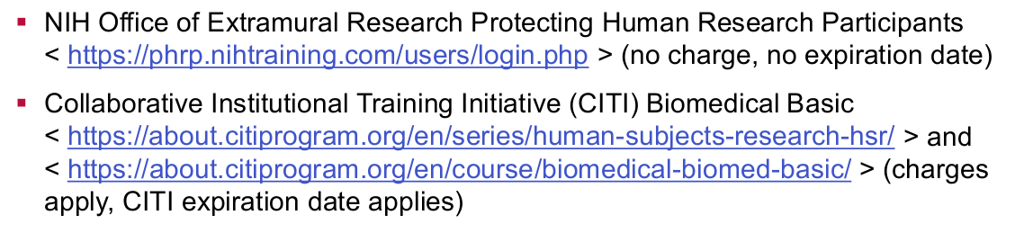
1.
Current Human Subjects Protection and Good Clinical Practice training is required.
Acceptable HSP training options include (but are not limited to)
https://www.nrgoncology.org/Resources/NCI-CTEP-RCR

Slide 49
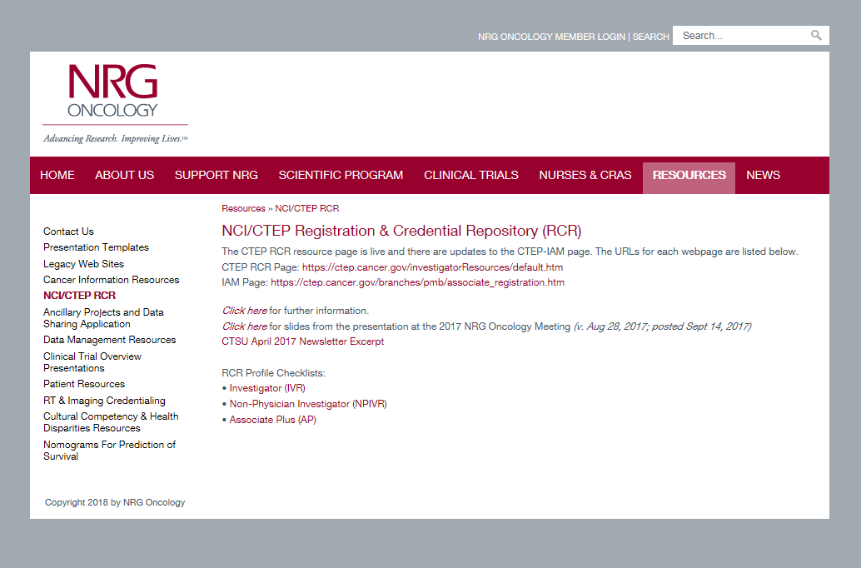

Slide 50
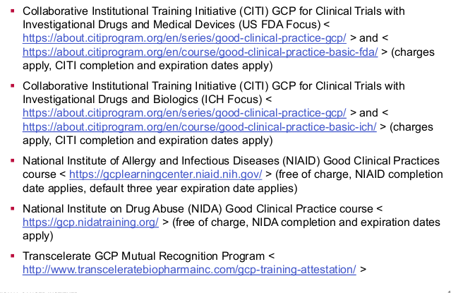
1b. Common GCP training options include
https://www.nrgoncology.org/Resources/NCI-CTEP-RCR (slides from 2017 meeting)

Slide 51
2*.
Required to have a current CTEP Registration via NCI PMB in order to be listed as Study Chair, Co-Chair, Study Pathologist (includes IVR, NPIVRs, AP)
Registration is accomplished via the NCI Registration and Credential Repository (RCR)
    C of I
https://www.nrgoncology.org/Resources/NCI-CTEP-RCR (slides from 2017 meeting)

Slide 52
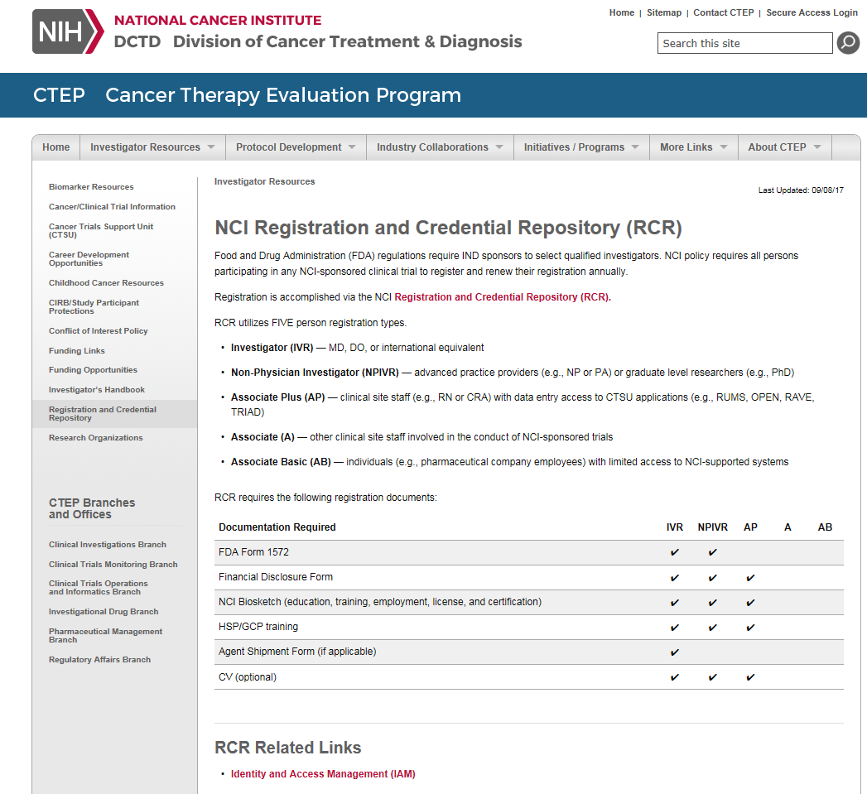

Slide 53
3.
Whether there is intent to include investigators in Canada
Whether there is intent to include investigators from other groups outside the US and Canada (e.g., German Breast Group; Australia)

Slide 54
4*.
Regulatory contacts within Companies –
  sooner rather than later, particularly re: IND or CTA
  Budget discussions are with Operations/Finance offices
  A commitment from the company should be given before concept presented to NRG Oncology

Slide 55
5.*
Correlative science
  If a defined assay is to be done, it must be funded to be included in the protocol.
  If there is an integral marker, information about the assay lab(s); whether assay is FDA-cleared (approved) or not (to assess any need for an IDE)

Slide 56
6.
Safety Assessments prior to and during the trial
  Investigators (Protocol Chairs; Protocol Officer) responsible for timely review
  SUSARS/CIOMS from NCI or Company: from NCI processed centrally (centers)
  Investigator Brochures

Slide 57
7.
Responses to NCI/PIO
  center office responds back to most queries/correspondences individually
  Of note: For availability for reviews (CTEP coordinated calls) investigators do need to respond.

Slide 58
8.*
NCI CIRB submissions are centrally submitted
    Protocol Chairs/Officers may need to answer questions for the applications and be available at time of CIRB review

Slide 59
9.
Informed consent form
  Clarity
  Required elements
  Adherence to NCI template/sample

Slide 60
Contact Information
Co-Directors
Phil.East: campbellk@NRGoncology.org
Phil.West: soton@NRGoncology.org
Pgh.: bradleyt@NRGoncology.org
Managers
Phil.East: wiserk@NRGoncology.org
Phil.West: fielde@NRGoncology.org
Pgh: langerj@NRGoncology.org
barrye@NRGoncology.org

Slide 61
NRG Oncology Biospecimen Access
Integral and Integrated and Exploratory, Oh my!
Heather A Lankes, PhD, MPH
Director, Translational Research Operations
Biospecimen Bank-Columbus
NRG Oncology Semi-Annual Meeting
July 12, 2018

Slide 62

NRG Oncology Biospecimen Banks
over 1.3 million biospecimens from almost 200,000 cases
Gynecologic
Brain, H&N, Non-Colorectal GI, GU, Lung
Pittsburgh, PA
Columbus, OH
San Francisco, CA
Breast and Colorectal GI
Houston, TX
Breast and Colorectal GI
Serum Bank

Slide 63
Biospecimen Types Collected
FFPE Tissue | Frozen Tissue | Blood Biospecimens | Other
Blocks Unstained Slides Stained Slides Scrolls Cores Punches | Snap Frozen OCT CSF & Bone Marrow | Whole blood Peripheral Blood Mononuclear Cells (PBMC) Plasma Serum Buffy Coat | Buccal Saliva Urine Stool Cervical Cells Peritoneal Fluid Peritoneal Wash

Slide 64
NCTN Biomarker Testing
An integral biomarker is one that is inherent to the design of the trial and must be measured in real-time for the trial to proceed.
An integral assay that will be used to determine eligibility or treatment may need to be performed under an Investigational Device Exemption (IDE) from the FDA.
Approved by the Biomarker Review Committee (BRC) as part of the clinical trial protocol.
Integrated biomarkers are defined as tests that are designed to test a hypothesis, not to generate hypotheses.
The integrated biomarker assay already should have been tested in human subjects and demonstrated reproducible analytic qualities.
Approved by the Biomarker Review Committee (BRC) as part of the clinical trial protocol.
All other biomarkers are considered exploratory biomarkers.

Slide 65
NCTN Biomarker Testing
All other biomarkers are considered exploratory biomarkers.
At present, depending on the nature of the clinical trial:
    Approved by the NCTN Core Correlative Science Committee (NCTN-CCSC)
    or
    Approved by NRG Oncology

Slide 66
NCTN-CCSC
The NCTN-CCSC does not:
Review or address use of clinical trial samples assigned for integral and integrated biomarkers that have undergone prior NCI review.
Review requests for use of clinical trial samples for trials that are still under DSMB oversight and/or have not yet reported out their primary endpoints.
Review requests for specimens from select trials that have their own special Steering Committee for reviewing specimen requests, particularly international trials led by non-US groups.
Review proposed uses of samples coming from:
  Group biobanking protocols involving specimen collection not associated with a clinical trial or not collecting patient outcome data. Such requests are reviewed by other NCI committees.
  Sample requests related to internal NCI collaborative processes, such as the Clinical Trial Sequencing Project or NCI Blue Ribbon Panel. Such requests are reviewed by other NCI committees.
Provide provisional letters of support in response to grant letter requests.

Slide 67
Proposals Likely to be Approved by the NCTN-CCSC
Clinically-annotated biospecimens collected on NCTN clinical trails are non-renewable resources.
Given the value of these non-renewable resources, only strong proposals asking questions that require depth of annotated clinical information can be approved.
    In many cases, biospecimens could be used to evaluate predictive biomarker hypotheses based on the trial treatments and outcomes.
Successful NCTN-CCSC proposals will generally utilize the unique clinical data and trial design to test a question with potential clinical implications.
Biospecimens requested for proposals that are subject to NCTN-CCSC review will generally not be appropriate to use for more exploratory studies.

Slide 68
Resources for More Exploratory Proposals
Information about several alternative specimen collections that are not part of the Navigator inventory can be found via the NCI Cancer Diagnosis Program website: https://cdp.cancer.gov/resources/human_specimen/finding_human_tissue.htm
One of the resources on that page is the Specimen Resource Locator, which provides information about a number of resources that may be appropriate for more exploratory proposals: https://www.specimens.cancer.gov/
The Cooperative Human Tissue Network (CHTN) has been providing biospecimens to the research community for more than 20 years and will continue to provide quality biospecimens to IRB-approved researchers for many more: https://www.chtn.org/

Slide 69
How do I submit my proposal for exploratory biomarker testing to the NCTN-CCSC?
Online through NCTN Navigator
“Manually” through NRG Oncology Biospecimen Access

Slide 70


Inventory Resource for Investigators to Identify and Request NCTN Clinical Trials Biospecimens of Interest
https://navigator.ctsu.org/
Trials/Biospecimens Available in Navigator
NTCN Adult Treatment Trials, Legacy Cooperative Groups, Phase III or Large Biospecimen Collection Protocols with Clinical Data, Completed Trials with Primary Outcome Reported; Specimens from Newly Completed Trials will be added after primary publication on a rolling basis*
Request Process
  Explore the Site (Review Specimens and Trials)
  Consider / Develop Scientific Question
  Obtain CTEP-IAM Account (if needed)
  Submit an LOI (Letter of Intent)
  Await notification (Feasible/Not Feasible)
  If feasible, submit a Proposal Submission Form
  If approved, submit proof of funding, IRB approval, executed data/material use agreement(s), and partial payment(s) prior to specimen/data release
  Use specimens/data as outlined in approved proposal, and agreed to in data/material use agreement(s)
  Publish results and comply with data sharing requirements
NRG Navigator Concierges
Brain, H&N, Non-Colorectal GI, GU, Lung: Sheralee Miller (millers@nrgoncology.org)
Breast, Colorectal GI: Teresa Bradley (bradleyt@nrgoncology.org)
GYN: Heather Lankes (lankesh@nrgoncology.org)
*Requests for trials/biospecimens not in Navigator will follow the Biospecimen Access process outlined on the NRG webpage (https://www.nrgoncology.org/Scientific-Program/Biospecimen-Access).

Slide 71
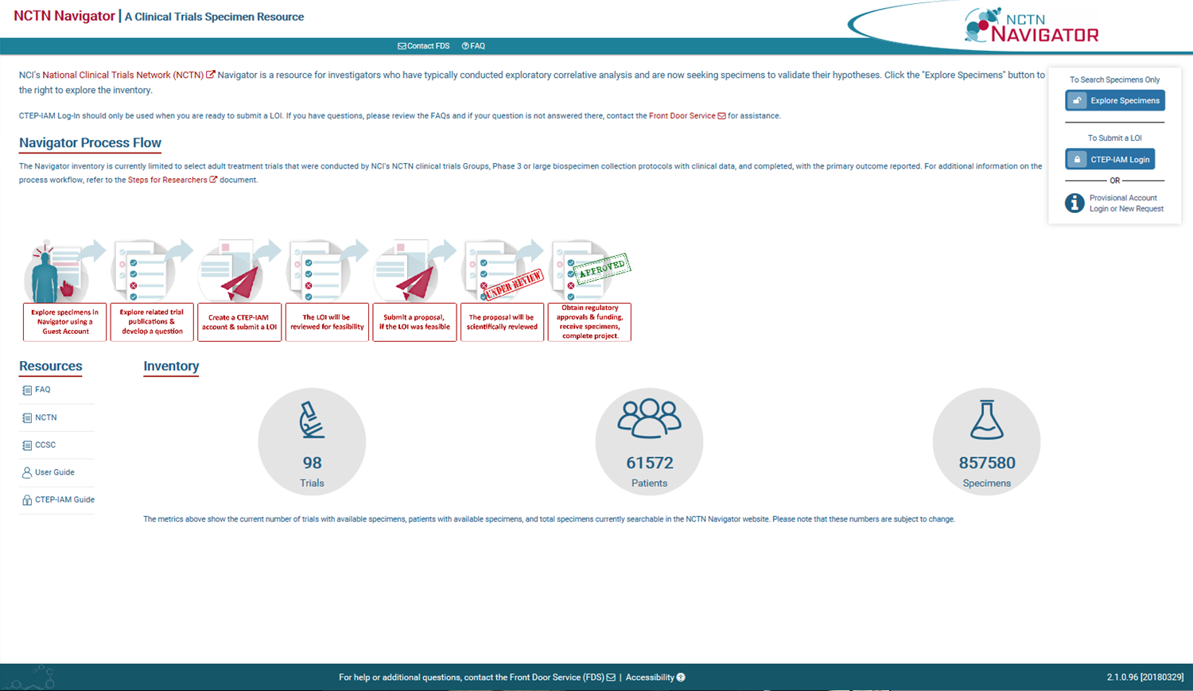

Slide 72
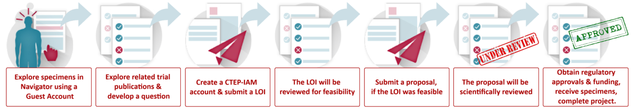
Navigator Process

Slide 73
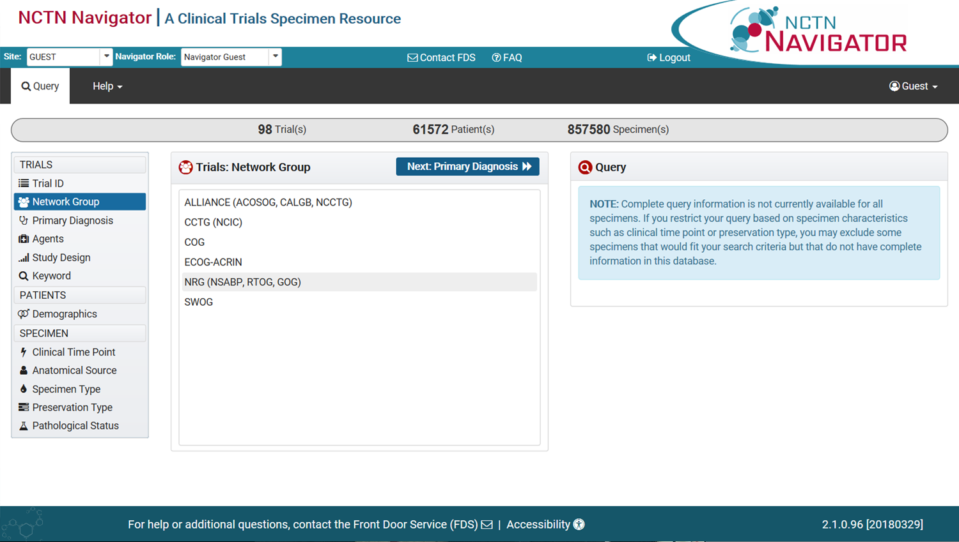

Slide 74
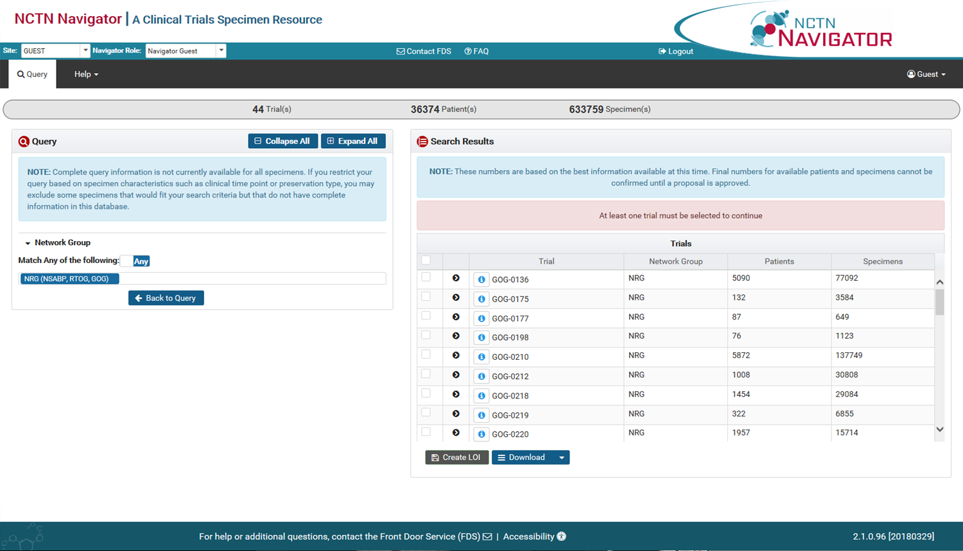

Slide 75
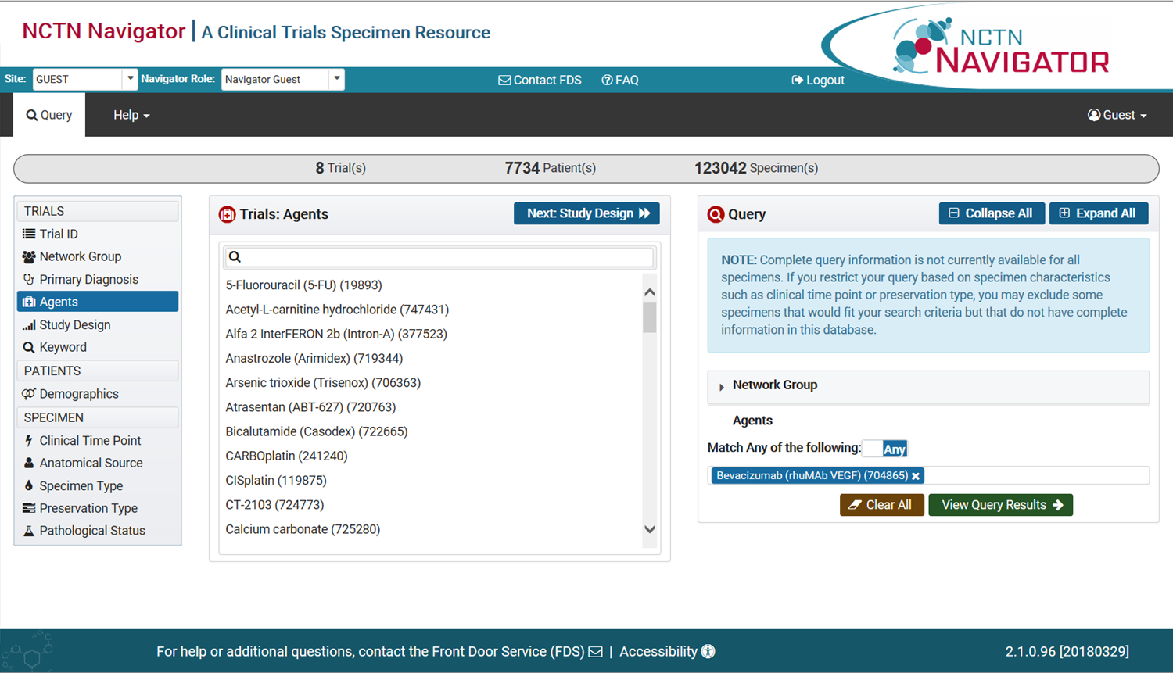

Slide 76
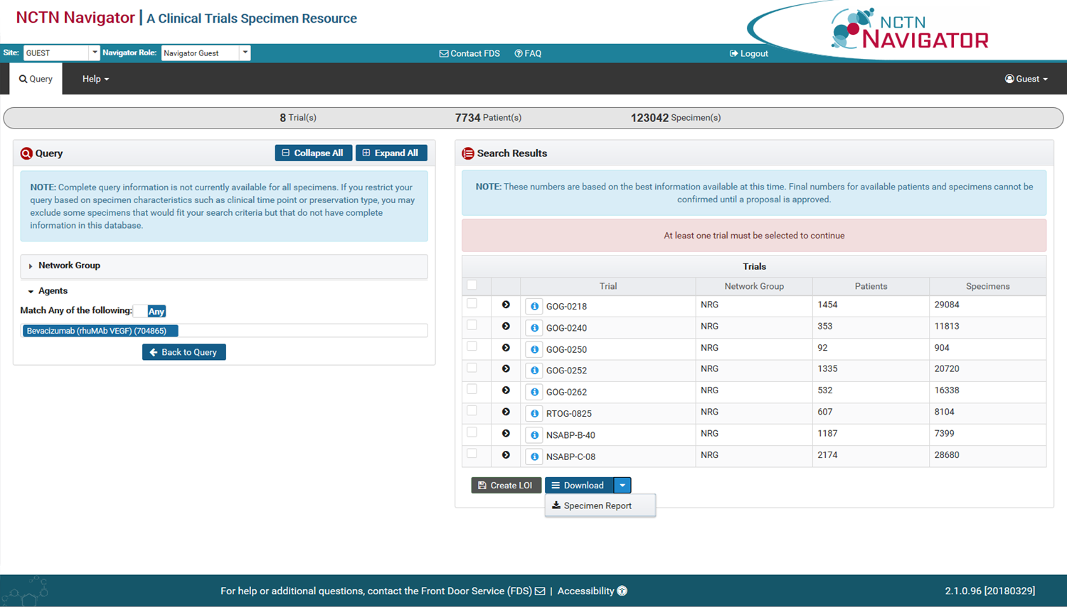

Slide 77
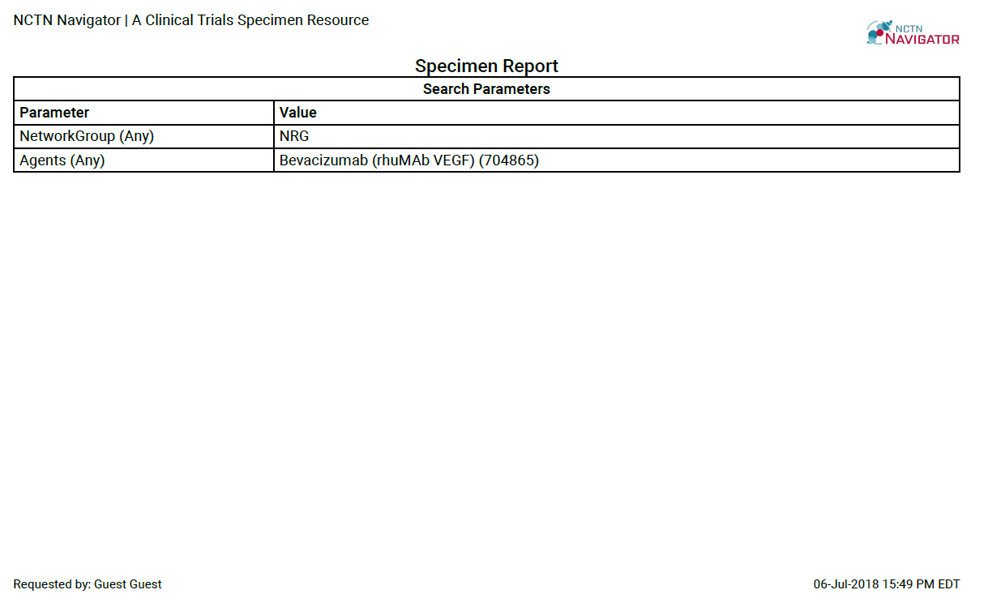

Slide 78
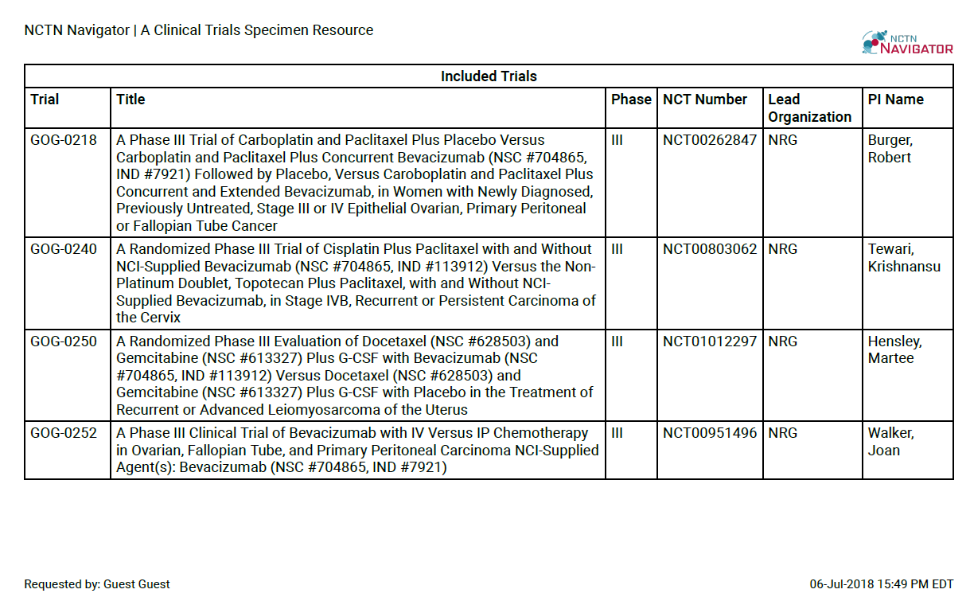

Slide 79
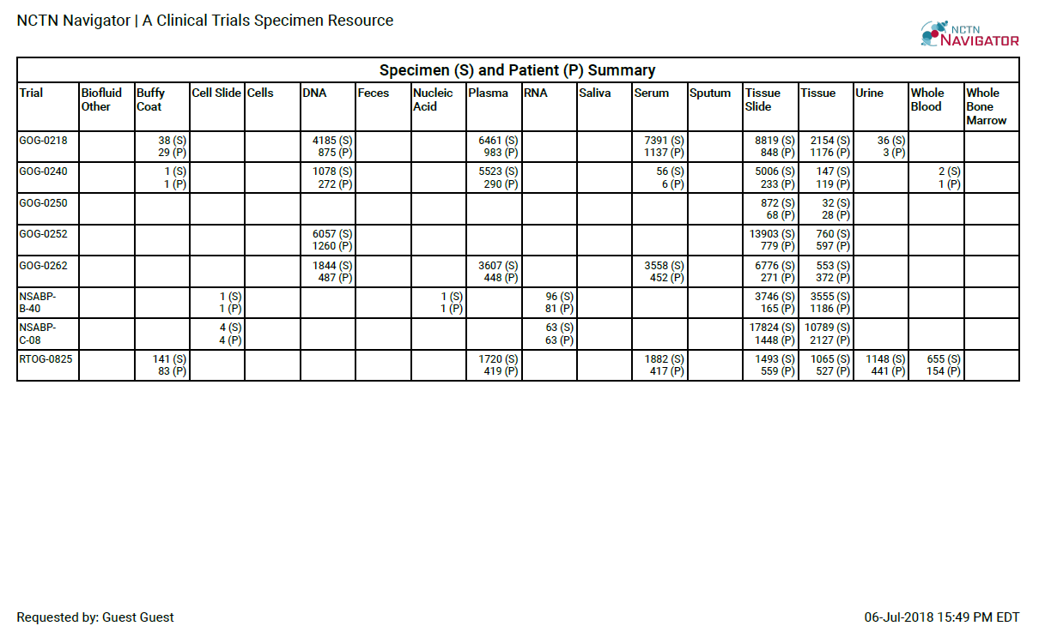

Slide 81
Letter of Intent (LOI)
Project title
Project hypothesis
Are you interested in potentially collaborating with the NCTN Group(s)?
Biospecimen request details
Clinical data request details
Planned assays (list)
Comments

Slide 82
Navigator Process

Slide 83
Proposal
Objectives and hypothesis
Background and significance
Research design and methods
Statistical consideration (biostatistician collaboration)
Requited attachments (letters of collaboration from all co-investigators)

Slide 84
Navigator Process
NCTN-CCSC
IRB
MUA
Funding

Slide 85
How do I submit my proposal for exploratory biomarker testing to the NCTN-CCSC?
Online through NCTN Navigator
“Manually” through NRG Oncology Biospecimen Access

Slide 86

Biospecimen Access

Slide 87
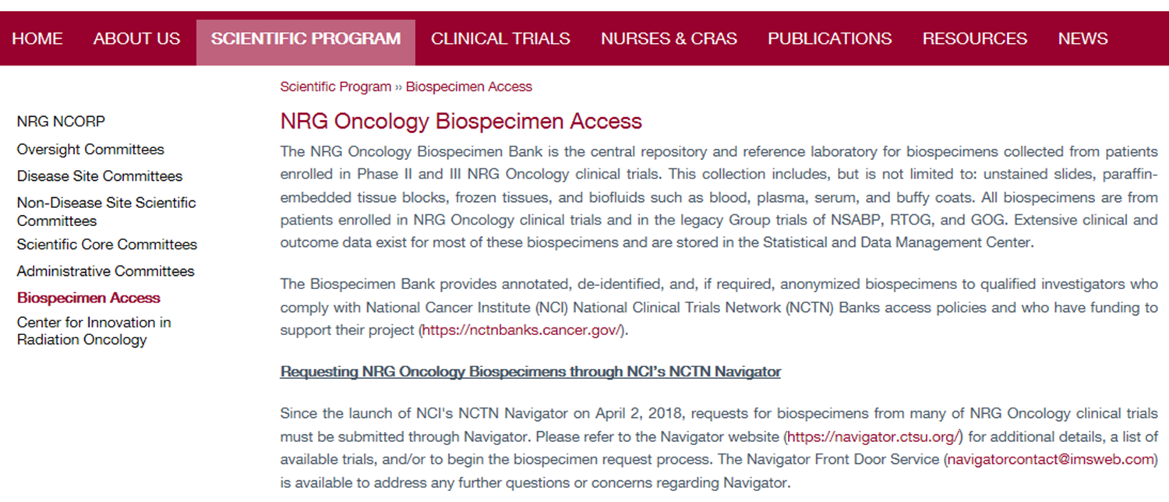
Biospecimen Access

Slide 88
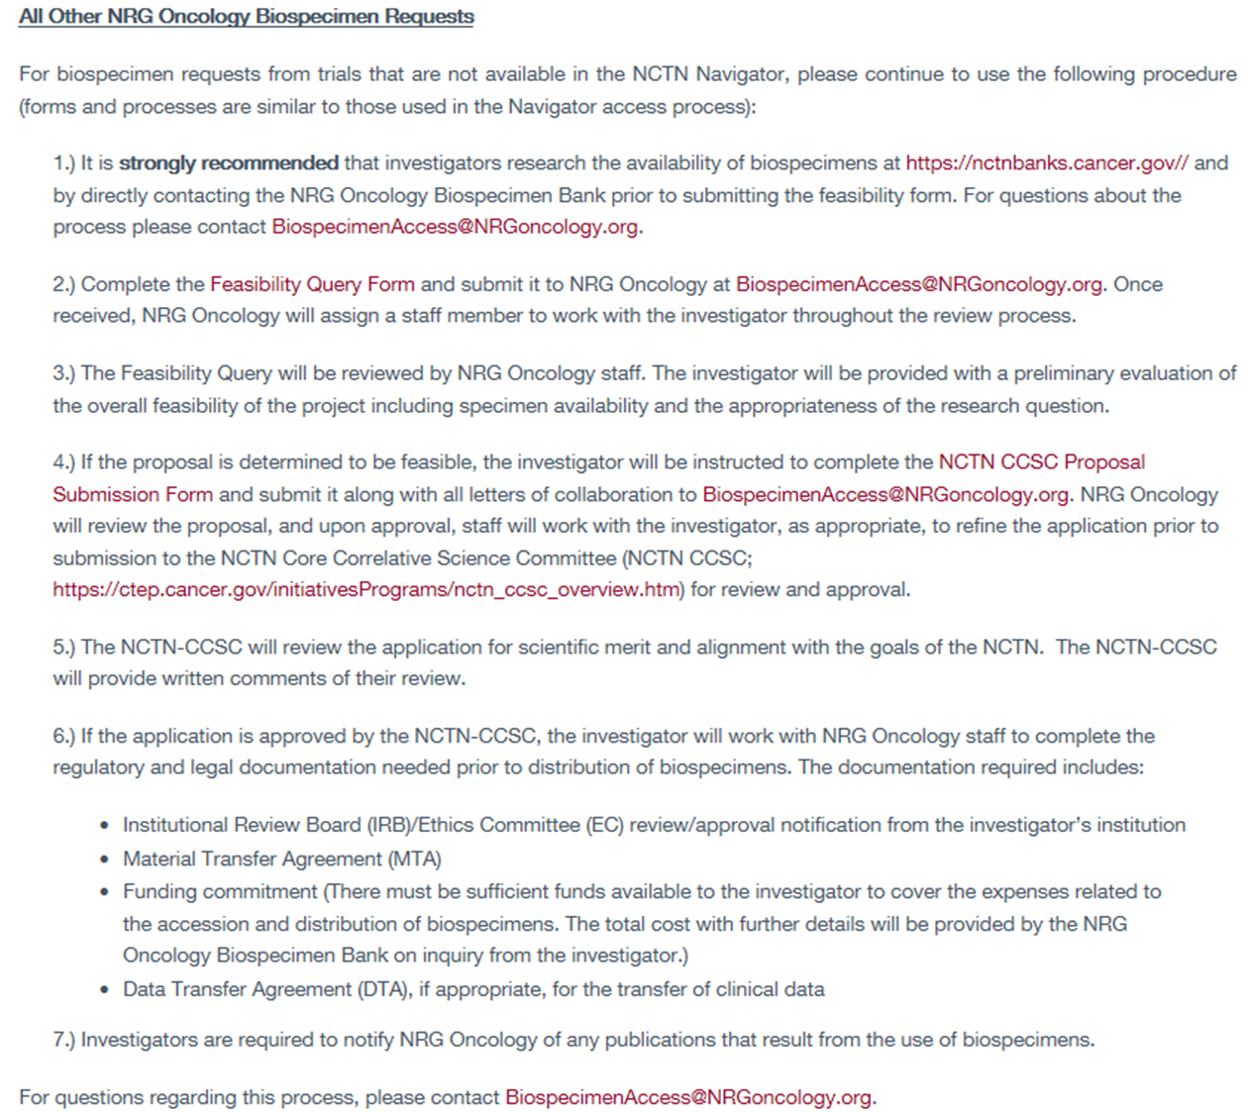

Slide 89
NCTN Biomarker Testing
All other biomarkers are considered exploratory biomarkers.
At present, depending on the nature of the clinical trial:
    Approved by the NCTN Core Correlative Science Committee (NCTN-CCSC) after trial closure, release from data monitoring (if applicable), completion of integral and/or integrated biomarkers, and publication.
    or
    Approved by NRG Oncology.

Slide 90
Translational Science Committees
Breast
Vice Chair-TS: Matthew Ellis, BSc, MB, Bchir, PhD
Workshop: Fri, 7/13, 2-3:30pm
Brain
Vice Chair-TS: Arnab Chakravarti, MD
Workshop: Fri, 7/13, 8-10:30am
GI
Vice Chair-TS
Colorectal: Tatjana Kolevska, MD
Non-colorectal: Chandan Guha, PhD, MBBS
Workshop: Sat, 7/14, 7-9am
GYN
Vice Chair-TS: Heather Lankes, PhD, MPH
Workshop: Fri, 7/13, 10:30-12pm
Translational Science
Chair: Michael Birrer, MD, PhD
Vice Chair: Adam Dicker, MD, PhD
Vice Chair: Matthew Ellis, BSc, MB, BChir, PhD
Workshop: Thurs, 7/12, 6:30-8pm
GU
Vice Chair-TS: Alan Pollack, MD, PhD
Workshop: Fri, 7/13, 2-4pm
Head & Neck
Vice Chair-TS: Nail Hayes, MD, MPH
Workshop: Fri, 7/13, 2-3pm
Lung
Vice Chair-TS: Bo Lu, MD, PhD
Workshop: Fri, 7/13, 4-6pm

Slide 91
Resources
NRG Oncology Biospecimen Access
https://www.nrgoncology.org/Scientific-Program/Biospecimen-Access
NCTN Navigator
https://navigator.ctsu.org/navigator
NCTN Navigator Front Door Service (FDS)
navigatorcontact@imsweb.com
NRG Navigator Concierges
Brain, H&N, Non-Colorectal GI, GU, Lung: Sheralee Miller (millers@nrgoncology.org)
Breast, Colorectal GI: Teresa Bradley (bradleyt@nrgoncology.org)
GYN: Heather Lankes (lankesh@nrgoncology.org)
NCTN CCSC
https://ctep.cancer.gov/initiativesPrograms/nctn_ccsc_overview.htm
NCTN Banks
https://nctnbanks.cancer.gov/

Slide 92
NRG Oncology Biospecimen Access
Integral and Integrated and Exploratory, Oh my!
Questions

Slide 93
The Role of the Statistician in Protocol
Development and Study Design
Greg Yothers, PhD
Head of Statistics Core, NRG Oncology SDMC
Assoc Professor of Biostatistics, Univ of Pittsburgh
Clinical Trials 101 – New Investigator Educational Session
NRG Semiannual Meeting
Thursday 12Jul2018

Slide 94
Outline
Introduction to the NRG Oncology Statistics and Data Management Center (SDMC)
Phases of clinical studies (research)
Basic statistics for clinical research
Statisticians in clinical trial development in NRG
Some additional thoughts

Slide 95
NRG Oncology Statistics and Data Management Center (SDMC) Organizational Structure
aka “the stat office”
Four Divisions

Slide 96
NRG SDMC – Biostatistics Division
Three offices:
  Pittsburgh
  Philadelphia
  Buffalo
Senior statisticians aligned with NRG Disease Site Committees and subcommittees, e.g., GYN, Ovary, Lung, Brain, etc.
Each NRG Disease Site Committee has at least one SDMC statistician as a dedicated fully participating (voting) member
  NRG SDMC Biostats is truly collaborative division;
  not simply consulting

Slide 97
What types of projects do we (Biostatistics Division) work on?
Clinical trials: phase I, II, III
Translational research projects (embedded in clinical trials, and based on banked tissue, e.g., 0136 and 0210)
Quality of life studies (embedded in phase III trials, and standalone)
Ancillary data studies (questions not asked in a protocol)
Own methodologic research (in our spare time)

Slide 98
Outline
Introduction to the NRG Oncology Statistics and Data Management Center (SDMC)
Phases of clinical studies (research)
Basic statistics for clinical research
Statisticians in clinical trial development in NRG
Some additional thoughts

Slide 99
Phases of Cancer Research
Preclinical
  Nonhuman studies (laboratory and animal)
  Efficacy, toxicity and pharmacokinetic information
  Objective is to determine the feasibility of the investigational agent for possible human testing
3

Slide 100
Phases of Cancer Research
Phase 0
  Sub-therapeutic dose
  10-15 patients
  All patients get investigational agent
  Objective is to determine the consistency of pharmacokinetics and pharmacodynamics in humans compared to laboratory and animal models
3

Slide 101
Phases of Cancer Research
Phase I
  Dose finding study
  20-100 patients
  Patients receive escalating doses of the investigational agent
  Trial usually ends with dose limiting toxicity
  Objective is to find a modality for delivery and a tolerable dose
4

Slide 102
Phases of Cancer Research
Phase II
  Proof of principle
  Usually 40-400 patients
  Compare patients treated with investigational agent to historical control (single arm) or to patients concurrently randomized (multi-arm, preferred)
  May be open label or single or double blind
  Objective is to determine safety of the chosen dose and show activity of the investigational agent in a defined disease population
5

Slide 103
Phases of Cancer Research
Phase III
  Definitive proof of efficacy
  May involve several hundred to several thousand patients
  Always a randomized trial
  May be open label or single or double blind
  Objective is to conclusively demonstrate safety and effectiveness of the investigational agent and usually obtain regulatory approval
6

Slide 104
Phases of Cancer Research
Phase IV
  Post-Marketing surveillance
  Look for rare or slow developing adverse events
  Look for subgroups of the population who may not benefit
  Refine the risk/benefit profile for the agent
7

Slide 105
Outline
Introduction to the NRG Oncology Statistics and Data Management Center (SDMC)
Phases of clinical studies (research)
Basic statistics for clinical research
Statisticians in clinical trial development in NRG
Some additional thoughts

Slide 106
Basic Statistics
Alpha, type I error, size of the statistical test, these are all synonymous for the probability of a false finding of efficacy when the agent under study is not active
Beta and type II error are synonymous for the probability of falsely finding an agent inactive when the agent truly has a specified level of activity
Power is the probability of a true finding of efficacy when the agent under study has a specified level of activity
Power = 1 – Beta
9

Slide 107
Basic Statistics
Sample size calculations
  Require some consensus on what level of activity is clinically meaningful and worth discovering – power is always associated with a specific level of activity
  Level of activity may be difference in rates (for Response or Disease Stabilization) or hazard ratio (for PFS or TTP)
  Depends on the type I & II error rates (alpha & beta)
  Depends on the rate of events (or proportion) for the control group
10

Slide 108
Outline
Introduction to the NRG Oncology Statistics and Data Management Center (SDMC)
Phases of clinical studies (research)
Basic statistics for clinical research
Statisticians in clinical trial development in NRG
Some additional thoughts

Slide 109
Statisticians in
NRG Clinical Development
Statisticians are voting members on each disease site committee/subcommittee
  Participate in the discussion of the overall research agenda
  Provide guidance on trial portfolio development
  Historical knowledge of past studies in relevant disease sites and patient populations
  Help address important feasibility questions before new trial ideas progress to full concepts
    Past accrual rates
    Past study designs

Slide 110
Statisticians in
NRG Clinical Trial Development
Concept to NRG disease site committee
  Focus at this stage is often on the concept/idea,
  not so much the stats or sample size
  If there is a statistical section, it should come from or have the blessing of the NRG SDMC statistician
Concept to NRG Research Strategy Committee (RSC)
  Same concept as at disease site committee

Slide 111
Statisticians in
NRG Clinical Trial Development (cont’d)
Concept to NCI, Task Force and/or Steering Committee
  Statistical section from NRG SDMC statistician
  Focus at this stage is on everything, including:
    Concept/idea
    Design/statistical design
    Sample size
  Collaboration between study team: study chair/PI, statistician, disease site chair, industry partners, NCI and peer reviewers
  Lots of back and forth between TF, SC, study team
    Critiques
    Reponses to critiques
    Changes…

Slide 112
Statisticians in
NRG Clinical Trial Development (cont’d)
Protocol to CTEP
  Statistical section from NRG SDMC statistician
  Collaboration between study team: study chair/PI, statistician, disease site chair, industry partners, translational chair, QOL chair
    Study team now incorporates others:
      Data management (in SDMC), e.g., schedules, forms, database
      Operations office, e.g., admin, regulatory
Other review bodies
  In some cases, FDA review occurs

Slide 113
Designing a Study – Decisions to be made in collaboration with study team
Phase?
Single-arm vs. randomized. Why?
  Solid historical control data?
Design: superiority, non-inferiority, equivalence, factorial?
Expected accrual rate? Data? external? ours?
Expected effect size? Data?
Expected PFS, OS, etc. for control arm in this patient population? Data? external? ours?
Statistical error rates (types I & II) and sample size?
Biomarkers? Subgroups? Enrichment?
Stratification (if randomized)?
Interim analysis?

Slide 114
Some of what might do in between our discussions
Review of past NRG (NSABP, RTOG, GOG) data
Review of clinical literature
Review of statistical/trial literature
Calculations
Simulations
Internal (SDMC) discussion, presentation, official review

Slide 115
Outline
Introduction to the NRG Oncology Statistics and Data Management Center (SDMC)
Phases of clinical studies (research)
Basic statistics for clinical research
Statisticians in clinical trial development in NRG
Some additional thoughts

Slide 116


An ounce of prevention is worth a pound of cure

Slide 117


An ounce of consultation/collaboration is worth a pound of quality data
Consultation/Collaboration
Biostat
Physician
Study results

Slide 118

Bias for “Positive” Results in Clinical Trials
Tom Fleming (Accelerating Anticancer Agent Development and Validation Workshop, 2011)

Slide 119
Some Resources for Learning More
Statistics Notes in the British Medical Journal
www-users.york.ac.uk/~mb55/pubs/pbstnote.htm
Chernick MR (2011) The Essentials of Biostatistics for Physicians, Nurses, and Clinicians. Wiley.
Swinscow, Campbell (2002) Statistics at Square One. BMJ Books
Campbell (2006) Statistics at Square Two: Understanding Modern Statistical Applications in Medicine. BMJ Books
Greenhalgh (2014). How to Read a Paper: The Basics of Evidence-Based Medicine. BMJ Books.
Gigerenzer, et al (2008). Helping Doctors and Patients Make Sense of Health Statistics. Psychological Science in the Public Interest 8:53-96.
Statistical articles in JCO, CCR
Nuzzo (2015). Fooling Ourselves. Nature 526:182-185

Slide 120









