Slide 1
NRG Oncology General Session
July 2018
#NRG18 @NRGONC
Wally Curran, MD
Presiding Group Chair

Slide 2
General Session Agenda
Overview W Curran
Exec Director K Stoermer
Scientific Update M Machtay
Membership L Wickerham
Publications
NRG NCORP D Bruner
Stat Data Management J Costantino
Tissue Banking R Jordan
Wrap-Up W Curran

Slide 3
NCTN 6 Year Competitive Renewal
  Submitted 1/18
  Committee Review 6/18
  New Grant to Start in 3/19
New Leadership Structure
  Reduction of Deputy Group Chairs 6 to 3
  New Committee Chairs
  Leadership Transitions between 6/18 and 2/19
Notes:
Refer to Ned Sharpless’s recent comments - highlighted the most important one here

Slide 4
NRG Oncology Group Mission
  To Improve the Duration & Quality of Lives of Adults with Specific Cancers through the Conduct of Its Science-Driven, NCI-Supported Multi-Institutional Clinical Trials

Slide 5
NRG’s Specific Patient Cohorts
  Patients with common or rare gender-specific malignancies, including gynecologic, prostate, or breast cancers, and/or
  Patients with localized or locally advanced malignancies including other GU malignancies or those originating in other sites, including the lungs, head and neck region, brain, or GI tract

Slide 6
NRG Oncology Grant - Specific Aim 1
Investigate developments in medical technology, including radiation oncology, imaging, & surgery for opportunities to test these advances in its multi-institutional clinical trials.

Slide 7
NRG Oncology Grant - Specific Aim 2
Inform the design and execution of its phase II and phase III trials with employment of biomarker- & biologic pathway-defined approaches to risk stratification, investigational therapy assignment, & clinical trial decision-making.

Slide 8
NRG Oncology Grant - Specific Aim 3
Apply emerging knowledge in precision oncology and in immuno-oncology to the design & execution of its translational and clinical research efforts for the two defined patient cohorts.

Slide 9
NRG Achievements 2014-2017
Publications
302 peer-reviewed manuscripts
365 published abstracts
At least 51 led to practice-defining standards
Notes:
Considered adding examples, but I think we probably have examples being presented at the general session anyway? So we just reference those presentations.

Slide 10

Congratulations!
  Congratulations NRG!!!!
Notes:
Grant Scores (we can add more here if Summary Statement comes in)

Slide 11
Congratulations NRG!!!
!Sweet 16!!
  S
Notes:
Grant Scores (we can add more here if Summary Statement comes in)

Slide 12
NCI Appropriations FY 2014-2019
(in millions)
$5,965
$6,136
$5,689
$5,626
$400
$300
$300
$400
Source: NCI Office of Budget and Finance

Slide 13
FY 2018 NCI Budget Overview
(dollars in thousands)
Appropriation Increase over FY 2017¹
FY 2017 Enacted | $5,389,329
FY 2018 Enacted | $5,664,800
Appropriation Increase | $275,471
Estimated Increase, as of 6/22/2018
Taps, Assessments, Transfers, Salaries & Benefits | $37,900
Small Business Set Aside | $10,000
Additional Investments in the RPG Pool | $147,000
Centers and SPOREs | $20,000
NCTN and NCORP | $10,000
Total | $275,471
¹ Does not include $300M 21st Century Cures funding for Cancer Moonshot

Slide 14
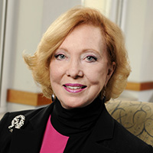
NRG Deputy Chair Transitions
Deborah Watkins Bruner, Ph.D.
  Deputy Director, Publications

Slide 15
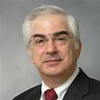
NRG Deputy Chair Transitions
  Thomas Julian, MD
  - Deputy Director, Communications

Slide 16

New NRG Deputy Group Chair
Harry D. Bear, MD, Ph.D
Deputy Group Chair
Publications and Communications
Notes:
Dr. Bear will be in place 1/1/19, Dr. Miller is taking over the reins currently. Dr. Machtay continues in his current role.

Slide 17
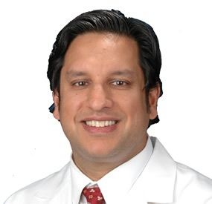
New NRG Leadership
  Krish Tewari, MD
  -Committee Chair, Publications
  Thomas Julian, MD
  -Committee Chair, Communications

Slide 18
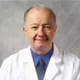
Deputy Group Chair Transitions
        Larry J. Copeland, MD
        Deputy Group Chair
        Research Integrity

Slide 19
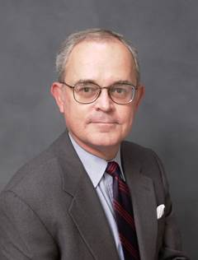
Deputy Group Chair Transitions
D.
D Lawrence Wickerham, M.D.
Deputy Chair
Membership
Notes:
We have a plaque on order – we will need to do a retirement honoring moment

Slide 20

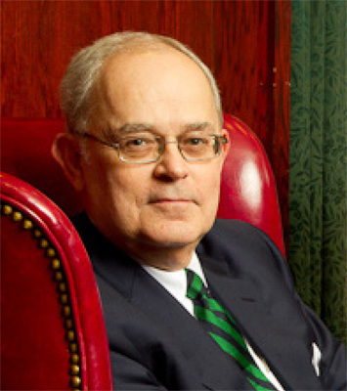
D. D Lawrence Wickerham, M.D.
Notes:
We have a plaque on order – we will need to do a retirement honoring moment

Slide 21
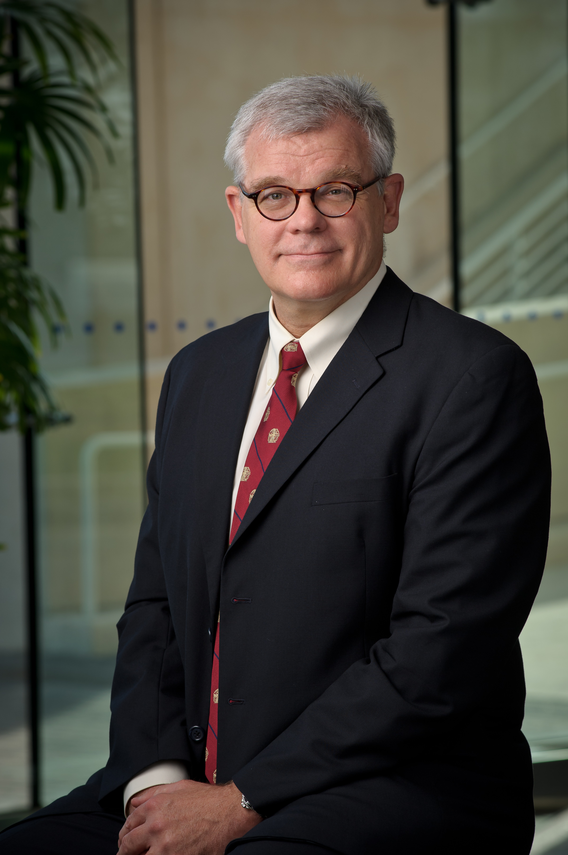
New NRG Deputy Group Chairman
David S. Miller, MD
Deputy Group Chair
Membership and Integrity Officer
Notes:
Dr. Bear will be in place 1/1/19, Dr. Miller is taking over the reins currently. Dr. Machtay continues in his current role.

Slide 22

Deputy Group Chair Transitions
J. Tate Thigpen, MD
Deputy Group Chair
Concept Prioritization &
Advisory Committee

Slide 23
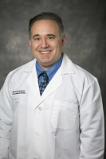
NRG Deputy Group Chair
Mitchell Machtay, MD
Deputy Chair
Research
Notes:
Dr. Bear will be in place 1/1/19, Dr. Miller is taking over the reins currently. Dr. Machtay continues in his current role.

Slide 24
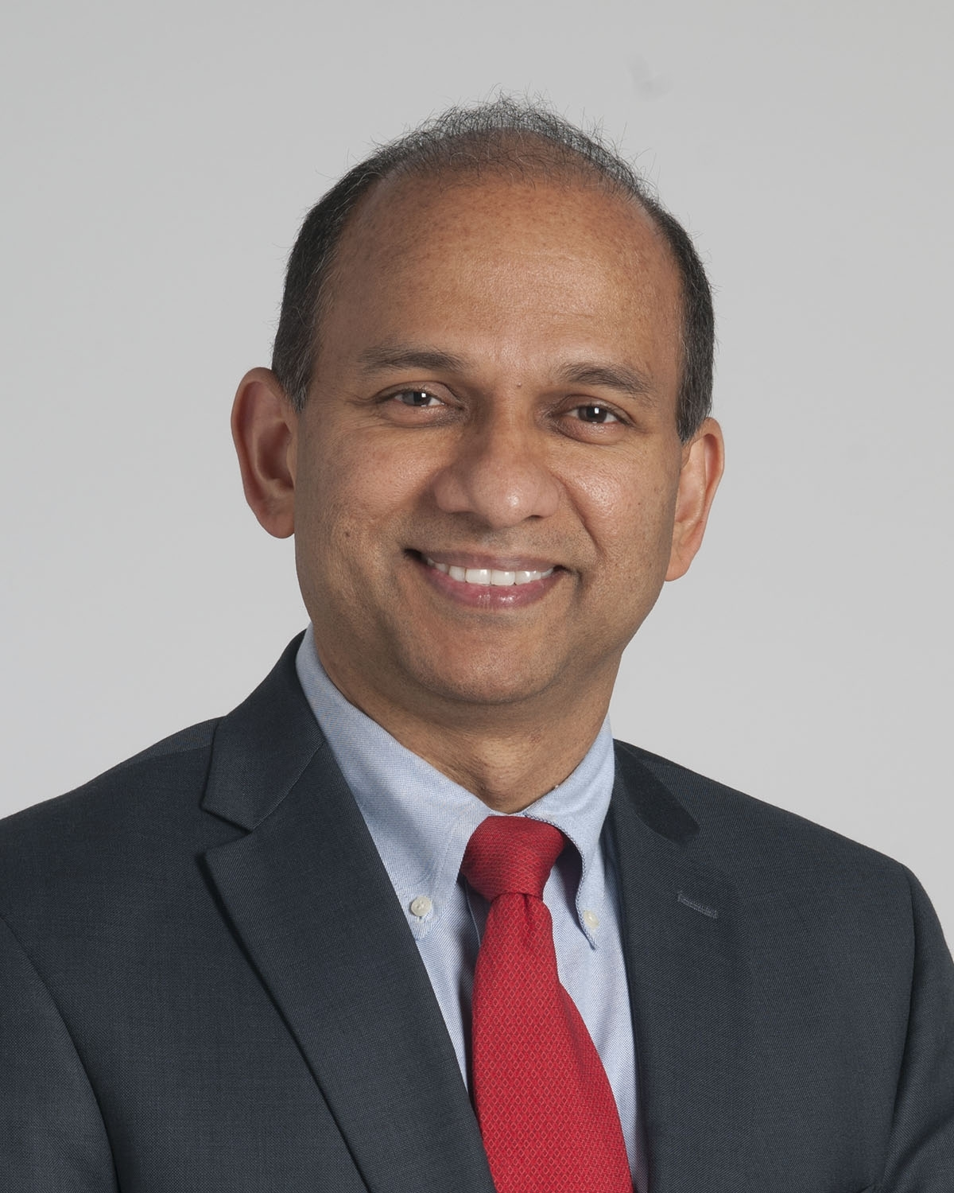
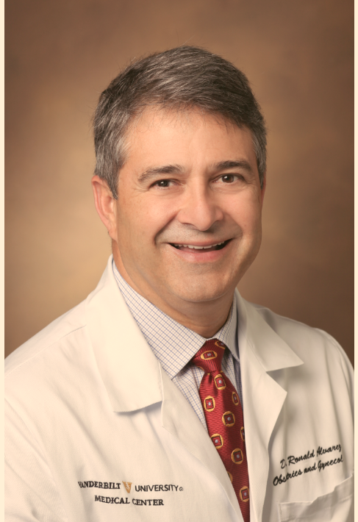
New NRG Oncology Research Center Leaders
NRG Research Strategy Committee Leaders
Jame Abraham, M.D
Ronald Alvarez, M.D.
Notes:
New Chairs for RSC will assume the baton at this meeting

Slide 25
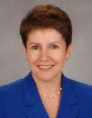
New NRG Oncology Research Center Leader Center
Protocol Oversight & Monitoring Committee Chair
Maria Werner–Wasik, M.D.
Notes:
Is having a brief gathering at this meeting to begin to operationalization

Slide 26
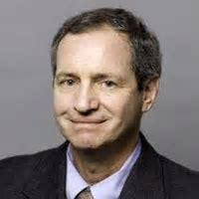
NCI CTEP Leadership TransitionCenter
Dr. Jeff Abrams
Associate Director
CTEP of NCI
Retirement December 2018
Notes:
Is having a brief gathering at this meeting to begin to operationalization

Slide 27
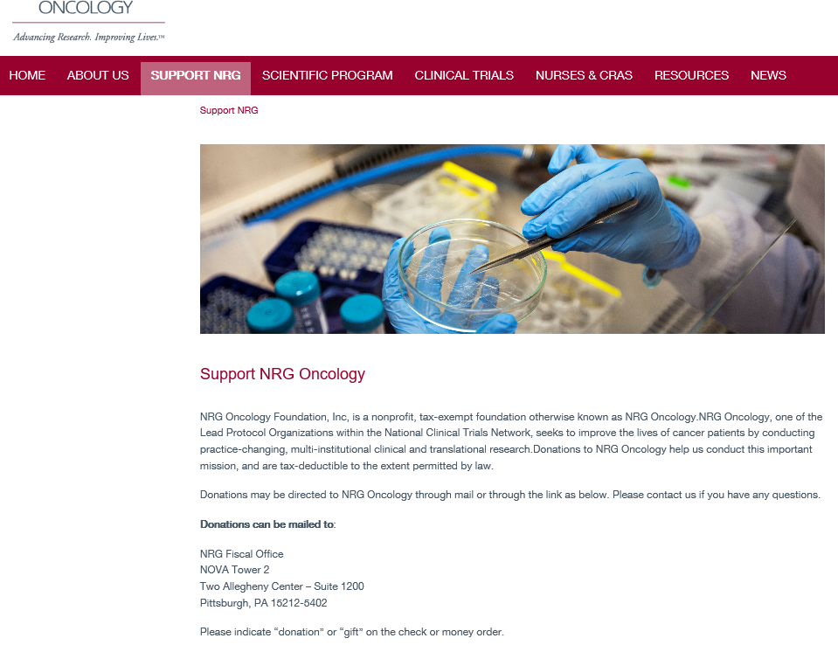
www.nrgoncology.org/Support-NRG
Notes:
Added functionality

Slide 28
NRG Achievements 2014-2017
NRG’s Vision 2019-2025
Thank You!
All this was accomplished during the integration of the legacy groups and other major transitions.
None of this is or will be possible without NRG’s members!!!

Slide 29


Slide 30
Membership Categories
– Voting Members –
Required to credit 40 patient cases per year to NRG
40 cases from the entire NRG portfolio
Affiliate accrual will count toward the 40 case requirement
NCTN accrual credited to NRG will also count
Maintain satisfactory data quality and audit performance

Slide 31
NRG Main Members
Lead Academic Performance Sites (LAPS) 30
National Community Oncology
Research (NCORP) Sites 32
Minority/Underserved NCORP Sites 10
Other Centers 145
Total 217

Slide 32
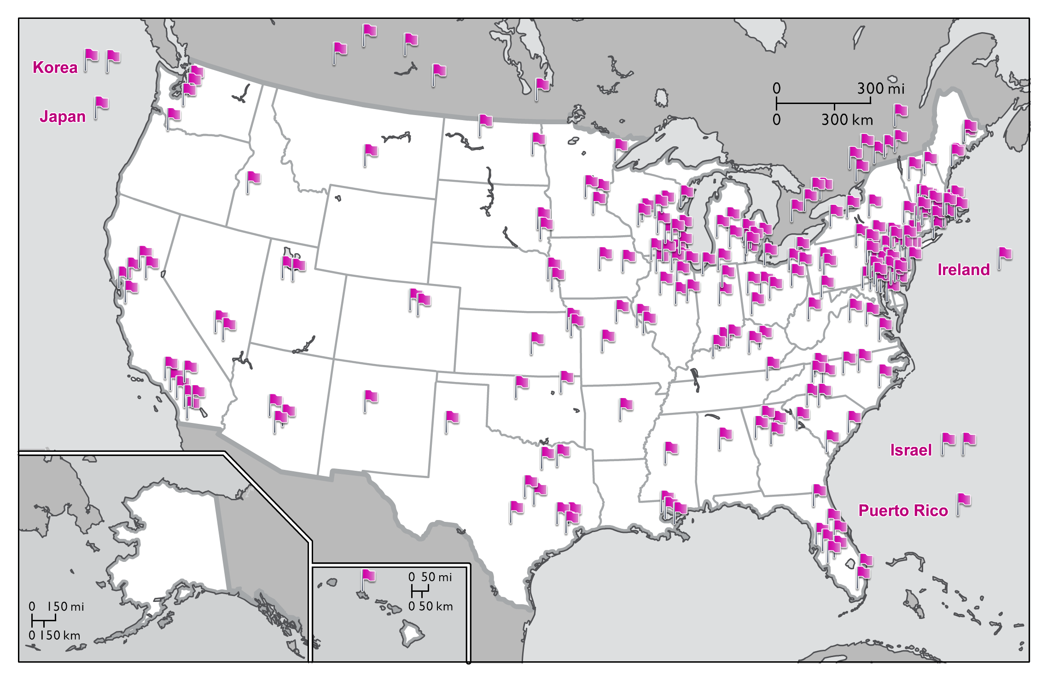
NRG Oncology Main Member, LAPS, and
NCORP Institutions as of June 2018
China
Singapore
Switzerland
Australia

Slide 33
NRG Main Member Site Locations
All 50 states in the US plus the District of Columbia and Puerto Rico
4 Canadian provinces
10 additional international Main Member sites located in 9 countries

Slide 34
NRG Oncology
Accrual by Site Category
Jan 1, 2018-June 30, 2018
NCORP &
M/U NCORP
29%
LAPS
27%

Slide 35
Top Accruing Main Member Sites
January 1 – June 30, 2018
Seoul National University Hospital
Froedtert and the Medical College of Wisconsin
Aultman Health Foundation
CHUM – Centre Hospitalier de l’Universite de Montreal
Thomas Jefferson University Hospital
University of Florida Health Science Center – Gainesville
5. Women and Infants Hospital
8. CHU de Quebec-L’Hotel-Dieu de Quebec (HDQ)
8. Northwestern Medicine Cancer Center Warrenville
10. Arizona Center for Cancer Care-Peoria
10. University of Texas Health Science Center at San Antonio

Slide 36
Top Accruing Lead Academic Participating Sites
(LAPS)
January 1 – June 30, 2018
University of Oklahoma Health Sciences Center LAPS
CWRU – Case Comprehensive Cancer Center LAPS
Washington University – Siteman Cancer Center LAPS
Wayne State University – Karmanos Cancer Center LAPS
Memorial Sloan – Kettering Cancer Center LAPS
University of Texas MD Anderson Cancer Center LAPS
Emory University – Winship Cancer Institute LAPS
Ohio State University Comprehensive Cancer Center LAPS
9. University of Texas Southwestern Medical Center LAPS
10. University of Pittsburgh Cancer Institute LAPS

Slide 37
Top Accruing NCI Community Oncology
Research Program (NCORP)
January 1 – June 30, 2018
Kaiser Permanente NCI Community Oncology Research Program
Catholic Health Initiatives NCORP
Southeast Clinical Oncology Research Consortium NCORP
New Mexico Minority Underserved NCORP
5. Aurora NCI Community Oncology Research Program
5. Delaware/Christiana Care NCI Community Oncology Research
7. Metro Minnesota Community Oncology Research Consortium
8. Heartland Cancer Research NCORP
9. Colorado Cancer Research Program NCORP
9. Columbia University Minority Underserved NCORP

Slide 38
Top Accruing Non-US Sites
January 1 – June 30, 2018
CHUM – Centre Hospitalier de l’Universite de Montreal
CHU de Quebec-L’Hotel-Dieu de Quebec (HDQ)
Centre Hospitalier Universitaire de Sherbrooke-Fleurimont
3. Saskatoon Cancer Center
3. Seoul National University Hospital
3. Seoul National University Bundang Hospital
The Research Institute of the McGill University Health
Centre (MUHC)
7. University Health Network-Princess Margaret Hospital
7. Allan Blair Cancer Centre
10. Tom Baker Cancer Centre
10. Kantonsspital Aarau

Slide 40
NRG Oncology
Research Center Overview
July 2018
Mitchell Machtay, MD
Deputy Group Chair for Research

Slide 41
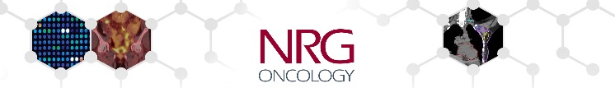
Selected Priorities of the NRG Research Center
For the New Grant Period
Scientific
  Immunotherapy as part of curative-intent regimens.
  Biospecimens as Integral and/or Integrated Biomarkers.
  Imaging results as Integral and/or Integrated Biomarkers.
  Endpoints other than overall survival.
Operational
  Selected Reorganizations
  Eligibility Streamlining and Accrual Enhancement.
  Improving OEWG Timelines.
  New Investigators’ Engagement.

Slide 42
NRG Oncology Operations Center
NRG Oncology Foundation, Inc.
Board of Directors
Group Chairs/Principal Investigators
  Walter J. Curran, Jr., MD, Robert Mannel, MD, Norman Wolmark, MD
Statistics & Data Management Center
James Dignam, PhD
Deputy Group Chairs
Operations Center
Kati Stoermer
Executive Director
Communications
Publications
Publications & Communications
Harry Bear, MD, PhD
Protocol Development
Research
Mitchell Machtay, MD
Regulatory Affairs
Translational Science
Research Strategy Cte.
Membership & Research Integrity
David S. Miller, MD
Protocol Oversight & Management
Cte.
Ancillary Projects Cte.
Member Services
Finance
Meeting Services

Slide 43
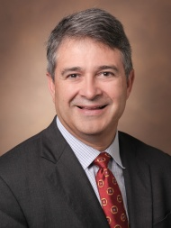
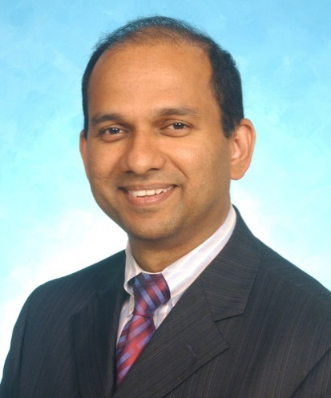
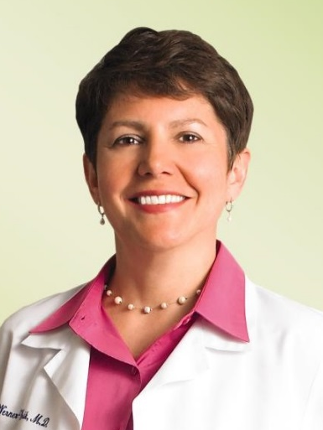
Research Center Senior Leadership
Mitch Machtay, M.D.: Deputy Group Chair for Research
Ron Alvarez, M.D.: Chair, Research Strategy Committee
Jame Abraham, M.D.: Vice-Chair, Research Strategy Committee
Maria Werner-Wasik, M.D.: Chair, Protocol Monitoring Committee
James Dignam, Ph.D.: Group Statistician
Dr. Alvarez
Dr. Abraham
Dr. Werner-Wasik

Slide 44
NRG Protocol Metrics
To Date: 41 NRG trials have been activated/open to enrollment since birth of NRG (3/1/2014): 35 CTEP; 2 Intergroup; 4 NCORP
1 study activated in 2018 to date.
38 new studies in development by NRG HQ (approved by RSC).

Slide 45
NRG Activation: 2018
NRG-GU006: A Phase II, Double‐Blinded, Placebo‐Controlled Randomized Trial of Salvage Radiotherapy With or Without Enhanced Anti‐Androgen Therapy With Apalutamide in Recurrent Prostate Cancer (Activated April 2018; first patient enrolled July 2018).
XRT (64.8-70.2 Gy) + placebo x 6 mo.
Tissue Analysis (Decipher PAM50)
REGISTER
R
XRT (64.8-70.2 Gy) + Apalutamide x 6 mo.
Stratification:
Margins (+ vs. -)
PSA (<0.5 vs. 0.5-1.0)
Decipher PAM50 result (Luminal B vs. other)
Sample Size: N=324 pts
1° endpoint = bDFS
PIs: Felix Feng,MD; Dan Spratt, MD; Industry Collaborator: Janssen

Slide 46
Coming soon! - Anticipated Activations:
NRG-GY012: IIR of Olaparib, Cediranib and combo Cediranib/ Olaparib in recurrent or persistent endometrial CA.
NRG-GY017: Ph I Atezolizumab as immune primer in Locally Adv. Cervix CA
NRG-GY018: Ph III carbo/taxol +/- pembrolizumab as initial tx in advanced endometrial CA
NRG-BR004: PhIII Paclitaxel/Trastuzumab/Pertuzumab with Atezolizumab vs. Placebo in 1st Line HER2+ Metastatic Breast Cancer
NRG-GI005: Ph II/III ctDNA Predictive Marker in Stage II Colon Cancer
NRG-GI006: Ph III Protons vs IMRT for Treatment of Esophageal CA
NRG-LU003: A Biomarker‐Driven Protocol for Previously Treated NSCLC ALK Positive Patients: The NCI‐NRG ALK Master Protocol
NRG-LU004: PhI RT (standard or Hypo) + Durvalumab (no chemo) in PD‐L1 Adv. NSCLC
NRG-CC007CD: Optimizing survivorship care plans for prostate cancer survivors who receive androgen deprivation therapy.

Slide 47
Coming Attraction Protocols
GY018: Ph IIIR carbo/taxol with or w/o pembrolizumab as initial tx in measurable stage 3, 4A,4B or recurrent Endometrial Cancer (CA)
Paclitaxol/Carboplatin
+ Pembrolizumab
Advanced Endometrial CA with known MMR IHC status
R
Paclitaxol/Carboplatin
+ Placebo
STRATIFICATION
Mismatch repair deficient (dMMR) (yes/no)
Performance status (0 vs 1)
Prior chemotherapy (yes/no)
PI: Ramez Eskander M.D. Industry Collaborator: Merck

Slide 48
Coming Attraction Protocols
GI006: PHASE III RANDOMIZED TRIAL OF PROTON BEAM THERAPY (PBT) VERSUS INTENSITY MODULATED PHOTON RADIOTHERAPY (IMRT) FOR THE TREATMENT OF ESOPHAGEAL CANCER
Proton RT + Carboplatin/Paclitaxel followed by Surgery
Confirm insurance coverage for PBT
R
REGISTER
IMRT + Carboplatin/Paclitaxel followed by Surgery
Stratification:
Histology (AdenoCA vs. Squamous)
Anticipated post-CRT surgery (Yes vs. No)
Induction chemotherapy (Yes vs. No)
PI: Steven Lin, M.D

Slide 49
Coming Attraction Protocols
BR004: PhIIIR, Double‐Blind, Paclitaxel/ Trastuzumab/ Pertuzumab w/ Atezolizumab/Placebo in First Line HER2+ Metastatic Breast Cancer
Paclitaxel/ Trastuzumab/Pertuzumab/ Placebo
HER2-Positive Metastatic Breast Cancer
R
Paclitaxel/ Trastuzumab/Pertuzumab/ Atezolizumab
STRATIFICATION
Prior neoadjuvant or adjuvant therapy with trastuzumab (no; yes without both pertuzumab and delayed adjuvant neratinib; yes with either pertuzumab or delayed adjuvant neratinib)
Estrogen receptor status (positive; negative)
PD-L1 status (positive; negative)
Disease sites (any visceral without brain metastasis; non-visceral only without brain metastasis; brain metastasis)
PI: Charles Geyer M.D.

Slide 50
Research Strategy Results: Last 2 RSC mtgs
1st/2nd Quarters of 2018 RSC meetings: 11 concepts
Disease Site | Concept | Status
Brain | BN1747 (meningioma) | CTEP reviewed 6/2018
Brain | BN1803 (Rare Midline glioma) | Pending CTEP submission
Brain | BN1827 (GBM - vector) | BMSC to review 8/2018
GI: | GI1824 (Esophageal - vector) | Pending CTEP submission
GI: | GI1802 (Pancreatic – SBRT/drugs) | Pending CTEP submission
GU | GU1826 (Prostate CA Imaging) | TF to review 8/2018
GYN | CV1748/GY020 (Vulvar GROINS) | GCSC approved
GYN | UC1731 (Low grade endometrial CA) | GCSC to review 8/2018
GYN | UC1805 (high risk endometrial CA) | Pending CTEP submission
HN | HN1801 (high risk H&N CA) | CTEP disapproved
Lung | LU1825 (Mesothelioma) | Pending CTEP submission

Slide 51

NRG: Other Coming Attractions
Pink Sheets (Grant Critiques).
NCORP renewal process.
Jointly sponsored NCTN protocols (e.g. NRG/SWOG).
PTMA’s for new agents/Phase I’s.
Digital Health Protocols.
New partnerships with industry, cancer centers/SPORES.
Junior/New Investigators NRG Workshop in Philadelphia

Slide 52
Thank You!
NRG Research Strategy Committee:
Saturday 3 p.m.-6 p.m., Salon H/5th Fl.
NRG Investigators welcome --
RSVP to
Mitchell.Machtay@uhhospitals.org
and/or
Ronald.Alvarez@vanderbilt.edu

Slide 53
NRG Oncology Biospecimen Bank
Richard Jordan DDS PhD
Nilsa Ramirez, MD
Peter Lucas, MD, PhD
Summer NRG Oncology Meeting
Philadelphia

Slide 54
NCTN # Trials by Phase & Lead Group
3/1/2014 through 2/28/2018
TRIAL PHASE | ALLIANCE | COG | ECOG-ACRIN | NRG | SWOG | Other (NCI CCR) | TOTAL | % of TOTAL
Phase 1 | 4 |  | 1 | 8 | 2 |  | 15 | 5%
Phase 1/2 | 7 | 2 | 3 | 1 | 5 |  | 18 | 5%
Phase 2 | 21 | 23 | 49 | 34 | 29 | 1 | 157 | 47%
Phase 2/3 | 2 | 2 | 1 | 9 | 3 |  | 17 | 5%
Phase 3 | 23 | 23 | 19 | 31 | 11 |  | 107 | 32%
Imaging |  |  | 7 |  |  |  | 7 | 2%
Other | 1 | 1 | 2 | 1 | 2 |  | 7 | 2%
Pilot |  | 4 |  |  |  |  | 4 | 1%
TOTAL # Studies | 58 | 55 | 82 | 84 | 52 | 1 | 332 | 100%
% of TOTAL # Studies | 17% | 17% | 25% | 25% | 16% | 0.3% | 100%
(*) Phase based on latest version of the protocol if the trial was changed after activation

Slide 56
NRGBB Inventory
To May 31st, 2018 | SF | PGH | COL | Totals:
Total Cases w/ Biospecimens | 38,476 | 103,948 | 44,007 | 186,431
Total FFPE Biospecimens | 288,257 | 806,334 | 244,985 | 1,339,576
Total Frozen Tissue Biospecimens | 607 | 2,416 | 67,356 | 80,379
Total Frozen Liquid Biospecimens | 341,952 | 65,054 | 541,305 | 948,311
Annual Incoming Cases: 6/1/17- 5/31/18 | 1,836 | 1,275 | 1,294 | 4,405
Annual Incoming Biospecimens: 6/1/17- 5/31/18 | 28,721 | 4,733 | 21,153 | 54,607
Annual Distributed Biospecimens for Integral Marker Studies June 2017-May 2018 | 503 | 0* | 0* | 503
Annual Distributed Biospecimens for TRP/Exploratory/Integrated studies: June 2017- May 2018 | 10,171 | 468 | 10,573** | 21,212
**includes pre-NCTN biomarkers, NCTN integrated and exploratory biomarkers, and DCP/NCORP studies

Slide 57
U24 supplement request 2018
 | Amount | % of Budget
San Francisco Bank Site | $232,973 | 38%
NCH (Columbus) Bank Site | $197,400 | 33%
Pittsburgh Bank Site | $159,104 | 27%
NRG Oncology Foundation | $10,523 | 2%
Total Request | $600,000 | 100%

Slide 58
NRG Oncology Biospecimen Bank
Integral/Integrated Markers:
Investigators served by Biospecimen Bank
(2013-May 31, 2018)
 | # Investigators
Columbus | 55
SF | 28
Pittsburgh | 9
Total | 92
*individual investigators served, regardless of the type of biomarker testing and number of distributions

Slide 59
NRG Oncology Biospecimen Bank:
Total Number of Distributed Samples
(2015-May 31st, 2018)
NRG Year | # of Trials | Total Cases | Total # Distributed Specimens/ Year | FFPE Tissue Block or PUNCH | FFPE Slides | Plasma | Serum | Other Fluids | Whole Blood | DNA
2015 | 26 | 4,661 | 17,657 | 530 | 12,207 | 2,097 | 2,266 | 385 | 29 | 34
2016 | 19 | 2,647 | 15,652 | 161 | 14,208 | 160 | 417 | 129 | 216 | 361
2017 | 16 | 2,296 | 16,055 | 585 | 10,667 | 2,150 | 2,651 | 0 | 0 | 2
2018 | 29 | 8,522 | 21,491 | 34 | 13,449 | 2,180 | 5,635 | 0 | 0 | 193

Slide 60
NRG Oncology Biospecimen Bank
Investigators Served with Biospecimens for Approved Translational Research Projects
 | Internal | External | Total
SF | 18 | 5 | 23
Columbus | 14 | 0 | 14
Pittsburgh | 4 | 9 | 13
Total | 36 | 14 | 50

Slide 61
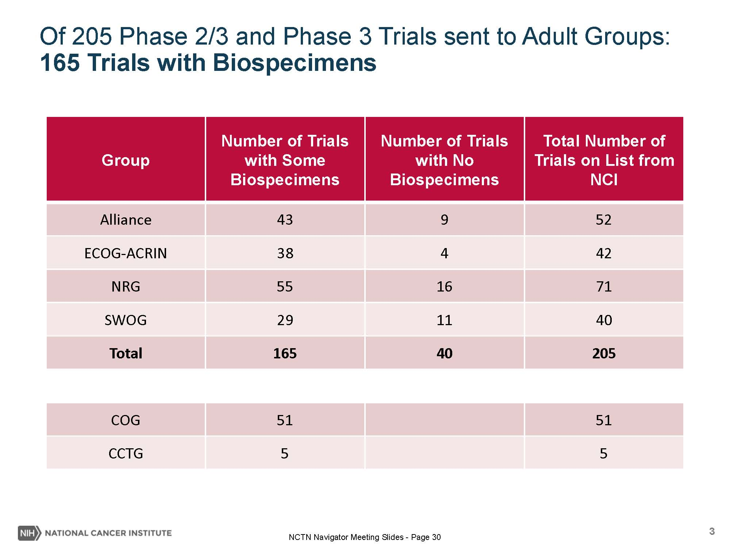

Slide 62
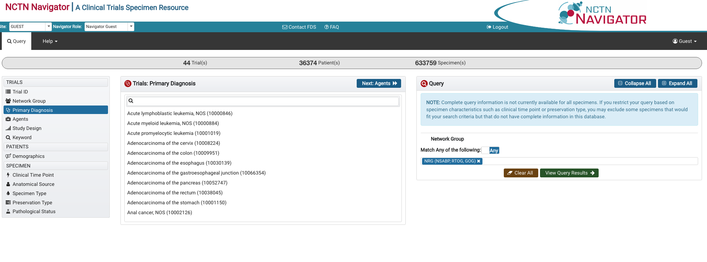
https://navigator.ctsu.org/

Slide 63
NRG Oncology CCSC Proposals
(2013-May 31, 2018: pre-Navigator)
Disease Site | Feasibility Queries Received | Feasibility Queries Approved | CCSC Proposals Submitted | CCSC Proposals Approved | CCSC Decision Pending
BN | 5 | 5 | 4 | 3 | 0
BR | 14 | 10 | 7 | 2** | 0
Cervix | 1 | 1 | 1 | 1 | 0
Corpus | 7 | 6 | 3* | 0 | 0
GI | 4 | 4 | 3 | 1 | 0
GU | 7 | 7 | 7 | 6 | 1
HN | 2 | 2 | 2 | 2 | 0
LU | 4 | 4 | 4 | 2 | 1
Ovary | 5 | 4 | 4 | 1 | 3
Totals | 49 | 43 | 32 | 16 | 5
*proposals not received prior to April 2, 2018, will “start over” in Navigator
** some unapproved will be revised and re-submitted through Navigator

Slide 64
NRG Biospecimen Bank
NCI NCTN Navigator Requests
(April 2nd-May 31, 2018)
Disease Site | LOI > Navigator | Feasibility Report > Group | Feasibility Report > Navigator | Navigator Feasibility Approved: Proposal In Process | CCSC Review Pending
BR | 1 | 1 | 1 | 0 | 1
Cervix | 2 | 2 | 1 | 1 | 0
GU | 4 | 4 | 4 | 4 | 0
HN | 4 | 4 | 4 | 4 | 0
Lung | 1 | 1 | 1 | 1 | 0
Totals | 12 | 12 | 11 | 10 | 1

Slide 65
Statistics and Data Management Center (SDMC)

Slide 66
NCI Grant Renewal Status
Separate CTEP grants for the NRG Operations Office and SDMC.
Score for SDMC CTEP grant was 18.
New CTEP grant cycle starts March 1, 2019.
There is only one NCORP grant for all of NRG
  We are working with the NCORP PIs to develop the NRG NCORP renewal grant application.
  Application due the end of August.

Slide 67
Data Quality Portal (DQP)
Reminder that CTSU has made the DQP available for NRG trials. Select the DQP Tab at the CTSU website.
Allows each clinical site to identify a list of all delinquent forms from their site, for all RAVE trails in which they are participating.
Every two weeks, CTSU sends each site an e-mail reminder to use the portal to address their delinquent reports.
Should use the portal to identify which, if any, forms from your site are delinquent.

Slide 68
Performance Assessments
We are developing a NRG Oncology Network Performance Report that will assess performance for each Network within NRG trials.
Assessment based on:
  delinquency of forms,
  timely response to data request,
  accrual achieved for the current year.
Network as a whole and for sites within the Network

Slide 69
Statistics and Data Management Center
Questions?

