Slide 1
PACIFIC 4 / RTOG 3515
Cliff Robinson, MD (PI)
Washington University in St. Louis
@SBRT_CR
NRG Summer 2020 Lung Committee
07/17/20
@NRGOnc
NRG Oncology

Slide 2
Disclosures
Stock – Radialogica
Research Grants – Varian, Elekta, Merck
Consulting – Astra Zeneca, EMD Serono
Speaking – Varian, ViewRay
NRG-XXXX

Slide 3
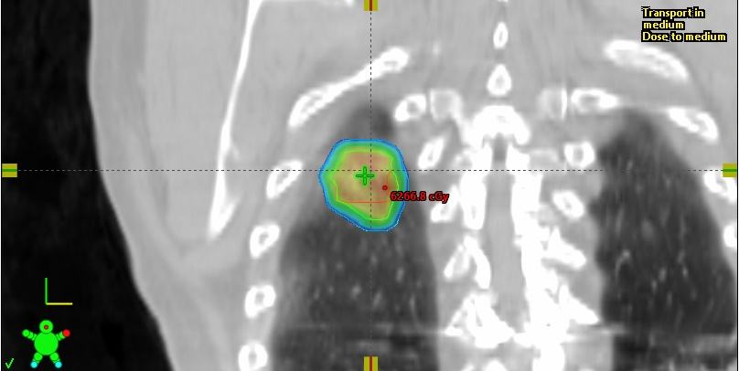
Increasing Use of SBRT for Early NSCLC
Corso, et al Am J Clin Oncol 2017

Slide 4
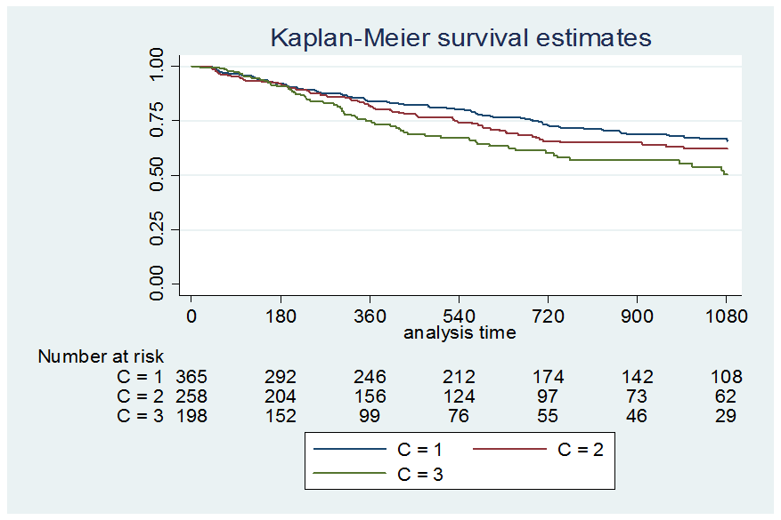
SBRT Failures Increase With Size
Freedom from First Failure (Death Competing Risk)
 | 1y | 2y | 3y
<=2 cm | 80.3 | 69.1 | 62.8
>2-3 cm | 74.1 | 65.1 | 60.2
>3-7 cm | 67.2 | 56.9 | 51.1
n=821
Washington University - Unpublished

Slide 5
NCCN Guidelines - NSCLC
(-) mediastinal nodes
Operable
Inoperable
Surgical Resection
Definitive RT (SBRT)
Stage IA
Stage IB, Stage II
(-) mediastinal nodes
Operable
Inoperable
Surgical Resection
N0
Definitive RT (SBRT)
N1
Definitive Chemoradiation
Consider Adjuvant Chemo (Category 2B)
High Risk Ib-IIb
IB: Peripheral T2a, N0
I: Central T1-2a, N0
II: T1-2ab, N1; T2b, N0
IIB: T3, N0
IA: Peripheral T1abc, N0

Slide 6
Adjuvant therapy after SBRT?
Effective adjuvant therapy needed
Cytotoxic chemo NCCN Category 2B recommendation for “high risk” based on surgical data.
Challenging in frail SBRT population
Immunotherapy well tolerated in Stage III and IV population…

Slide 7
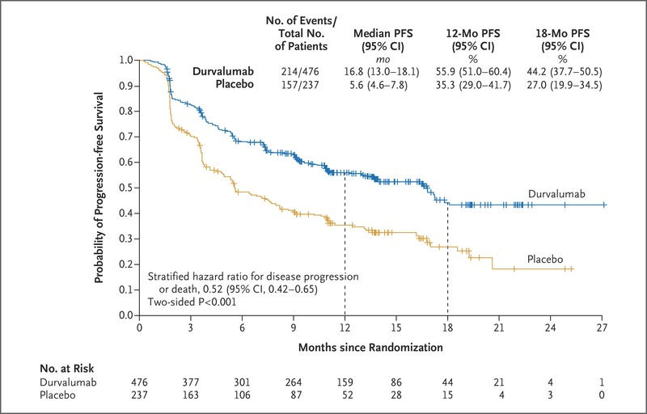
PACIFIC – CRT +/- durva for stage III
713 pts, 2:1 randomized
Durva q2wk 10 mg/kg or placebo up to 12 mo
PFS 17.2 mo vs. 5.6 mo
OS NR vs. 28.7 mo
Well tolerated
G3/4 AEs – 30.5% vs. 26.1%
Pulmonary – 4.8% vs. 2.6%
mPFS 16.8 mo vs. 5.6 mo
mOS NR vs. 28.7 mo
Antonia et al, NEJM 2018

Slide 8
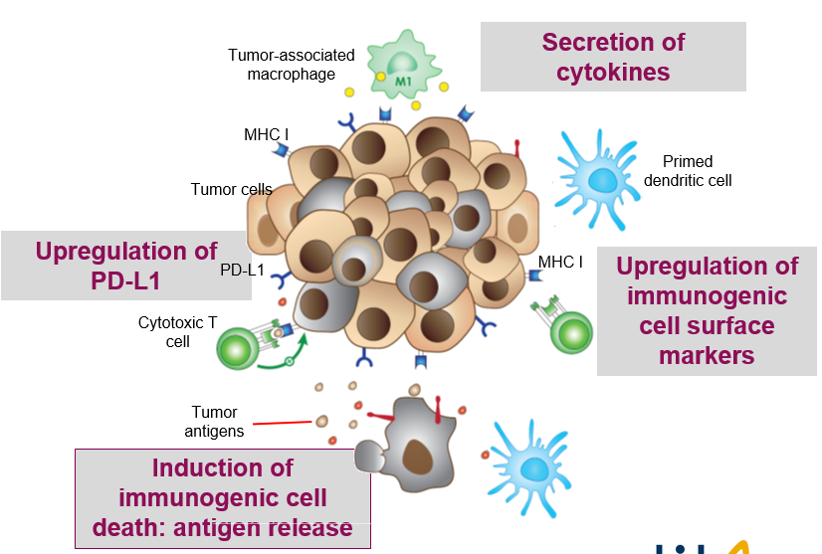
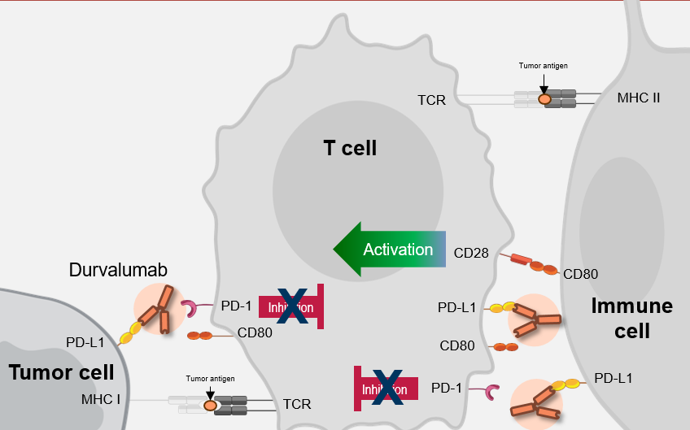
Scientific Rationale SBRT + IO
Radiation therapy → Immunogenic cell death
Higher fraction doses (SBRT) → increased antigen release and uptake by APCs, increased T cell priming in draining lymph nodes
Increased T cell infiltration into TME
Upregulation of PD-L1 expression
SBRT
Triggers or augments antigenic antitumour response
Anti-PD-L1
Acts to preserve ongoing immune responses by blocking an immunosuppressive signal, PD-L1
Enhanced antitumour activity by improving local control and decreasing systemic spread
Daly ME, et al. J Thorac Oncol. 2015;10(12):1685-1693,
Kaur P, Asea A. Front Oncol. 2012;2:191,
Deng L, et al. J Clin Invest. 2014;124(2):687-695,
Stewart R, et al. Cancer Immunol Res 2015;3:1052-62
Notes:
IO + SBRT → may augment response to SBRT, reduce recurrence risk through systemic action on subclinical sites of disease

Slide 9
Early Clinical Data Shows Safety Signal
iSABR (MDACC)
rPh2
SBRT +/- nivo
SBRT w/nivo => nivo (7 total)
N=92/145
2xG2 RP, 1xG3 dyspnea
No pt discontinue therapy from AE
iSABR (UCLA)
Ph1/rRh2
SBRT +/- durva
Durva x 1 => SBRT => durva (4 mo)
Ph1 (N=15)
No SAEs, go to rPh2
UC Davis
Ph1/Ph2 expansion
SBRT + atezo
Atezo x 2 => SBRT w atezo => atezo x 3 (6 total)
3+3 (3mg/kg, 10mg/kg 1200 mg flat)
Ph1 (N=15)
1xG3 rash DLT @ 10mg/kg
RP2D 1200 mg, N=5
No other SAEs to date

Slide 10
PACIFIC-4 / RTOG 3515
Inclusion Criteria
Clinical Stage I/II node negative (T1 – T3 N0)
Medically inoperable or refuse surgery
ECOG PS 0-2
All comers for histology and PDL-1 status
Sync/Metach allowed
Up to 28 Days
N=630
530 T1c-T3
100 T1a/b
1:1
Primary Endpoint: PFS (BICR)
Key Secondary Endpoint:
OS
Lung Cancer Mortality
Patient Screening
Baseline Scan
Submit Tumor Samples
Collect Baseline ctDNA
Durva 1500mg q 4 wks x 24 mos
SOC definitive SBRT
R
Placebo q 4 wks x 24 mos
Stratifications:
T1 vs. T2/3
Central vs. peripheral
SBRT Dose Reflects Int’l Variability
50-60 Gy/8, 50-55 Gy/5,
42-48 Gy/4, 54 Gy/3

Slide 11
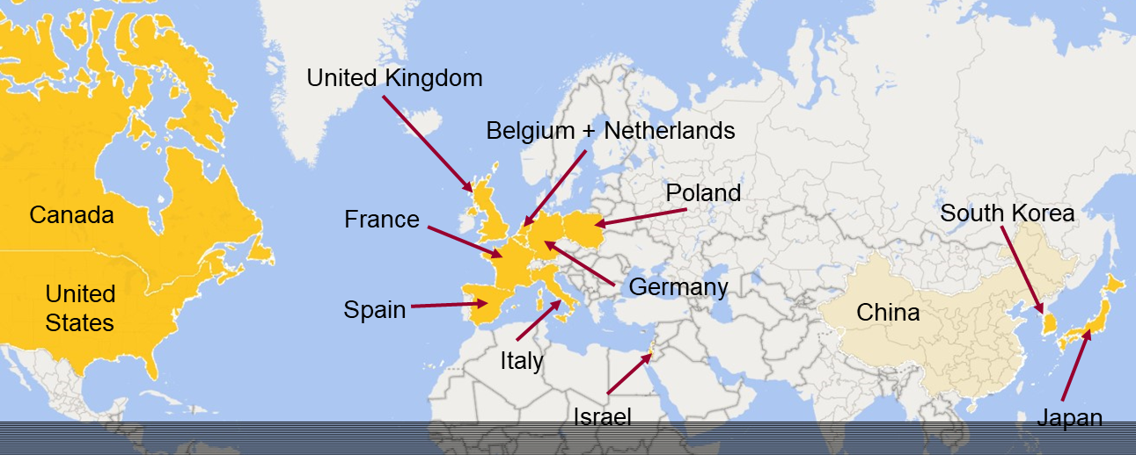
PACIFIC-4 International Enrollment
FSI 03/2019
97 randomized
14 Countries, ~200 sites

Slide 12
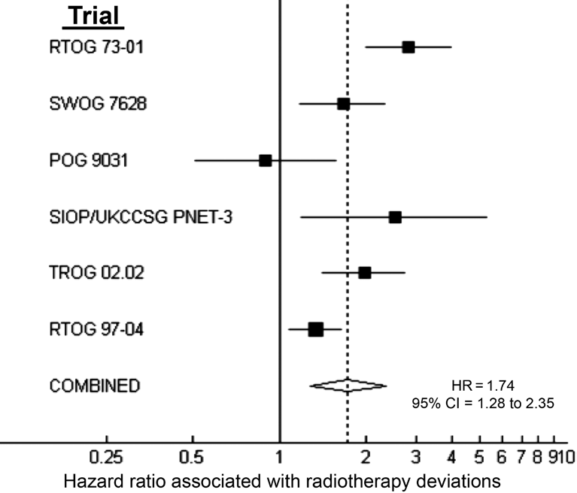
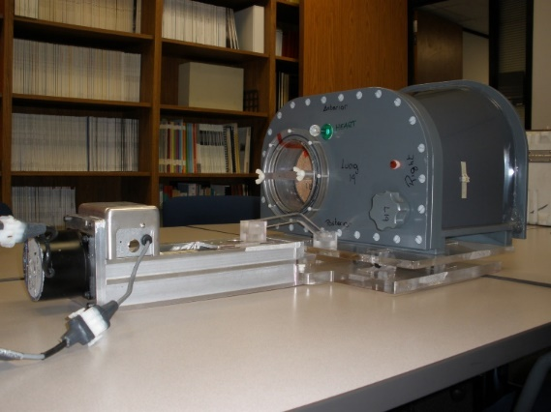
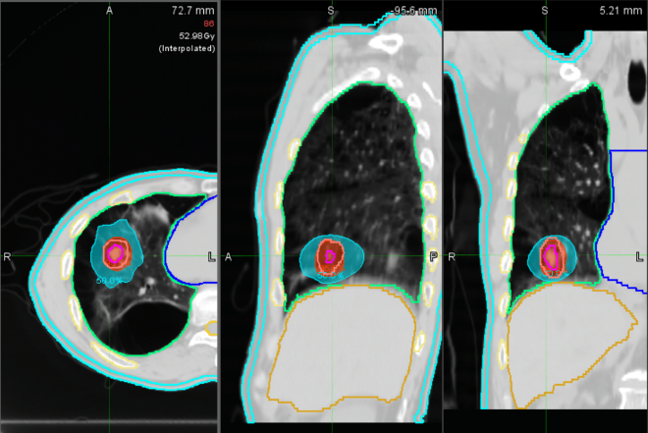
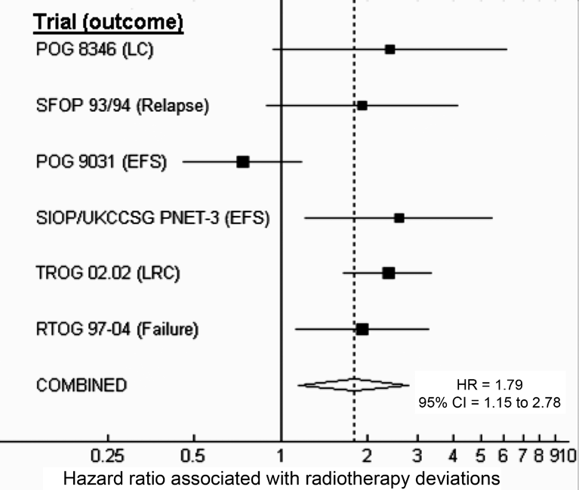
International QA/QC
Ohri et al (JNCI, 2013)
Credentialing
1.74
X
Mortality
1.79
X
Recurrence
Plan QA

Slide 13
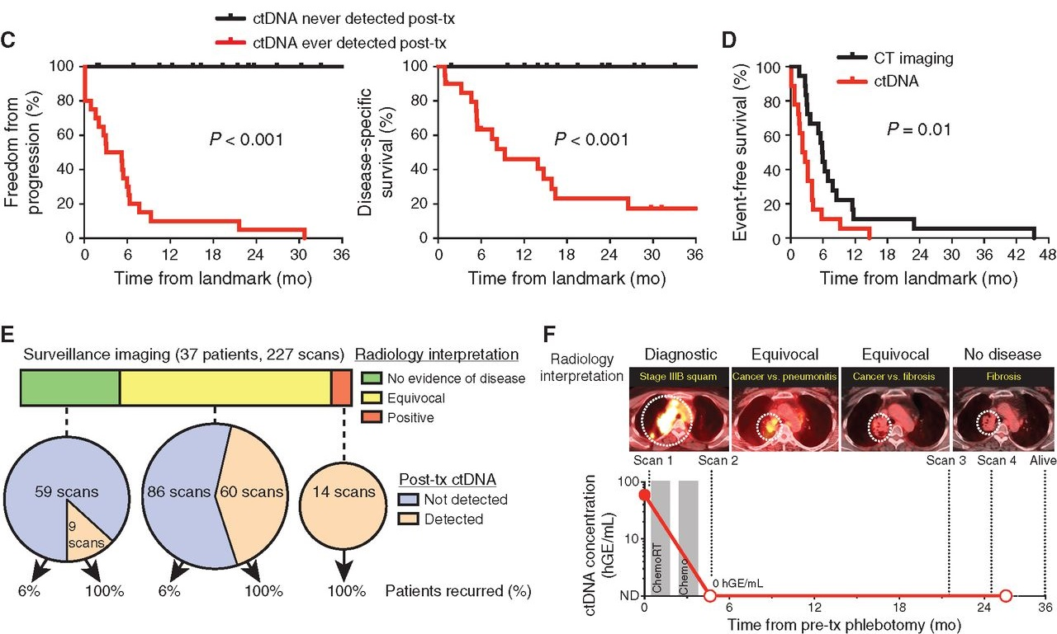
Predictors of failure – ctDNA?
Chaudhuri et al, Cancer Disc 2017

Slide 14
Thank You!
@SBRT_CR

