Slide 1
NRG Oncology Town Hall
NRG Virtual Summer Meeting 2020
10-11am ET
@NRGOnc
NRG Oncology

Slide 2
Ensuring Cancer Research Progress Amid a Global Pandemic
Norman E. Sharpless, M.D.
NRG Oncology Virtual Meeting
July 17, 2020
@NCIDirector
@TheNCI

Slide 3
Today’s presentation
Budget outlook
NCI response to COVID-19
Clinical Research Updates
Addressing racial inequity in cancer research
Q&A

Slide 4
NCI Appropriations FY 2015 – 2020 (in millions)
21st Century Cures Act - orange
Childhood Cancer Initiative - green
$6,440
$6,494
$5,965
$6,144
$195
$195
$5,689
$300
$400
$50
$50
$300
$6,249
+ $306M COVID-19 serology
(April 2020)
+ $414M emergency funding

Slide 5
NCI Response to COVID-19
SARS-CoV-2 serology research
NCI COVID-19 in Cancer Patients Study (NCCAPS)
Guidance for cancer clinical trials
Flexibilities and opportunities for grantees
Genomic studies of COVID-19 outcomes
Trials of immunomodulatory agents for severe COVID-19 pneumonia
cancer.gov/coronavirus-researchers

Slide 6
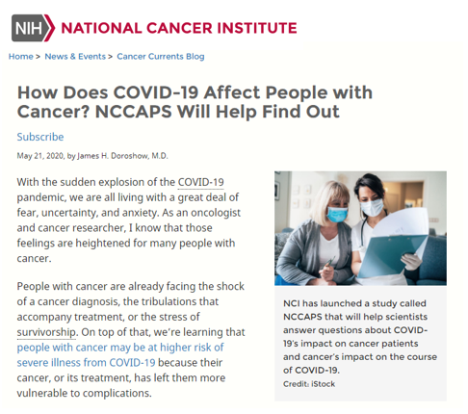
NCI COVID-19 in Cancer Patients Study (NCCAPS)
NCTN
AS OF JULY 7
612
TRIAL SITES
ACTIVATED IN
45
STATES
NCORP
ETCTN

Slide 7
Flexibilities to support grantees during the pandemic
Extending deadlines for applications
Allowing institutions to use NCI grant funds to maintain salaries and stipends
Extending project timelines and reporting requirements
Extending eligibility periods for early-stage investigators and trainees
Carryover for institutional training grants (T35, T32, K12) with prior approval

Slide 8
Emergency Support for Postdoctoral Fellows during COVID-19
Notice of Special Interest (NOSI): NOT-CA-20-082
Administrative supplements to cover salary for a postdoctoral fellow whose stipend support from a non-profit funder has been lost because of the COVID-19 global pandemic.

Slide 9
Impacts of the COVID-19 pandemic on long-term trends in cancer statistics
Delayed Diagnosis | Reduced screening Reduced follow-up on suspicious findings from screening Reduced visits to address symptoms | Treatment Delay Increased Mortality
Deferred Care | Postponed surgery Postponed radiation Postponed chemotherapy | Treatment Delay Increased Mortality
Reduced / Non-Standard care | Less intense chemotherapy Neo-adjuvant chemo instead of immediate surgery | Reduced Response Increased Mortality
Reduced access to care
Uninsured
Under-insured
Underserved populations

Slide 10
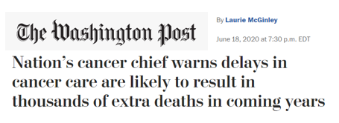
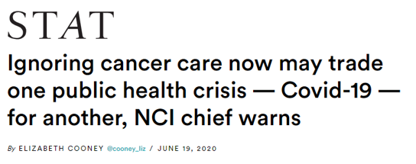
19 June 2020

Slide 11
NCI National Clinical Trials Network (NCTN) Accrual to “Screening” and “Intervention” Steps in Trials by week
304
251
Total Accrual across Network
Screening
109
82
Week Ending

Slide 12
Adapting clinical trials during the pandemic
Some study agents may be shipped to patients
Patient care may be transferred to other study sites
Some services can be provided by local providers, with oversight by responsible investigator
“Remote” informed consent (telephone + signature)
Minor deviations: study visits by telemedicine rather than in-person; delayed study visits; delayed lab or imaging tests; minimal treatment delays; biospecimen collections

Slide 13
During the COVID-19 pandemic, has your site used the following modified clinical trials processes for NCTN trials?
 | Yes | No | Average Usefulness 1 - not at all useful to 5- very useful
Worked with local healthcare providers to provide continuity of care for patients on NCTN trials | 52 | 31 | 3.9 (n=63)
Used virtual (telehealth / telephone) study visits | 85 | 5 | 4.6 (n=88)
Shipped oral IND agents directly to patients enrolled | 53 | 26 | 4.5 (n=63)
Used remote informed consent to enroll patients | 51 | 35 | 4.2 (n=64)
Underwent a remote audit by an NCTN group | 20 | 66 | 3.6 (n=29)

Slide 14
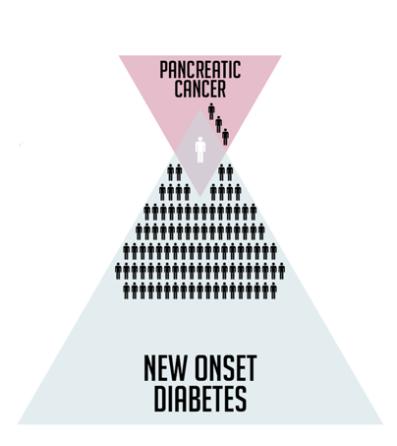
Pancreatic Cancer & New Onset Diabetes
New Onset Diabetes Study
With the National Institute of Diabetes and Digestive and Kidney Diseases
Cohort study recruiting 10,000 people aged 50-85 with newly diagnosed diabetes
Enrolling at 12 sites in 9 states
Partnering with Pancreatic Cancer Action Network
About 1 in 100 people with new onset diabetes are diagnosed with pancreatic cancer within 3 years of their diabetes diagnosis.
1 in 4 people diagnosed with pancreatic cancer were first diagnosed with diabetes.

Slide 15
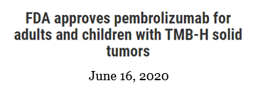
Pembrolizumab for TMB-H tumors

Slide 16
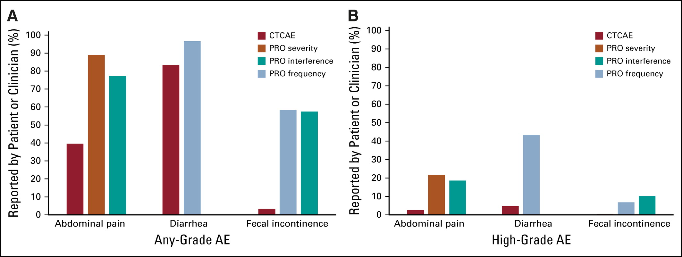
Improvement in Patient-Reported Outcomes With Intensity-Modulated Radiotherapy (RT) Compared With Standard RT: A Report From the NRG Oncology RTOG 1203 Study
J Clin Oncol. 2020 May 20;38(15):1685-1692. Epub 2020 Feb 19.

Slide 17
NCI Efforts to Promote Racial Equity
Addressing Cancer Health Disparities
Promoting Workforce Diversity
Creating an Inclusive Culture at NCI

Slide 18
Minority accrual to clinical trials
Accrual to NCTN and NCORP trials (and predecessor programs)
Phases I – III, 1999 – 2019
Black or African American

Slide 19
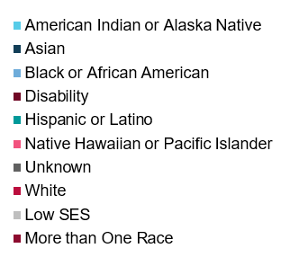
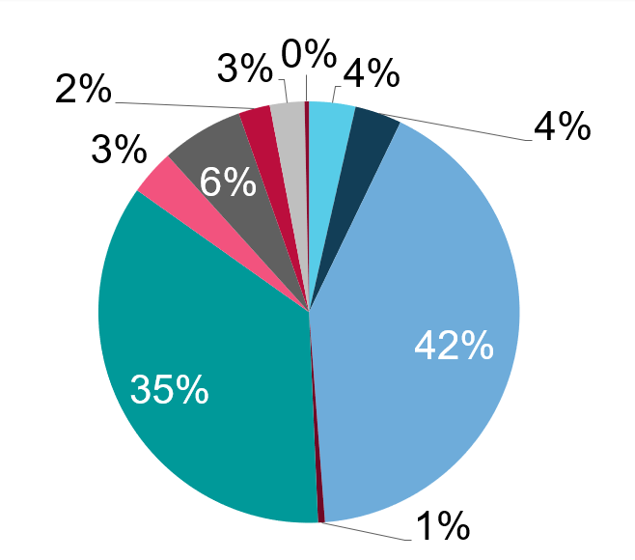
Continuing Umbrella of Research Experiences (CURE)
2001 - 2018:
4,753 Trainees

Slide 20
The Cancer Letter, June 5, 2020

Slide 21
www.cancer.gov
www.cancer.gov/espanol
1-800-4-CANCER
NCIinfo@nih.gov
@NCIDirector
@TheNCI
Thank you!

Slide 22
Question and Answer session Panel view Wally Curran Norm Wolmark Robert Mannel Deb Bruner Joan Walker Ned Sharpless
@NRGOnc
NRG Oncology

