Slide 1
EORTC 1634-BTG Personalized Risk-Adapted Therapy in Post-Pubertal Patients with Newly Diagnosed Medulloblastoma (PersoMed-I)
Study PI: Peter Hau, M.D.
NRG PI(s):
Vinay Puduvalli, M.D.
Vinai Gondi, M.D.

Slide 2
Background
Medulloblastoma constitutes ~8% of all intracranial tumors. Adults in general fare worse than children.
Standard treatment involves maximal safe surgical resection followed by craniospinal radiotherapy with concurrent and adjuvant chemotherapy.
Experience in treating medulloblastomas has predominantly evolved from pediatric studies and have often been applied to adult patients.
This has been largely due to the lack of reliable data given that these tumors are uncommon in adults
Recent studies have shown distinct molecular subtypes distributed among the various age groups, associated with differing prognoses, and mandating reassessment of tx paradigms in age groups and in molecular subtypes.
This international multicenter trial focuses on treatment of post-pubertal adolescents and adults not only by personalizing their treatment by targeting molecular subtypes of the tumor but also by adaptively and comprehensively assessing their risks.

Slide 3
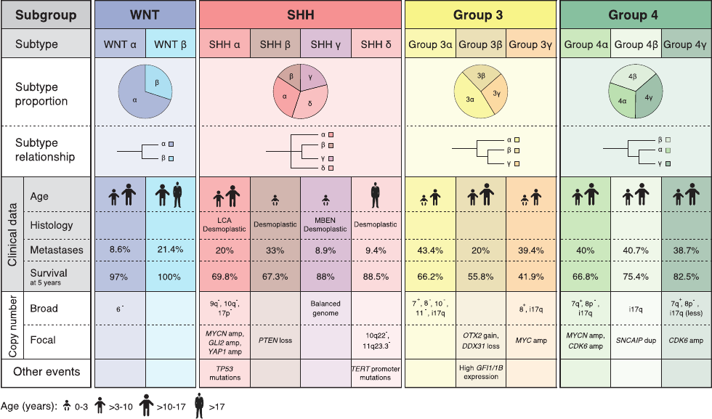
Molecular Subgroups
Cavalli FMG, et al. Cancer Cell 2017.

Slide 4
Targeted Therapy in the Experimental Arm- SHH
SHH-subgroup
medulloblastoma
Nothcott et al., Nature Review Primers 2019
Inhibition of the SHH-signaling pathway is feasible
Adolescent & adult SHH-group medulloblastomas are the best targetable population for SHH inhibitors
The SHH-subgroup is highly overrepresented in adults {Kool, 2012}
Adolescent & adults have SHH mutations at the level of SMO (to which most inhibitors target) or upstream {Kool, 2014}
Animal models with SMO-inhibitors show impressive effects {Samkari, 2015}
Notes:
Adult SHH-medulloblastomas are enriched for PTCH1 and SMO mutations and coupled with a near absence of TP53 mutations
Aberrations in PTCH1=prognostically positive
LOH PTCH1=prognostically positive
Loss of function mutation PTCH1 = prognostically positive (Robinson, JCO 2016)

Slide 5
Justification: Standard arm
Based on NOA-07 and HIT 2000:
NOA-7: prospective descriptive multicenter single-arm phase II trial Beier et al Neurooncol 2018
Boost to Met´s
cerebral 11 x 1,8 Gy
spinal 8 x 1,8 Gy
Radiotherapy
craniospinal axis
35.2 Gy (22 x 1.6 Gy)
boost to primary site
19.8 Gy (11 x 1.8 Gy)
Inclusion Criteria: Age 21 and older, Histology: Medulloblastoma, all subgroups (M0/1)
Demographics: Median age 37 years (range: 21-53); Female:Male ratio = 11 (36.7%):19 (63.3%)
>M0
Maintenance ChemoRx
8 x 6 weeks (1 cycle = 42d)
D1
CCNU 75 mg/m² Cisplatin 70 mg/m²
Vincristine 1.5 mg/m²
D8 &15
Vincristine 1.5 mg/m²
Resection
NOA-07
2-4 wks.
Concom. ChemoTh
Vincristine
1.5 mg/m² / week
M0
Re-Resection (optional)
If > 1.5 cm²
6 wks.
HIT-2000 Adult Observational Study (chemotherapy sustained). Freidrich C et al Europ J Cancer 2013
RT (35.2 Gy CSRT -boost to 55.2 Gy to posterior fossa) followed in most patients by maintenance chemotherapy (CCNU 75 mg/m2 , vincristine 1.5 mg/m2 [max 2 mg] and cisplatin 70 mg/m2, n=49) x up to 8 cycles
Higher termination rate in NOA-07 compared with HIT-2000
Patients in HIT-2000 younger (median age 28.5 vs 37)
More adequate toxicity management in HIT-2000
Modifications for EORTC-1634-BTG:
Vincristine reduced to q2 weeks during RT and to Days 1 & 15 from Days 1,8 & 15 during post-RT maintenance
Maintenance reduced from 8 to 6 cycles
Beier, Hau et al, Neuro-Oncology 2019
Notes:
NOA-7: 30 adults patients evaluable. 50% classic and desmoplastic/nodular histology. 67% percent SHH without TP53 alterations; 13% WNT, 17% non-WNT/non-SHH. While 4 chemo cycles were feasible, considerable toxicity and a high amount of dose reductions throughout the first 4 cycles noted. The 3-year event-free survival rate was 66.6% at the time of databank lock. https://pubmed.ncbi.nlm.nih.gov/29016837/?from_single_result=29016837&show_create_notification_links=False
HIT-2000: 70 adults enrolled; RT (35.2 Gy to the craniospinal axis and a boost to 55.2 Gy to the posterior fossa) followed in 49 patients by maintenance chemotherapy (lomustine (CCNU), vincristine and cisplatin – toxicity tolerable. At a median follow-up of 3.7 years, the 4-year event-free survival (EFS) and overall survival (OS) rates±standard error (SE) were 68%±7% and 89%±5%. Patients with desmoplastic medulloblastoma and lateral tumour location (n=19) had a lower EFS compared to patients with centrally located desmoplastic tumours (n=10) (p=0.011). https://www.sciencedirect.com/science/article/pii/S0959804912008052?via%3Dihub

Slide 6
Study Design
Eligibility criteria: Post-pubertal (bone age: F>15, M>17),
molecularly classified, centrally confirmed M0-M1 medulloblastoma
Strat factors: 1) Geography, 2) Photon vs. proton tx, 3) Age ≤30 vs. >30

Slide 7
Objectives
Primary Objective:
To compare PFS between standard therapy and experimental therapy in the SHH-dependent subgroup
Secondary Objectives:
PFS by local investigator
Overall Survival
Safety profile (CTCAE)
Short- and long-term health-related quality of life (HR-QoL)
Short- and long-term neurocognitive function and social outcome
Short- and long-term endocrine function
Correlation of molecular markers with measures of clinical benefit
Protons vs. photons toxicity endpoint

Slide 8
Statistical Considerations
Three-year PFS of 73% in the standard arm and 86.6% in the experimental arm (HR=0.456)
128 eligible per-protocol patients (PP) from the SHH-subgroup (70%, 64 in each arm)
43 PFS events are needed to evaluate 3-year PFS in the SHH subgroup
Total number of per protocol patients is 184. 10% non-PP patients are assumed
204 standard risk patients must be registered
NRG Oncology to contribute an estimated 20%
Uniquely positioned due to engagement of multiple US proton centers and the increasing usage of proton therapy for adult medulloblastoma in the US

Slide 9
International Co-operation and Patient Numbers
US = 20-30 / year
NOA = 14 clinical sites, n=24-32 / year
Trial coordination: Regensburg
Neuropathology reference: Heidelberg
Neuroimaging reference: EORTC, Munich & Frankfurt
Radiotherapy QA: EORTC, Munich & Leipzig
BNOC = 16 / year
EORTC without UK = 67 / year
COGNO = 8-16 / year
Patients: n = 107 / year (n = 92 / year)
Priority Program: 'Translational Oncology‘
Personalized Risk-Adapted Therapy in Post-Pubertal Patients with Newly-Diagnosed Medulloblastoma (PersoMed-I)
Notes:
Support is of utmost importance (German centers, structures at EORTC that are attached to German patients)
Without funding, the trial will not be possible at this time
Further funding opportunities are uncertain at this time
Australia 0.9 Mio, NCI supports, EORTC 0.5 Mio.
Germany ommitted if Krebshilfe does not fund
Initiative will be followed outside GER if Krebshilfe does not fund
Sonidegib: many tries by other investigators, we succeeded
Data ownership has been negotiated in between NOA and EORTC
Other Krebshilfe / EORTC trials as example

Slide 10
Infrastructure for NRG Accrual from US Proton Centers
Mayo MN
MDACC
MGH
NWern
UFlorida
Mayo AZ
WashU
UPenn
Miami
UWash
Case
MSKCC
Emory
Rutgers
Willis Knighton
Beaumont
UCincin
NRG Oncology:
QA: 1) Credentialed proton technology
2) Central QA of proton therapy plans
Protons vs. photons toxicity endpoint

Slide 11
Logistics to Consider
NRG would be the US sponsor and would need to cross file the IND
NRG to create Group Specific Appendix
Drug Distribution
Central Path & molecular profiling are needed for randomization (Mardis et al -genomic facility at NWCH potential)
Data collection/Patient registration
Neurocognitive testing
Central Radiology review
Translational Research
*Pending NRG RSC and CTEP/BMSC approval.

Slide 12
Key Points & Summary
First randomized trial conducted in adults
First randomized trial with targeted therapy
Established (= functional) treatment-modifying tools rolled out in a prospective trial
Early translation expected for patients’ benefit
Sufficient recruitment ensured
Financial support for core trial is secured (EORTC)
Drug support (Sonidegib) by industry secured
Translational projects fully financed in Europe and Australia
Backbone for future trials of medulloblastoma

