Slide 2
NRG Main Members
Lead Academic Performance Sites (LAPS) 30
National Community Oncology
Research (NCORP) Sites 32
Minority/Underserved NCORP Sites 10
Other Centers 145
Total 217

Slide 3
NRG Main Member Site Locations
47 states in the US plus Puerto Rico
4 Canadian provinces
11 additional international Main Member sites located in 8 countries

Slide 4
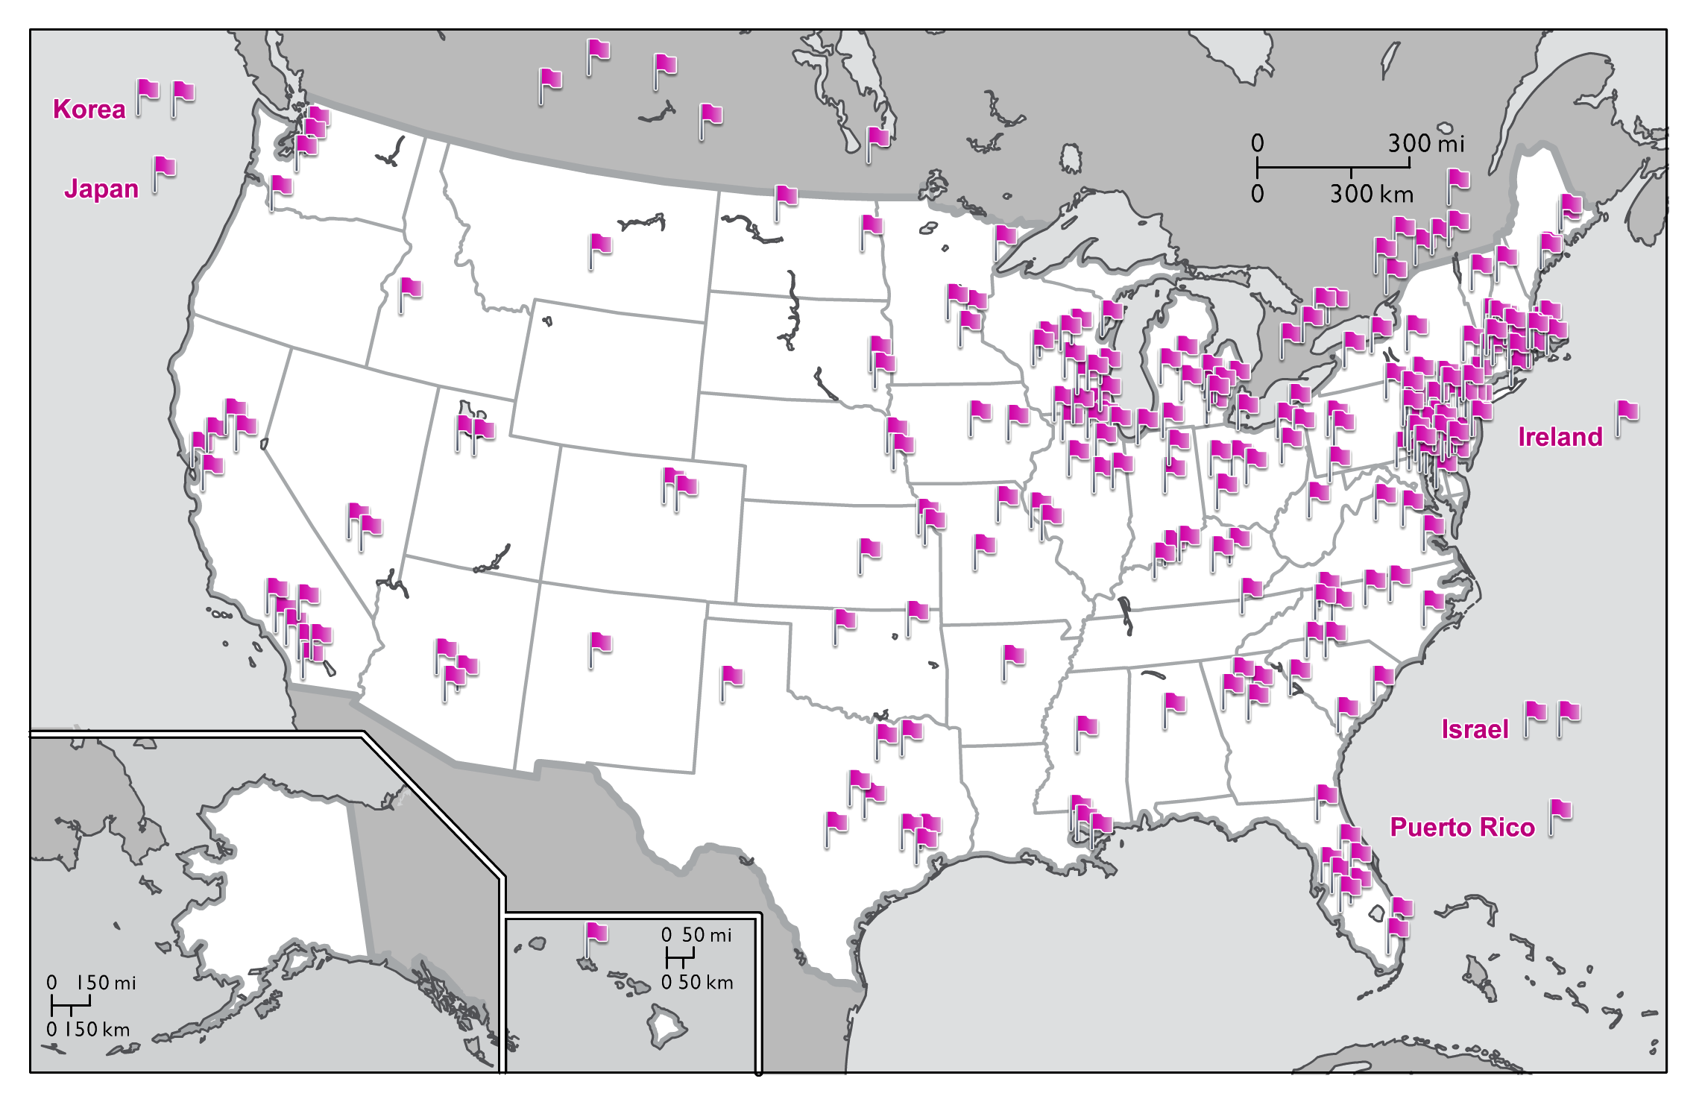
NRG Oncology Main Member, LAPS, and
NCORP Institutions as of December 2018
China
Singapore
Switzerland
Australia

Slide 5
Membership Categories – Main Members –
Required to credit 15 patient cases per year to NRG
15 cases from the entire NRG portfolio
Affiliate accrual will count toward the 15 case requirement
NCTN accrual credited to NRG will also count
Maintain satisfactory data quality and audit performance

Slide 6
NRG Oncology Accrual by Site Category January 1 – December 31, 2018
NCORP &
M/U NCORP
26%
LAPS
33%

Slide 7
Top Accruing Main Member Sites NRG Oncology Trials January 1 – December 31, 2018
Seoul National University Hospital
Thomas Jefferson University Hospital
CHUM – Centre Hospitalier de l’Universite de Montreal
Women and Infants Hospital
CHU de Quebec-L’Hotel-Dieu de Quebec (HDQ)
The US Oncology Network
6. University of Maryland/Greenebaum Cancer Center
7. University of Kansas Cancer Center
8. Froedtert and the Medical College of Wisconsin
9. Arizona Center for Cancer Care-Peoria
9. Sutter Cancer Research Consortium

Slide 8
Top Accruing Lead Academic Participating Sites (LAPS) NRG Oncology Trials January 1 – December 31, 2018
Washington University – Siteman Cancer Center LAP
CWRU – Case Comprehensive Cancer Center LAPS
University of Oklahoma Health Sciences Center LAPS
Wayne State University – Karmanos Cancer Center LAPS
Memorial Sloan – Kettering Cancer Center LAPS
University of Texas MD Anderson Cancer Center LAPS
University of Texas Southwestern Medical Center LAPS
7. University of Michigan Comprehensive Cancer Center LAPS
7. Emory University – Winship Cancer Institute LAPS
8. Ohio State University Comprehensive Cancer Center LAPS

Slide 9
Top Accruing NCI Community Oncology Research Program (NCORP) NRG Oncology Trials January 1 – December 31, 2018
1. Kaiser Permanente NCI Community Oncology Research Program
Southeast Clinical Oncology Research Consortium NCORP
Delaware/Christiana Care NCI Community Oncology Research
4. New Mexico Minority Underserved NCORP
5. Heartland Cancer Research NCORP
6. Metro Minnesota Community Oncology Research Consortium
6. Cancer Research Consortium of West Michigan NCORP
7. Michigan Cancer Research Consortium NCORP
7. Northwest NCI Community Oncology Research Program
8. Northwell Health NCORP

Slide 10
Top Accruing Non-US Sites NRG Oncology Trials January 1 – December 31, 2018
1. CHUM – Centre Hospitalier de l’Universite de Montreal
2. CHU de Quebec-L’Hotel-Dieu de Quebec (HDQ)
3. Seoul National University Bundang Hospital
4. Saskatoon Cancer Center
5. Fudan University Shanghai Cancer Center
6. University Health Network-Princess Margaret Hospital
6. The Research Institute of the McGill University Health
Centre (MUHC)
7. Kantonsspital Aarau
8. Yonsei University Health System-Severance Hospital
8. Centre Hospitalier Universitaire de Sherbrooke-Fleurimont

Slide 11
Audit
Regularly scheduled network audit: 72
AZ127 Arizona Center for Cancer Care-Peoria (2 sites)
40021 Rabin Medical Center (1 site)
IN044 The Community Hospital (1 sites)
IL010 Advocate Lutheran General Hospital (2 sites)

