Slide 1
A Phase II Prospective Randomized Clinical Trial
of Time, Dose, Fractionation and Sequence of
SRS and Immunotherapy
in Melanoma Patients with Brain Metastases
June 9, 2020

Slide 2
Study Team:
Study Chair: Paul W. Sperduto, MD, MPP, Metro-Minnesota
Community Oncology Research Consortium (MMCORC)
Co-Chair, Radiation Oncology: Rupesh Kotecha, MD, Miami Cancer Inst.
Co-Chair, Medical Oncology: Manmeet Ahluwalia, MD, Cleveland Clinic
Co-Chair, Correlative Studies: Raju Raval, MD, PhD, Ohio State Univ.
Co-Chair, Neuroradiology: Daniel Barboriak, MD, PhD, Duke University
Co-Chair, Physics: Raj Varadhan, PhD, Minneapolis Radiation Oncology
NRG Statistics: Mei Polley, PhD, University of Chicago
NRG Brain Committee Chair: Minesh Mehta, MD, Miami Cancer Institute
Champions for this trial from other NCTN research groups:
SWOG: Zeynep Eroglu, MD & Peter Forsyth, MD, Moffitt Cancer Center
Alliance: Paul D. Brown, MD, Mayo Clinic
ECOG: Mohammad Khan, MD, PhD, Emory University

Slide 3
Template for Trials of Immunotherapy & SRS in Brain Metastases
The proposed design of combined immunotherapy and radiation provides
a template for future trials of patients with other primary tumors which
commonly cause brain metastases and are treated with immunotherapy, including:
Non-Small Cell Lung Cancer
Triple-Negative Breast Cancer
Renal Cell Carcinoma
Melanoma

Slide 4
TITLE: A Phase II Prospective Randomized Trial of Time, Dose,
Fractionation & Sequence of SRS & Immunotherapy in
Melanoma Patients with Brain Metastases
DESIGN: Two-by-Two Factorial Study Design
SCHEMA:
Melanoma brain metastases (0.5 to ≤ 3 cm in max diameter) 1-20 lesions Resection allowed of up to 4 lesions if clinically indicated Absence of leptomeningeal disease | S T R A T I F Y | Melanoma-molGPA: (1.5-2.5 vs. 3.0-4.0) Prior BRAFi/MEKi (yes/no) Steroid Dose at randomization (Dex 0-2 vs > 2 -8 mg qd) | R A N D O M I Z E (1:1) | Arms 1 and 2 SRS: → IPI 3 mg/kg + NIVO 1 mg/kg q3wk x 4 NIVO 3 mg/kg q2wk (IPI/NIVO within 2 wks of SRS) Arms 3 and 4 IPI 3 mg/kg + NIVO 1 mg/kg q3wk x 4 NIVO 3 mg/kg q2wk→ RT (SRS after 1st dose of ICI) | R A N D O M I Z E (1:1) | Arm 1 SRS in 1 fraction to all lesions Arm 2 HF-SRS in 3 fractions to all lesions Arm 3 SRS in 1 fraction to all lesions Arm 4 HF-SRS in 3 fractions to all lesions

Slide 5
HYPOTHESES
Three fraction SRS is more immunogenic than single fraction SRS
SRS prior to immunotherapy results in better outcomes than the reverse sequence
RATIONALE:
The most immunogenic SRS technique is unknown. Vanpouille-Box (Nature Commun 2017, Ngwa/Formenti, (Nat Rev Cancer 2018), Chen (IJROBP 2018) and Theelen (JAMA Onc 2019 suggest 3 fraction SRS is more immunogenic than single fraction SRS.
The optimal sequence of SRS and immunotherapy is unknown. Pommeranz (IJROBP 2020) suggests SRS prior to immunotherapy is better.
Two recent trials [Amaral (J Immunother Cancer 2020) and Pomeranz (IJROBP 2020)] show a survival advantage for local therapy (SRS) with ipilimumab + nivolumab compared to ipi + nivo alone.
N0574, Brown et al (JAMA 2016) confirmed IC-PFS6 with SRS alone of 82%.
Two phase II trials [Checkmate 204, Tawbi NEJM 2018) and Australian ABC (Long, Lancet 2018)] have shown in asymptomatic patients that ipi + nivo results in IC-PFS6 of 53-64%

Slide 6
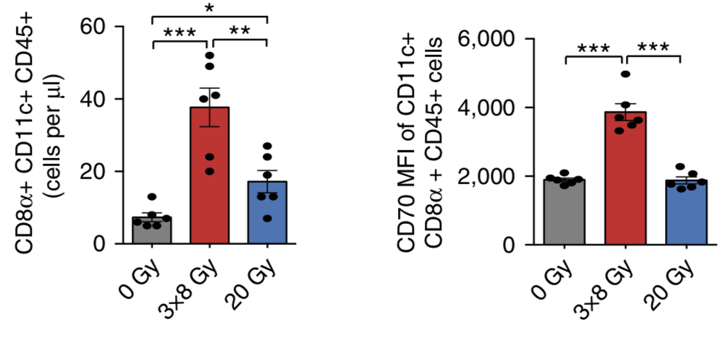
BACKGROUND:
3 FRACTION SRS MAY BE MORE IMMUNOGENIC THAN SINGLE FRACTION SRS
Vanpouille-Box et al showed a marked increase in the CD8 tumor
infiltrating dendritic cells (TIDC) after 8Gy x 3 fractions but not in single
fractions of 20Gy.
Vanpouille-Box, Nature Communications 2017;8:15618

Slide 7
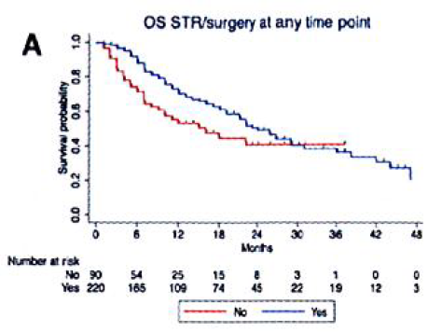
BACKGROUND: SRS BEFORE IMMUNOTHERAPY MAY RESULT
IN BETTER OUTCOMES THAN IMMUNOTHERAPY BEFORE SRS
German Dermatological CooperativeOncology Group (DeCOG)
Multi-institutional (23) retrospective study
N = 380
Treatment Median Survival
Ipi + Nivo 16 mo
Ipi + Nivo + LT 24 mo
p = 0.009
LT: local treatment (either surg or SRS)
Amaral et al, J Immunother Cancer 2020

Slide 8
BACKGROUND: Comparison of the Literature
Publication Author/Year | Dx | Rx | Sx | N | 6 mo IC-PFS | 6 mo EC-PFS | Median OS
Australian ABC Long et al. 2018 | Melanoma | Ipi+Nivo | no | 35 | 53% | 51% | NR
 |  | Nivo | no | 25 | 20% | 35% | 18.5
Checkmate-204 Tawbi et al. 2018 | Melanoma | Ipi+Nivo | no | 94 | 64% | 76% | NR
N0574 Brown et al. 2016 | All Primaries | SRS | yes | 111 | 82% |  | 10.4 p=0.92
 |  | WBRT+ SRS | yes | 102 | 93% |  | 7.4
DeCOG Amaral et al. 2020 | Melanoma | Ipi+Nivo | yes | 160 |  |  | 16 p=0.009
 |  | Ipi+Nivo+LT | yes | 220 |  |  | 24
Dx: diagnosis; Rx: treatment; Sx: symptomatic; N: number; mo: months; IC: intracranial;
EC: extracranial; PFS: progression free survival Ipi: ipilimumab; Nivo: nivolumab;
SRS: stereotactic radiosurgery; WBRT; whole brain radiation therapy;
LT: local treatment (either resection or SRS); NR: not reached

Slide 9
Factors Favoring Successful Accrual
We are confident we can complete accrual for this study because:
Melanoma brain metastases are common; 30,000-50,000/year.
The sample size (n=132) is relatively small.
3. Eligibility of the NRG study has some but not complete overlap with the SWOG S2000 study. For example the SWOG S2000 trial is limited to BRAF-positive patients only.
4. Three other NCTN groups (SWOG, Alliance and ECOG) have agreed to provide written statements of support and assigned “champions” within each of those groups to encourage accrual to the NRG study from those groups.
SWOG champion for the NRG trial: Zeynep Eroglu, MD, Moffitt
Alliance champion for the NRG trial: Paul Brown, MD, Mayo Clinic
ECOG champion for the NRG trial: Mohammad Khan, MD, PhD

Slide 10
ELIGIBILITY
1. Biopsy proven melanoma
2. < 20 new untreated brain metastases confirmed by brain MRI
3. Lesions 0.5 – 3.0 cm in largest dimension
4. Patients may have received prior BRAF or MEK inhibitors
5. Performance Status: ECOG 0-2 are eligible
6. Patients with Melanoma-molGPA > 1.0 are eligible
7. Patients receiving steroids < 8mg qd dexamethasone are eligible.

Slide 11
ENDPOINTS
Primary Endpoint: Intracranial Progression-Free Survival at 6 months (IC-PFS6), defined as percentage of patients who are alive and free of intracranial progression at the 6-months disease evaluation
Secondary Endpoints:
Local Control at 6 and 12 months
Distant Intracranial Control at 6 and 12 months
Progression-free survival (PFS), defined as time from randomization until intracranial progression, extracranial progression, or death due to any cause, whichever occurs first
Overall survival (OS), defined as time from randomization until death due to any cause
Biomarker: Antigen Release (which schedule is most immunogenic)
Adverse Radiation Event (evaluate safety of fractionation and sequencing of treatment)
Planned subgroup analysis of patients who received both treatments within 1 week vs. 2 weeks
Planned subgroup analysis of symptomatic (KPS = 100) vs. asymptomatic pts (KPS < 100)

Slide 12
CORRELATIVE STUDIES
Molecular profile: BRAF, MEK and PDL1 status
Peripheral Blood: q 3-6 mo x 1 year for T Cell Receptor (TCR) sequencing for
a) peripheral blood lymphocytes;
b) myeloid derived suppressor cell quantification by flow cytometry;
c) T cell phenotype analysis by flow cytometry
Tumor Tissue: (one time evaluation for primary tumor & brain met tissue if available, for
a) Immunohistochemical (IHC) analysis for T cell infiltration
b) IHC analysis for PDL-1
c) Tumor immunophenotyping
d) Tumor mutational burden assessment

Slide 13
STATISTICAL DESIGN
(experimental)
(control)
 | SRS → IPI + NIVO | IPI + NIVO→SRS
SRS (1 fx) | Arm 1 | Arm 3
FSRS (3 fx) | Arm 2 | Arm 4
(control)
Question 1
(experimental)
Question 2
Two primary study questions:
Question 1: Fractionated SRS is more immunogenic than single fraction SRS.
Question 2: SRS followed by immunotherapy is associated with superior outcomes than the reverse paradigm.

Slide 14
STATISTICAL DESIGN
No plausible evidence that the effect of SRS fractionation would be different depending on the sequence of SRS and IPI+NIVO (i.e. no interaction between the SRS fractionation and sequence) 2 by 2 factorial design
Assume:
same primary endpoint for both study questions (IC-PFS6)
“control” vs. “experimental” arm IC-PFS6: 65% vs. 82.5%
1:1 randomization
1-sided 0.10 level binomial test
Design:
A total of 120 eligible patients needed to yield ~82% power
Accounting for 10% loss to follow-up, the trial will enroll
about 132 patients.
Assuming accrual of 4 pts per month and minimal accrual in the first 6 months, the trial will take about 3.75 years to complete.

Slide 15
STATISTICAL DESIGN
Futility Interim:
One futility interim will occur when 60 eligible patients have been enrolled (i.e. 50% information) – projected to occur at about 27 months after study initiation.
If the IC-PFS6 estimate favors the control arm in either comparison, subsequent randomization to its corresponding experimental arm will cease (all subsequent patients will receive that control regimen).
If futility is indicated for both questions, the study will be terminated early.
Analysis plan (for primary endpoint):
ITT analysis based on 1-sided 0.10 level exact binomial test
If loss to follow-up (LTFU) or early withdrawal in any patient prior to reaching the 6-months landmark, IC-PFS6 comparison will be based on Kaplan-Meier estimates and Greenwood’s formula to estimate the variances.

