Slide 2
NRG Network Requirements
Required to credit 15 patient cases per year to NRG
Maintain satisfactory data quality and audit performance
15 cases from the entire NRG portfolio
Affiliate accrual will count toward the 15 case requirement
NCTN accrual credited to NRG will also count

Slide 3
NRG Network Site Locations
47 states in the US plus Puerto Rico
4 Canadian provinces
11 additional international Main Member sites located in 8 countries

Slide 4
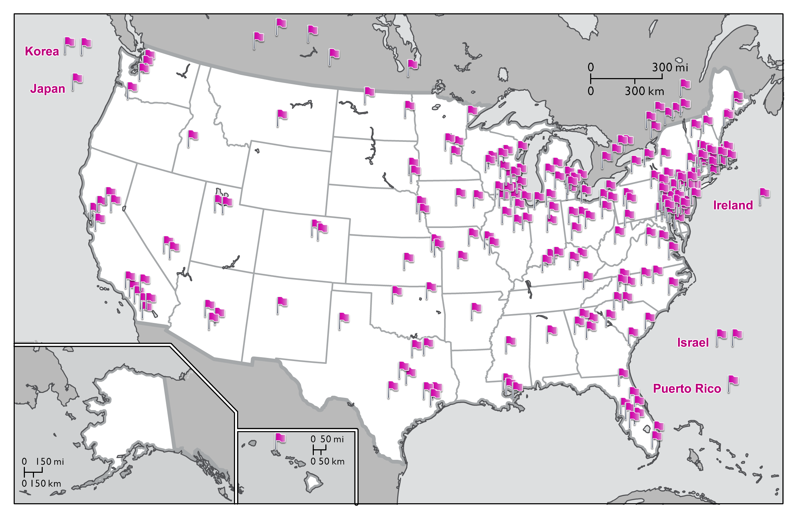
NRG Oncology Main Member, LAPS, and
NCORP Institutions as of December 2019
China
Singapore
Switzerland
Australia

Slide 5
NRG Networks
Lead Academic Performance Sites (LAPS) 32
National Community Oncology
Research (NCORP) Sites 29
Minority/Underserved NCORP Sites 11
Other Centers 125
Total 197

Slide 6
NRG Oncology Accrual by Network Category January 1 – December 31, 2019
NCORP &
M/U NCORP
27%
LAPS
33%

Slide 7
Top Accruing Main Members NRG Oncology Trials January 1 – December 31, 2019
Seoul National University Hospital
University Health Network-Princess Margaret Hospital
Sun Yat-sen University Cancer Center
CHU de Quebec-L’Hotel-Dieu de Quebec (HDQ)
University of Maryland/Greenebaum Cancer Center
Women and Infants Hospital
6. University of Cincinnati / Barrett Cancer Center
University of Iowa / Holden Comprehensive Cancer Center
7. UC San Diego Moores Cancer Center
8. The US Oncology Network
Loyola University Medical Center

Slide 8
Top Accruing Lead Academic Participating Sites (LAPS) NRG Oncology Trials January 1 – December 31, 2019
University of Oklahoma Health Sciences Center LAPS
CWRU Case Comprehensive Cancer Center LAPS
Washington University – Siteman Cancer Center LAP
Wayne State University – Karmanos Cancer Center LAPS
University of Texas MD Anderson Cancer Center LAPS
University of Texas Southwestern Medical Center LAPS
Memorial Sloan – Kettering Cancer Center LAPS
Thomas Jefferson University Hospital LAPS
Ohio State University Comprehensive Cancer Center LAPS
Dana-Farber / Partners CancerCare LAPS
Mayo Clinic LAPS
University of Michigan Comprehensive Cancer Center LAPS

Slide 9
Top Accruing NCI Community Oncology Research Program (NCORP) NRG Oncology Trials January 1 – December 31, 2019
1. Kaiser Permanente NCI Community Oncology Research Program
Southeast Clinical Oncology Research Consortium NCORP
Heartland Cancer Research NCORP
Metro Minnesota Community Oncology Research Consortium
Delaware/Christiana Care NCI Community Onc Research Program
6. New Mexico Minority Underserved NCORP
7. University of Kansas Cancer Center – MCA Rural MU NCORP
Pacific Cancer Research Consortium NCORP
8. Georgia NCI Community Oncology Research Program
Michigan Cancer Research Consortium NCORP

Slide 10
Top Accruing Non-US Sites NRG Oncology Trials January 1 – December 31, 2019
1. University Health Network-Princess Margaret Hospital
2. Sun Yat-sen University Cancer Center
3. CHU de Quebec-L'Hotel-Dieu de Quebec (HDQ)
4. Centre Hospitalier Universitaire de Sherbrooke-Fleurimont
5. Odette Cancer Centre- Sunnybrook Health Sciences Centre
6. Seoul National University Bundang Hospital
7. Fudan University Shanghai Cancer Center
The Research Institute of the McGill University Health Centre
Gangnam Severance Hospital
8. Allan Blair Cancer Centre

Slide 11
Voting Members
Voting Members shall be those Main Members that accrue at least 25 patients per year either as an average over (3) years or in the most recently completed calendar year and meet data timeliness and quality requirements

Slide 12
2020 New Voting Members
Boston Medical Center
Georgia Cares Minority Underserved NCORP
Gulf South Minority Underserved NCORP
Henry Ford Hospital
Iowa-Wide Oncology Research Coalition NCORP
Lahey Hospital and Medical Center
Moffitt Cancer Center
Northwestern University LAPS
Pacific Cancer Research Consortium NCORP
Parkview Regional Medical Center

Slide 13
2020 New Voting Members
Rhode Island Hospital
Rush University Medical Center
Rutgers Cancer Institute of New Jersey
Stony Brook University Medical Center
Sun Yat-sen University Cancer Center
UC Irvine Health/Chao Family Comprehensive Cancer Center
UC San Diego Moores Cancer Center
USC Norris Comprehensive Cancer Center LAPS
Western States Cancer Research NCORP

