Slide 1
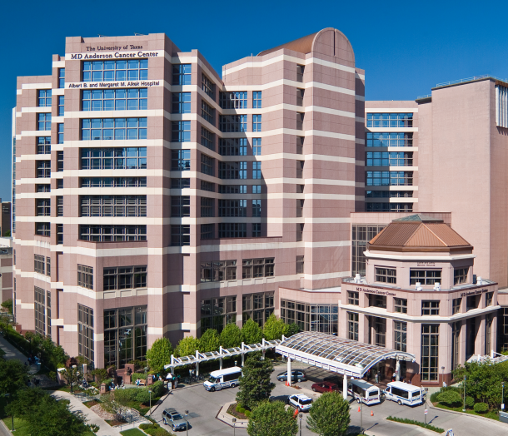
NRG LU007: Randomized phase II/III study of EP + Atezo +/- consolidation RT for ES-SCLC (RAPTOR)
Quynh Nguyen M.D.
Associate Professor, Department of Radiation Oncology
James Welsh M.D.
Associate Professor, Department of Radiation Oncology
John Heymach, M.D., Ph.D. Chair, Dept. of Thoracic/Head and Neck Medical Oncology
David Bruton, Jr. Chair in Cancer Research
NRG July 17, 2020

Slide 2
Rationale for the study
Chest RT prolongs PFS, improves 2Y survival, and reduces chest recurrences by more than 50% when given after chemo in ES SCLC in patients with non-PD, and is considered a SOC¹
Data suggests RT to extrathoracic sites may provide additional benefit
Atezo+EP followed by atezo is now a standard for ES SCLC
Atezo+chemo can be given safely with chest RT for stage 3 NSCLC (Deterred study²)
Pembro + RT can be given safely for ES SCLC (Tames study³)
RT may enhance efficacy of PD1/PD-L1 blockade
1. Slotman et al., Lancet 2015
2. Lin et al., JTO 2019
3. Welsh et al., JTO 2019

Slide 3
Slotman 2015 Role of thoracic RT in ES-SCLC
2009 to 2012
Randomize
Primary endpoint
- Overall survival @ 1 yr
- Intention-to-treat
Secondary endpoints
- Local control
- Pattern of failure
- PFS
- Toxicity
PCI + Thoracic RT
30 Gy/10 fx
n=247
498 ES-SCLC pts
- PS 0-2
- Any response to EP
- “acceptable” radiation fields
- no brain, pleural mets, or LMD
PCI alone
n=248
All patients:
PCI (20Gy/5fx, 25Gy/10fx, 30Gy/10,12 or 15fx)
Cis/Etoposide x 4-6 cycles
“in accordance with local policy”
Chemo response not centrally reviewed
7% of patients were ES by bulk of intrathoracic dz alone
Stratified by:
Institution (42)
+/- intrathoracic disease
Slotman BJ et al; Lancet 2015

Slide 4
Clinical outcome for TRT in ES-SCLC
OS
PFS
2 yr OS: 13% TRT vs 3% control (p=0.004)
PFS at 6 months was 24% TRT vs 20% no TRT group (p=0.001)
Secondary analysis showed < 3 sites distant metastases experienced largest benefit TRT
Thoracic radiotherapy in addition to prophylactic cranial irradiation should be considered for all patients with ES-SCLC who respond to chemotherapy
Slotman BJ et al; Lancet 2015
Notes:
Progression was less likely in the thoracic radiotherapy group than in the control group (HR=0·73, 95% CI 0·61–0·87, p=0·001; figure 4). Progression-free survival at 6 months was 24% (95% CI 19–30) for the thoracic radiotherapy group and 20% (95% CI 16–26) in the control group (p=0·001). Median progression-free survival was 4 months for the thoracic radiotherapy group and 3 months for the control group. In a test for interaction of factors with treatment, there was no significant difference in the effect of thoracic radiotherapy on progression-free survival for presence of intrathoracic disease at randomisation (p=0·11), sex (p=0·12), age (p=0·19), response to chemotherapy (p=0·92), WHO performance score (p=0·94), and extent of disease (p=0·78).
Isolated intrathoracic progression was rarer in the thoracic radiotherapy group (n=49, 19·8%) than in the control group (n=114, 46·0%, p<0·0001). Intrathoracic progression either with or without progression elsewhere occurred in 108 (43·7%) in the thoracic radiotherapy group versus 198 (79·8%) in the control group (p<0·0001). Brain metastases occurred in 24 (9·7%) versus 13 (5·2%; p=0·09), and disease progression at other sites occurred in 149 (60·3%) versus 100 (40·3%; p<0·0001). Table 3 shows patterns of progression. We considered progression occurring at different organ sites within 30 days as simultaneous progression. The thorax was the first site of disease progression for 103 (41·7%) patients in the thoracic radiotherapy group versus 193 (77·8%) in the control group (p=0·009).

Slide 5
Phase I trial of pembrolizumab plus RT after induction chemotherapy for ES SCLC (TAMES¹)
Part B
ES SCLC after first line platinum chemo (up to 6 cycles)
-PCI allowed
N=33 evaluable
Thoracic radiation +
Pembro Q3w
TRT 15 fx, 45 Gy, boost allowed
Adjuvant pembro
Results:
-Well tolerated
-No grade 4/5 SAE
-6% with GR 3 (astenia, paresthesia, autoimmune AE)
-median PFS 6.1m (CI 4.1-8.1)
-median OS 8.4 m (CI 6.7-10.1m)
1. Welsh et al., JTO 2019

Slide 6
IMPOWER133: the addition of atezolizumab to carbo/etoposide prolongs OS and PFS in ES SCLC
Median OS was 12.3 months in the atezo group and 10.3 months in the placebo group (HR=0.70; 95% CI, 0.54 to 0.91; P=0.007)
Median PFS was 5.2 months in the atezo group and 4.3 months in the placebo group (HR=0.77; 95% CI, 0.62 to 0.96; P=0.02)
Atezolizumab + carboplatin/etoposide consistent with previously reported safety profile
Horn et al., NEJM 2018

Slide 7
Proposed NRG-LU007 RAPTOR: RAndomized Phase II Trial of Consolidation Radiation + Immunotherapy for ES-SCLC
Arm 1:
XRT up to 5 RT sites, 30-45 Gy
+
atezolizumab
ES-SCLC with SD/PR after 4-6 cycles of carbo/cis + etoposide + atezolizumab
Phase II: N=138
Phase III: N= 324 total
(including phase II patients)
Atezolizumab maintenance
Q3W
R*
Arm 2:
Atezolizumab maintenance
Q3W
PRIMARY ENDPOINTS:
Phase II: PFS
Phase III: OS
Stratified: # RT sites (1-3 fields vs >3), partial response (PR) vs stable disease (SD), ECOG (0/1 vs 2)
PCI optional with consolidation, MRI after induction chemo, co enrollment SWOG S1827 encouraged
Can radiate symptomatic sites prior enrollment (i.e. bone mets, or WBRT)
Nguyen/Welsh/Heymach
Notes:
3.1 Eligibility Criteria
A patient cannot be considered eligible for this study unless ALL of the following conditions are met.
3.1.1 Pathologically (biopsy) proven diagnosis of extensive stage small cell lung cancer;
3.1.2 Partial response (PR) or stable disease (SD) after 4-6 cycles of etoposide/platinum (E/P) doublet plus atezolizumab within 6 weeks of completion of last cycle of chemotherapy or completion of PCI;
3.1.3 Patients must have had measurable disease (per RECIST) after chemotherapy and prior to randomization and 3 or fewer observable liver metastases and no histology-confirmed malignant pleural effusions.
3.1.4 Appropriate stage for study entry based on the following diagnostic workup:
• History/physical examination within 60 days prior to registration;
• Imaging to include MRI brain with contrast or Brain CT with contrast, CT chest, abdomen and pelvis, or PET/CT scan after the final cycle of chemotherapy and within 6 weeks prior to registration;
• Sufficient lung function with FEV1 ≥ 0.8 Liter or ≥ 35% predicted and DLCO ≥ 40% with or without bronchodilator within 30 days prior to registration;
3.1.5 Age ≥ 18;
3.1.6 ECOG Performance Status of 0-2 at the time ofregistration;
3.1.7 Laboratory Values within 14 days prior to registration:
Leukocytes
≥2,500/mcL
ANC ≥1,500/cells/mm3
Platelets ≥100,000 cells/mm3
Hemoglobin ≥8 g/dL
Total Bilirubin ≤1.5 x ULN
AST (SGOT) and ALT (SGPT) ≤3.0 x ULN (AST and/or ALT ≤5 ULN for patients with liver involvement)
Alkaline phosphatase ≤2.5 × ULN (≤5 ULN for patients with documented liver involvement or bone metastases)
Creatinine clearance:
CrCl (mL/min) =
[140 – age (years)] x weight (kg)
72 x serum creatinine (mg/dL) x 0.85 for female patients
3.1.8 Upfront central nervous system (CNS) radiotherapy for treatment of brain metastases is permitted provided there is no evidence of CNS progression at the time of randomization and patients are clinically stable on a dose of steroids <10 mg prednisone a day or equivalent. Upfront radiation therapy of symptomatic metastatic site is permissible if causing patient pain or impending fracture.
3.1.9 The patient or a legally authorized representative must provide study-specific informed consent prior to study entry.

Slide 8
Proposed NRG-LU007 RAPTOR study: endpoints
Primary Endpoints:
Phase II: to PFS between RT vs control arms, N=138
Phase III: To compare OS between RT vs control arms, N=324
Secondary Endpoints:
Toxicity
PFS and OS benefit in subgroups with 1-3 vs >3 tumors and RT all visible sites some visible sites
Statistical plan
Phase II: improvement of 6m PFS rate from 21% to 38% to warrant continuing to phase III
Phase III: 80% power to detect an improvement in 12m OS rate from 51% to 63% at 1-sided significance level of 0.025
Notes:
For the phase II portion, we hypothesize an improvement of 6-month PFS rate from approximately 21% to 38%to warrant continuing to the phase III study. The sample size of the phase II portion is 138 eligible patients. With at least 118 PFS events, the phase II portion provides at least 95% power to detect such an improvement at a 1-sided significance level of 0.15. The choice of type 1 and 2 errors may be justified by viewing
NRG-LU00770Version Date: TBDthe phase II portion as a randomized phase II screen design (Rubinstein et al,2005). The study will proceed into the phase III portion only after the planned interim analyses have shown that arm 2 has a positive effect on both PFS and OS. The overall sample size of phase II/III study (including the 138 accrued in the phase II portion) is 324 (308 eligible patients after guarding against ineligibility or lack-of-data rate of up to 5%). The final analysis for OS will occur when at least 251 deaths (full OS information) have been observed. The overall study will provide at least 80% power to detect an improvement of 12-month OS rate from approximately 51% to 63% at a 1-sided significance level of 0.025.

Slide 9
Proposed NRG-LU007 RAPTOR study: exploratory endpoints
Exploratory:
Association between pre-treatment tumor burden and PFS and OS benefit with treatment
PFS benefit in low and high blood tumor mutational burden (TMB) subgroups
Association between pre-treatment plasma ctDNA levels and clinical benefit
Changes in T cell repertoire induced by radiotherapy
*Association between SCLC molecular subgroups and clinical benefit (in development).

Slide 10
Inclusion criteria
Pathologically proven diagnosis of ES-SCLC
PR or SD after 4-6 cycles of carbo/cis + etoposide + atezolizumab within 9 weeks of last dose of chemotherapy or 6 weeks from completion of PCI
Patients must have had measurable disease (RECIST) after chemotherapy and prior to randomization and 3 or fewer observable liver metastases
Imaging include MRI brain with contrast or Brain CT with contrast, CT chest, abdomen and pelvis, or PET/CT scan after the final cycle of chemotherapy + 6 wks prior to registration
Pleural effusion if thoracentesis is negative of if too small sample w/thoracentesis or PET/CT negative
Age ≥ 18
ECOG Performance Status of 0-2 at the time of registration
Laboratory values within 14 days prior to registration
ANC ≥1,500/cells/mm3
Platelets ≥100,000 cells/mm3
Hemoglobin ≥8 g/dL
Total Bilirubin ≤1.5 x ULN
AST (SGOT) and ALT (SGPT) ≤3.0 x ULN (AST and/or ALT ≤5 ULN for patients with liver involvement)
Alkaline phosphatase ≤2.5 × ULN (≤5 ULN for patients with documented liver involvement or bone metastases)
Adequate renal function: serum creatinine ≤1.5 x ULN

Slide 11
Exclusion criteria
Metastatic disease invading the liver (>3 metastases), pleura, heart or >10 metastatic sites after induction systemic therapy
PriPrior thoracic or mediastinal radiation or metastatic site region of study
Prior invasive malignancy
(except non-melanomatous skin cancer) unless disease free for 5 year prior to randomization)
History of autoimmune disease
(including systemic lupus erythematosus, inflammatory bowel disease, vascular thrombosis associated with antiphospholipid syndrome, Wegener’s granulomatosis, Sjögren’s syndrome , Guillain-Barré syndrome, multiple sclerosis, vasculitis, or glomerulonephritis).
Severe co-morbidity
(severe liver, renal, COPD, cardiac morbities)
History of recent myocardial infarction
History of allogeneic organ transplant
Patients who have had immunotherapy induced pneumonitis.

Slide 12
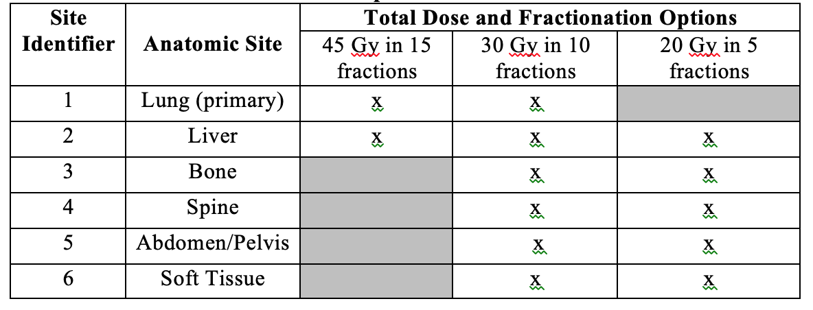
Radiation Technique
3D-Conformal Radiation (3DCRT) or Intensity Modulated RT (IMRT) allowed, Image Guided Radiation Therapy (IGRT) is required.
Standard RT up to 5 lesions in thorax, liver, bone, spine, abdomen/pelvis, soft tissue.

Slide 13
Assessments
Pre-treatment
During treatment
Assessments | Prior to Treatment
History, Physical & Vital Signs* | Within 14 days prior to registration
CT of the chest, abdomen and pelvis or PET/CT | After the last cycle of chemotherapy and within 42 days prior to registration
Brain MRI with contrast or Brain CT with contrast | After the last cycle of chemotherapy and within 42 days prior to registration
CMP (to include AST, ALT, bilirubin, creatinine) and CBC with differential (to include ANC, platelets, hemoglobin) | Within 14 days prior to registration
Serum Pregnancy Test (if applicable) | Within 14 days prior to registration
ECOG Performance Status | Within 14 days prior to registration
Biospecimen Collection: Tissue, plasma and peripheral blood for future exploratory analyses – see Section 10 for details | X
Assessments | Every cycle – Arm 1 and Arm 2
History, Physical & Vital Signs* | X
ECOG Performance Status | X
CMP** | X
CBC with differential† | X
TSH with reflex to T4, then T3 as clinically indicated | Every 3 cycles
MRI or CT brain | Every 3-4 mo. x 1 yr. then every 6 mo. during yr. 2
CT or PET/CT of the chest , abdomen and pelvis; MRI or CT scan of additional metastatic sites | Every 2 cycles for the first 12 cycles, then every 3 cycles thereafter.
Adverse event evaluation | X
Optional Biospecimen Collection: Serum, whole and peripheral blood for future exploratory analyses | Cycle 3 of atezolizumab, prior to treatment +/- one week

Slide 14
Correlatives
Blood collection: baseline, post-RT (C3D1), and at PD
plasma for ctDNA: VAF, TMB and specific mutations/subgroups
TCR sequencing to assess impact of consolidation of TCR clonality and immune response
Serum
Baseline tumor tissue (FFPE):
Association between SCLC subgroups and benefit (in development)

Slide 15
Discussion

