Slide 1
NRG-HN004: Randomized Phase II/III Trial of Radiotherapy with Concurrent Durvalumab vs. Radiotherapy with Concurrent Cetuximab in Patients with Stage III-IVB Head and Neck Cancer with a Contraindication to Cisplatin
Loren K. Mell, M.D.
Professor and Vice Chair, Clinical & Translational Research
UC San Diego Dept. of Radiation Medicine
La Jolla, California
NRG Oncology Virtual Summer Meeting
July 17, 2020
@NRGOnc
NRG Oncology

Slide 2
Trial Rationale
Optimal Treatment for Cisplatin-Ineligible HNC Population is Unclear
RT/Cetuximab is Standard, but Effectiveness in this Population is Controversial
PD-L1 Inhibitors are Safe in this Population, May be Better Tolerated and More Effective than Cetuximab

Slide 3
Phase II/III Schema

Slide 4
Endpoints & Accrual
Primary Endpoints:
Phase I: Safety
Phase II: PFS
Phase III: OS
Secondary Endpoints:
Patterns of Failure
QOL
Biocorrelates
P16 status in OPX & non-OPX patients
Effect of durvalumab by PD-L1 status
Serial PBMC specimens
Target Accrual
Lead-In: 10 (Completed)
Phase II: 234-260 (Ongoing)
Phase III: 210-233

Slide 5
Dosing Scheme, Target Accrual
Durvalumab:
2 Weeks Prior to RT: Durvalumab 1500 mg
Concurrent with RT: Durvalumab 1500 mg on Weeks 2* and 6
Following RT: Durvalumab 1500 mg every 4 Weeks x 4 cycles
*NOTE: 3 weeks between dose 1 and 2, then every 4 weeks
Cetuximab:
1 Week Prior to RT: 400 mg/m² loading dose
Concurrent with RT: 250 mg/m² weekly

Slide 6
Key Eligibility Criteria
Inclusion Criteria | Exclusion Criteria
Stage III-IVB previously untreated HNSCC larynx, HPX, or (unresectable) OC | Excludes favorable risk P16+ OPX, CUP
Stage III & selected Stage I-II OPX, CUP (AJCC 8th ed.) | Prior radiation, chemotherapy, or immunotherapy
Must have contraindication(s) to cisplatin Age >= 70 – at least 1 contraindication Age < 70 – 2 or more contraindications See comogram.org | Active autoimmune disease
Mandatory tissue submission Pre-Hoc P16 testing required for OPX/CUP, for stratification & eligibility Post-Hoc P16 testing for everyone | ECOG Status ≥ 3

Slide 7
Key Milestones & Anticipated Timelines
Phase I Status:
Activated December 2017; Closed June 2018
Phase I results reported at ASCO 2019
Safety & Feasibility Confirmed
Phase II Status:
Activated April 2019
Accrual: 102 (~7 per month)
Projected Completion: March 2023
Biocorrelates:
Tumor and serial blood / PBMC samples, pending analysis

Slide 8
Peripheral Blood Collection
Collected at 4 Time Points:
Baseline
Post-Systemic Therapy / Pre-Radiation
End of Radiation
End of All Therapy
166 Total Samples
63 individual patients
22% hemolyzed, 13% non-viable (learning curve)
10 with all 4 timepoints
39 with at least 2 timepoints including baseline

Slide 9
NRG HN004 Study Team
Loren K. Mell, MD University of California San Diego | PI / Radiation Oncology
Stuart Wong, MD Medical College of Wisconsin | Med. Oncology
Steven S. Chang, MD, FACS Henry Ford Cancer Institute | Surg. Oncology
Julie A. Kish, MD Moffitt Cancer Center | Sr. Adult Oncology
Andy Minn, MD, PhD University of Pennsylvania | Translational
Richard Jordan, DDS, PhD University of California San Francisco | Pathology
Minh Tam Truong, MD Boston Medical Center | Quality of Life
Tian Liu, PhD, DABR Emory University | Physics
Pedro Torres-Saavedro, PhD NRG Oncology | Statistics
Jonathan Harris, MS NRG Oncology | Supporting Statistician
Thien Nu Do NRG Oncology | Protocol Development
Nancy Linnemann, BS,RT(R)(T) NRG Oncology Marsha Radden, AS, RT(R)(T),CMD NRG Oncology | Core RT Services / Dosimetrists
Vanita Patel, MS NRG Oncology | Clinical Data Coordinator
Erin Moye NRG Oncology | Clinical Research Project Specialist

Slide 10
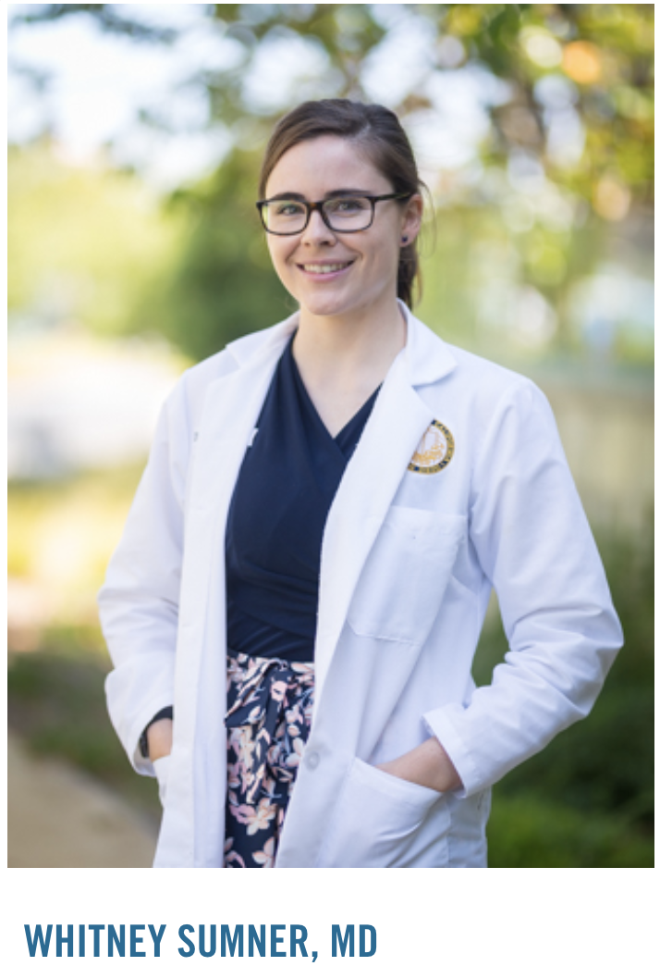
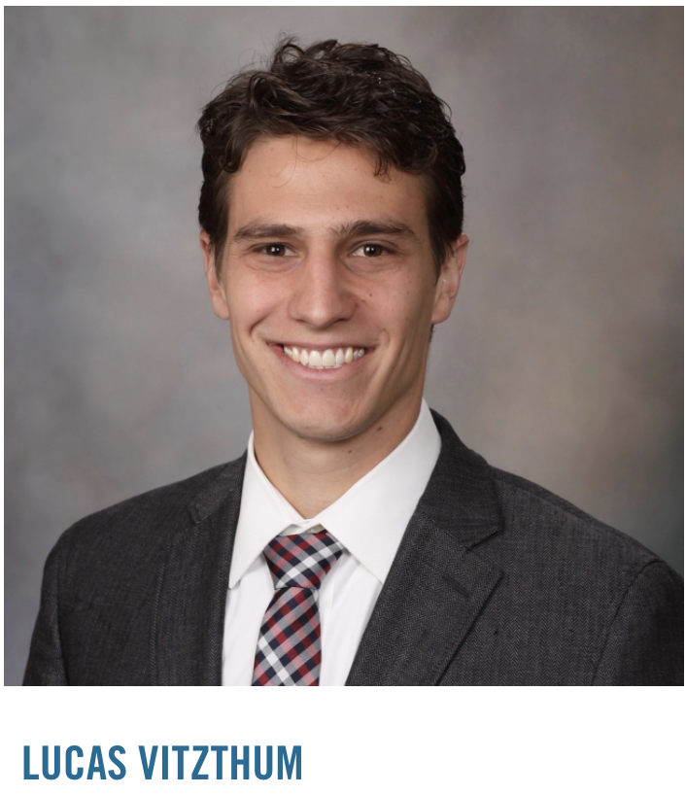
Mell Lab at UC San Diego

Slide 11
Data
Characteristic | n | %
Primary site
Oropharynx, P16+ | 6 | 60.0
Oropharynx, P16- | 2 | 20.0
Larynx | 2 | 20.0
T category (AJCC 7th)
T1-T2 | 5 | 50.0
T3-T4 | 5 | 50.0
N category (AJCC 7th)
N0-N1 | 2 | 20.0
N2-N3 | 8 | 80.0
Comorbidity / Frailty Indices
Charlson Comorbidity Index ≥ 1 | 6 | 60.0
ACE-27 ≥ 1 | 10 | 100.0
⍵ Score < 0.80 | 10 | 100.0
G-8 ≤ 14 | 7 | 70.0
CARG ≥ 30% | 1 | 10.0
CIRS-G ≥ 4 | 5 | 50.0
Creatinine Clearance < 60 mL/min | 0 | 0.0
Peripheral Neuropathy | 4 | 40.0
Hearing Loss | 3 | 30.0
Characteristic | n | %
Age (years)
≤ 49 | 1 | 10.0
50 - 59 | 0 | 0.0
60 - 69 | 6 | 60.0
≥ 70 | 3 | 30.0
Gender
Male | 9 | 90.0
Female | 1 | 10.0
Ethnicity
Hispanic or Latino | 0 | 0.0
Not Hispanic or Latino | 10 | 100.0
Unknown or not reported | 0 | 0.0
Zubrod performance status
0 | 4 | 40.0
1 | 6 | 60.0

Slide 12
System Organ Class |  | n and (%) of Patients by Grade
 |  | 1 | 2 | 3 | 4 | 5
Overall Highest Grade |  | 0 | 6 | 4 | 0 | 0
 |  | (0.0) | (60.0) | (40.0) | (0.0) | (0.0)
Ear and labyrinth disorders |  | 1 | 1 | 0 | 0 | 0
 |  | (10.0) | (10.0) | (0.0) | (0.0) | (0.0)
Gastrointestinal disorders |  | 2 | 4 | 4 | 0 | 0
 |  | (20.0) | (40.0) | (40.0) | (0.0) | (0.0)
General disorders and administration site conditions |  | 3 | 5 | 0 | 0 | 0
 |  | (30.0) | (50.0) | (0.0) | (0.0) | (0.0)
Infections and infestations |  | 0 | 1 | 1 | 0 | 0
 |  | (0.0) | (10.0) | (10.0) | (0.0) | (0.0)
Injury, poisoning and procedural complications |  | 5 | 3 | 0 | 0 | 0
 |  | (50.0) | (30.0) | (0.0) | (0.0) | (0.0)
Metabolism and nutrition disorders |  | 0 | 3 | 2 | 0 | 0
 |  | (0.0) | (30.0) | (20.0) | (0.0) | (0.0)
Musculoskeletal and connective tissue disorders |  | 0 | 0 | 1 | 0 | 0
 |  | (0.0) | (0.0) | (10.0) | (0.0) | (0.0)
Nervous system disorders |  | 3 | 1 | 0 | 0 | 0
 |  | (30.0) | (10.0) | (0.0) | (0.0) | (0.0)
Psychiatric disorders |  | 1 | 1 | 1 | 0 | 0
 |  | (10.0) | (10.0) | (10.0) | (0.0) | (0.0)
Renal and urinary disorders |  | 0 | 0 | 1 | 0 | 0
 |  | (0.0) | (0.0) | (10.0) | (0.0) | (0.0)
Respiratory, thoracic and mediastinal disorders |  | 3 | 3 | 2 | 0 | 0
 |  | (30.0) | (30.0) | (20.0) | (0.0) | (0.0)

