Slide 1
NRG-HN008: Phase 1 trial with expansion cohort of DNA-PK inhibition and IMRT in cisplatin-ineligible patients with stage 3-4 local-regionally advanced HNSCC
Maura Gillison MD, PhD
Michael Samuels, MD
NRG Oncology Virtual Summer Meeting
July 17, 2020
@NRGOnc
NRG Oncology

Slide 2
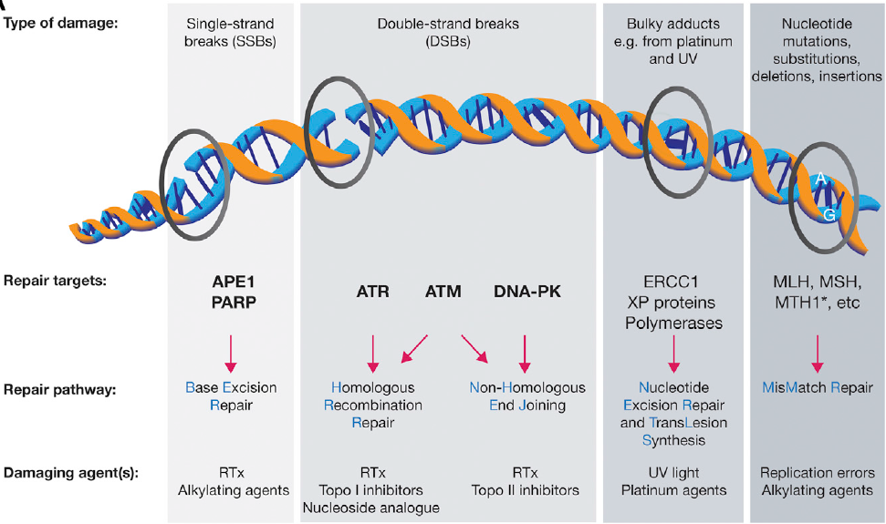

Slide 3
EVENTUAL GOAL: Randomized Phase 2 trial of DNA-PK inhibition or cisplatin with PD-L1 checkpoint blockade vs. cisplatin and IMRT in stage 3-4 local-regionally advanced HPV-negative HNSCC with a Phase I safely lead-in Maura Gillison, MD, PhD Michael Samuels, MD
ELIGIBILITY
High risk SCCa oral cavity, p16-oropharynx, larynx, hypopharynx
T2-3N1-N3 or T4N0-3 (excluding T2N1)
ECOG PS 0-1
Normal renal function, labs, no prior therapy for SCCHN
N=285
Arm 1 **M3814 QD M-F during RT +
Avelumab 10 mg/kg Q 2 wks from day -14 for 6 months +
IMRT 70 Gy/35 fx/7 weeks
Randomization
95 pts
Arm 2 Cisplatin 100 mg/m2/q3wks X 3 +
Avelumab 10 mg/kg Q 2 weeks from day -14 for 6 months +
IMRT 70 Gy/35 fx/7 weeks
Stratification:
T-stage
N-stage
Tumor site
95 pts
Primary Objective
1 year PFS
Secondary Objectives:
Acute toxicity at 3 mos
Late toxicity at 6 mos, 1 and 2 yrs
OS at 1 and 2 yrs
95 pts
Arm 3 Control
Cisplatin 100 mg/m2/q3wks X 3 +
IMRT 70 Gy/35 fx/7 weeks
Statistics: Sample size of 285 with provides 80% power for 10% improvement in 1-year PFS (HR 0.67) in Arm 1 or Arm 2 vs Arm 3 control, 86 eval pts per arm adjusted for 10% loss, 1-sided alpha 0.10.
**Preceded by safety lead-in using the MTD from a prior phase I study of cis/RT/M3814

Slide 4
CURRENT TRIAL IN DEVELOPMENT: NRG HN008: Phase 1 trial with expansion cohort of DNA-PK inhibition with PD-L1 checkpoint blockade and IMRT in cisplatin-ineligible patients with stage 3-4 local-regionally advanced HNSCC
ELIGIBILITY
High risk SCCa oral cavity, p16- oropharynx, larynx, hypopharynx
T2-3N1-N3 or T4N0-3 (excluding T2N1)
p16+ oropharynx T4N0-3 or T1-4N2-3
ECOG PS 0-1
Contraindication to cisplatin (renal, neuropathy, hearing)
Peposertib dose escalation:
DL4
250 mg
Avelumab:
800 mg fixed dose IV q2 wks x 1 year
IMRT:
70 Gy/35 fxs
DL3
200 mg
RP2D determined by SMC
DL2
150 mg
DL1*
100 mg (possible dose de-escalation to 50 mg)
Primary Objectives
Safety of peposertib/RT
Determine RP2D
Secondary Objectives:
Rates of gr 3 acute and late toxicity
Clinical RR at 3 mos by RECIST
PFS at 6 mos and 1 year
Statistics:
Bayesian optimal interval (BOIN) design to determine MTD of peposertib + IMRT
Patients enrolled in cohorts of 6
Maximum of 30 subjects in dose-finding portion
Acute DLT observation period is 28 days after IMRT completion
Once MTD is determined, then up to 12 additional subjects will be accrued to the expansion cohort

Slide 5
DLT definitions
Any Grade 3 or greater adverse event that is definitively or probably related to peposertib irrespective of relationship to RT and occurs during the specified observation window (up to 28 days from IMRT completion). AEs will be graded according to NCI CTCAE version 5.0. The following common toxicities of radiotherapy are excluded from the DLT definition:
Grade 3 mucositis
Grade 3 or 4 neutropenia (≤5 days duration) and not associated with fever
Grade 3 radiation dermatitis
Grade 3 or 4 nausea or vomiting (<3 days duration) with adequate and optimal therapy
Grade 3 dysphagia
Grade 3 pain within the treated field
Grade 3 fatigue or headache (<7 days duration) following initiation of adequate supportive care

Slide 6
DLT exclusions, cont.
Grade 3 or 4 asymptomatic lipase amylase elevation
Isolated Grade 3 or 4 lymphocytopenia without clinical sequelae
Grade 3 thrombocytopenia without bleeding
Any other single laboratory values out of the normal range that have no clinical significance

Slide 7
Study Duration
Anticipated activation by: October 19, 2020
Predicted accrual rate is 4 subjects/month based on the lead-in from HN004.
Overall study duration is expected to be about 3 years, but this will depend on how many dose levels are required for RP2D.

