Slide 1
Embedding PROs in the EMR: The Potential of Smart Devices to Impact Cancer Outcomes – SIMPRO Research Center
Hannah W. Hazard-Jenkins, MD FACS
Director of Clinical Services
West Virginia University Cancer Institute

Slide 2
Disclosures
National Institutes of Health / National Cancer Institute
UM1CA233080 funding

Slide 3
Current System
Healthcare is by-in-large reactive, not proactive
Communication between physician and patient is usually limited to face to face encounters with relative draught between visits
Focus at these visits is often on treatment decisions and not on symptoms and quality of life
Patient’s voice is inadequate in the current system

Slide 4
Patient Reported Outcome (PRO)
FDA “a measurement based on a report that comes directly from the patient about the status of a patient’s health condition without amendment or interpretation of the patient’s response by a clinician or anyone else”
PRO Task Force of the National Patient Centered Clinical Research Network agreed to the above definition in their consensus statement of 2015 but added that a proxy reporter may be necessary in certain situations
Most experience in PRO is with research and paper

Slide 5
PRO in Clinical Practice
Landmark paper in 2017 by Basch et al started the push to move PRO into clinical practice and not just research
Randomization of patients initiating chemotherapy for metastatic solid tumors 9/07 – 1/11
Randomized patients to usual care or asking 12 symptoms of the NCI Common Terminology Criteria for Adverse Events
Filled out at each apt and between apts with online web-based PRO questionnaire
If a severe or worsening event was reported it triggered an email to the nurse
766 patients enrolled
Nurse response rate of 77% in intervention group
Mean age was 61 (26-91)
86% white; 58% women; 22% less than HS degree; 30% inexperienced in computers
Median follow up 7 years
Median OS in PRO was 31.2m v 26m (Standard 95% CI 22.1-30.9, p=0.03)
Maintained in multi-variant analysis with HR of 0.83 (p=0.04)

Slide 6
Healthcare Policies, to date
2015 US Center for Medicare and Medicaid Innovation launched OCM (Oncology Care Model)
Early iteration required PRO-based quality metrics and vendors got on board
Removed as a requirement in 2016 resulted in near abandonment by vendors
21st Century Cures Act signed into law 12/2016
Demanded the creation of the Oncology Center of Excellence within the FDA mandating
the law builds on FDA's ongoing work to incorporate the perspectives of patients into the development of drugs, biological products, and devices in FDA's decision-making process
“measurement of the patient experience” for patient centered drug development
https://www.fda.gov/regulatoryinformation/lawsenforcedbyfda/significantamendmentstothefdcact/21stcenturycuresact/default.htm

Slide 7
Electronic PRO (ePRO)
They have been shown to decrease symptom burden, improve quality of life, reduce acute care and extend survival
Why?
Engages patients to be more knowledgeable and effect a self-management process
Can trigger between visit physician actions that improve symptoms
ePRO effectiveness is limited to major cancer centers
ePRO gaps
Most ePRO systems are not fully integrated into the EMR
ePRO systems have not worked toward effecting symptom coaching strategies
Clinical staff by-in
Work flow adaptation

Slide 8
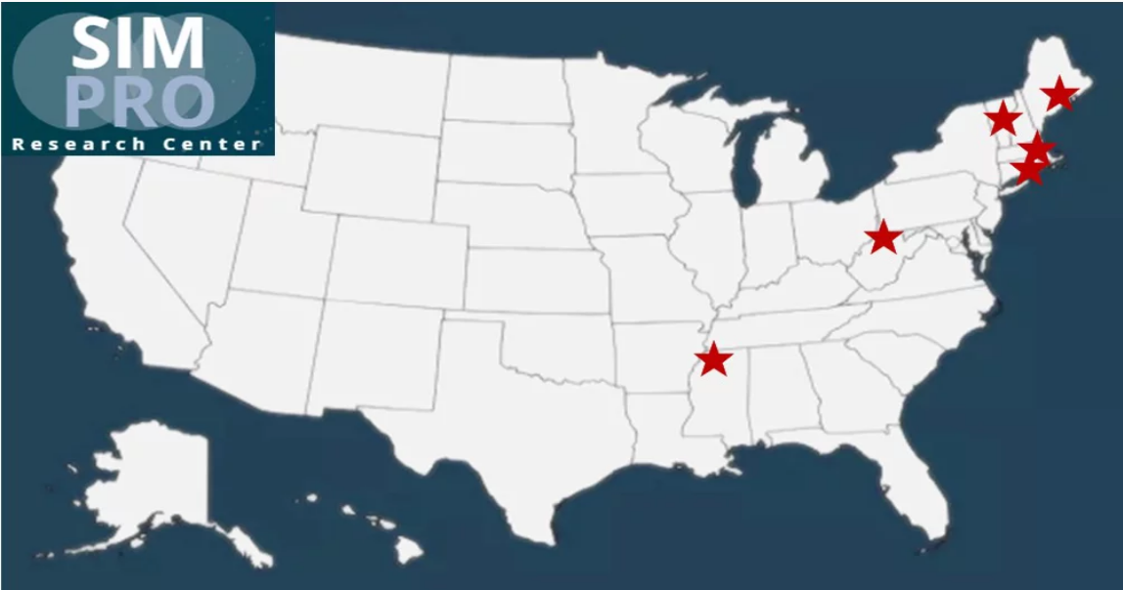
Seven Participating Health Systems:
Dana-Farber/Brigham and Women’s Cancer Center & DFCI @ South Shore Hospital
Dartmouth-Hitchcock
Baptist Memorial
Maine Medical Center
Lifespan/Rhode Island Hospital
West Virginia University Cancer Institute
University of North Carolina

Slide 9
Overall Research Goals
Create and refine eSyM – reporting and management system integrating ePROs with HER
Evaluate the impact of eSyM on patient outcomes, treatment delivery, and healthcare system utilization using a pragmatic cluster randomized study design
Undertake a systematic, deliberative approach to implementation to allow for the identification of barriers and facilitators that contribute to the adoption and sustainability of eSyM

Slide 10
Population studied

Slide 11
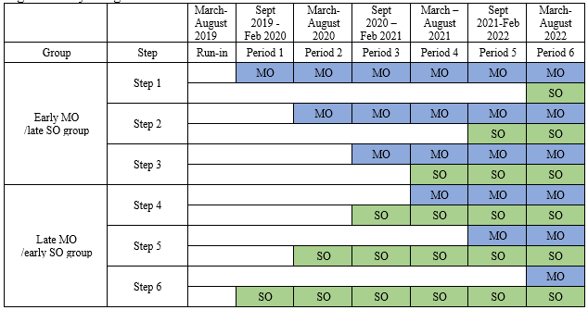
Baptist
Maine
DF/BW @ South Shore & Milford
Lifespan
Dartmouth
WVU

Slide 12
Symptom Item | Med Onc | Surg Onc
Pain | • | •
Nausea | • | •
Vomiting | • | •
Diarrhea | •
Constipation | • | •
Shortness of breath | • | •
Wound redness |  | •
Wound discharge |  | •
Overall well being | • | •
Other | • | •
Fatigue | • | •
Anxiety | • | •
Rash | •
Trouble drinking fluids | • | •
Numbness and tingling | •
Poor appetite | • | •
Trouble urinating |  | •
Physical function | • | •
To reduce patient survey burnout:
Keep the overall number of questions to a minimum
Alternate long surveys and short surveys
Legend
Blue | Administer item at each session
Purple | Administer every other session to MO patients
Green | Administer every other session to SO patients

Slide 13
Which OTHER symptoms have you experienced since your last report? (select all that apply)
Oral and Gastrointestinal Symptoms
Difficulty swallowing
Mouth or throat sores
Difficulty drinking fluids
Heartburn
Diarrhea (Other for Surg Onc ONLY)
Heart and Lung Symptoms
Cough
Wheezing
Heart palpitations
Swelling
Skin symptoms
Itching
Hand foot syndrome
Rash (Other for Surg Onc ONLY)
Neurological
Dizziness
Difficulty concentrating
Specific Types of Pain
Joint Pain
Muscle Pain
Headache
Abdominal pain
Mood
Feeling discouraged
Feeling sad
Urinary
Trouble urinating (Other for Med Onc ONLY)
Miscellaneous
Difficulty sleeping
Bleeding

Slide 14
**Day 1 through Day 30 will assess primary outcome. Surveys will then continue through day 90 to assess secondary outcomes.
Typical Month – Medical Oncology Patients
DAY | DAY | DAY | DAY | DAY | DAY | DAY
Typical Month – Surgical Oncology Patients
DAY | DAY | DAY | DAY | DAY | DAY | DAY
1st dose of new chemo regimen
DAY 4
“Ping!”
DAY 7
“Ping!”
Day of Discharge
DAY 1
“Ping!”
DAY 3
“Ping!”
DAY 5
“Ping!”
DAY 11
“Ping!”
DAY 14
“Ping!”
DAY 8
“Ping!”
DAY 10
“Ping!”
DAY 12
“Ping!”
DAY 18
“Ping!”
DAY 21
“Ping!”
DAY 15
“Ping!”
DAY 18
“Ping!”
DAY 25
“Ping!”
DAY 28
“Ping!”
DAY 22
“Ping!”
DAY 25
“Ping!”
DAY 32
“Ping!”
DAY 35
“Ping!”
DAY 32
“Ping!”
DAY 39
“Ping!”
DAY 42
“Ping!”
DAY 39
“Ping!”
…
…
Legend
 | Long survey
 | Short survey

Slide 15
Example of PRO-CTCAE symptom domain with 3 items – PAIN:
Since your last report, how OFTEN did you have PAIN?
Never
Rarely
Occasionally
Frequently
Almost constantly
Roll out only if answer to OFTEN PAIN question is not equal to “never”:
Since your last report, what was the SEVERITY of your PAIN at its WORST?
None
Mild
Moderate
Severe
Very severe
Roll out only if answer to OFTEN PAIN question is not equal to “never”:
Since your last report, how much did PAIN INTERFERE with your usual or daily activities?
Not at all
A little bit
Somewhat
Quite a bit
Very much
NEXT →

Slide 16
Composite Scoring Example **This combination of responses would be scored: 2
Since your last report, how OFTEN did you have PAIN?
Never
Rarely
Occasionally
Frequently
Almost constantly
Since your last report, what was the SEVERITY of your PAIN at its WORST?
None
Mild
Moderate
Severe
Very severe
Since your last report, how much did PAIN INTERFERE with your usual or daily activities?
Not at all
A little bit
Somewhat
Quite a bit
Very much
NEXT →

Slide 17
Composite Scoring & App Programming
Based on the combination of patient answers, each symptom report is given a score of 0, 1, 2, or 3.
PRO-CTCAE Composite Scoring – Already Programmed into EPIC | Patient-Facing | Clinician-Facing
0 | Patient will not receive any messaging | Dashboard only
1 | Patients will receive tips | Dashboard only
2 | Patients will receive more intensive tips | Dashboard only
3 | Patients will receive a prompt to call their care team | Dashboard plus InBasket Message

Slide 18
PROTO-Sample Dashboard: Population-Level View
SAMPLE eSyM Dashboard
Patient MRN | Pain | Diarrhea | Fatigue | Nausea | Rash | CPIN | Date of last report
Doe, John 123456 | 2^{PERSIST} | 0 | 0 | 4^{NEW} | 1 | 0 | 1/4/18
Baker, Joyce 789456 | 0 | 0 | 0 | 0 | 0 | 0 | 1/7/18
Smith, Jane 654321 | 2 | 3^{NEW} | 0 | 0 | 0 | 0 | 1/15/18
KEY:
Oval = low/moderate
Square = severe
“NEW” = 1st time reported
“PERSIST” = 4 or more reports in a row
Clinician dashboard features:
Sort by date of last eSyM report
Sort by symptom severity
Ability to select patient groups

Slide 19
Symptom Coaching: Inside the eSyM app, patients will receive: 1) tips to promote self-management of symptoms 2) links to other resources 3) ability to view trends over time
eSyM
Jane - You reported that you are experiencing nausea. Here are some ways to manage nausea that you might find helpful:
Quick tips:
Be proactive by taking anti-nausea medication
East small amounts of foods high in calories (pudding, ice cream, sherbets, yogurt, and milkshakes)
Rest quietly while sitting upright for at least an hour after eating
To read more about managing nausea:
See what the National Cancer Institute says by clicking here.

Slide 20
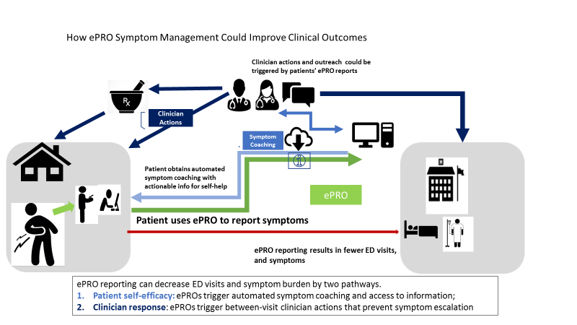

Slide 21
Acknowledgement
Site | Lead Investigator
Dana-Farber Cancer Institute | Deb Schrag MD, MPH & Michael Hassett MD
Maine Medical Center | Scot Remick MD
Lifespan/Rhode Island Hospital | Don Dizon MD
West Virginia University Cancer Institute | Hannah Hazard-Jenkins MD
Baptist Memorial | Ray Osarogiagbon MD
Dartmouth-Hitchcock Medical Center | Sandra Wong MD

Slide 22
Questions?

