Slide 1
NRG-HN2001: A phase II trial of using plasma EBV DNA to direct adjuvant therapy for high risk nasopharyngeal carcinoma after definitive treatment
PI: Nancy Y. Lee, MD, FASTRO
NRG Oncology Virtual Summer Meeting
July 17, 2020
@NRGOnc
NRG Oncology

Slide 2
Enrolled 626
N= 346
N= 99
High Risk Cohort Completed 10/2020

Slide 3
Relevant Scientific Background
Since advent of IMRT for non-metastatic NPC, high locoregional control is achieved
Distant metastasis is can be as high as 17% to 30% across all published series and is the predominant cause of patient death
T-, N- is limited in their determination of treatment outcomes
Detectable EBV DNA after definitive treatment that includes radiation consistently have shown to be the most robust poor prognostic marker of survival
A recent meta-analysis of almost 11,000 patients showed that detectable post-treatment plasma EBV DNA accounted for 5.43 fold increase in death versus the undetectable EBV DNA controlled for all other variables such as T, N stage

Slide 4
N=23 eligible studies including 10,732 patients
Pretreatment plasma EBV DNA level for OS was 2.78
Post-treatment plasma EBV DNA level for OS was 5.43

Slide 5
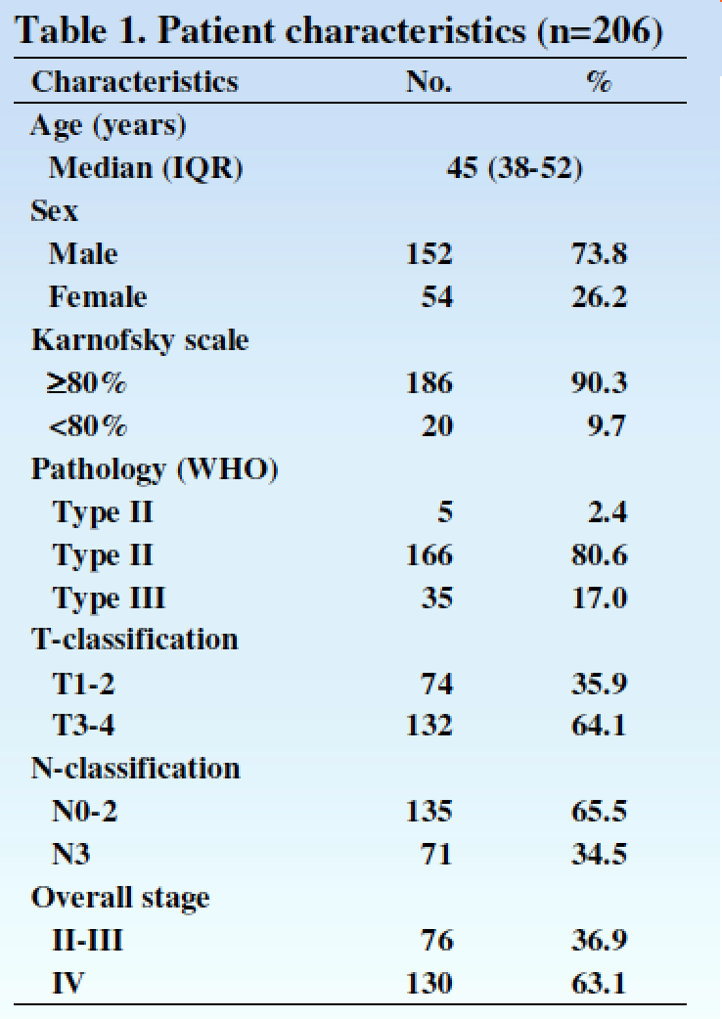
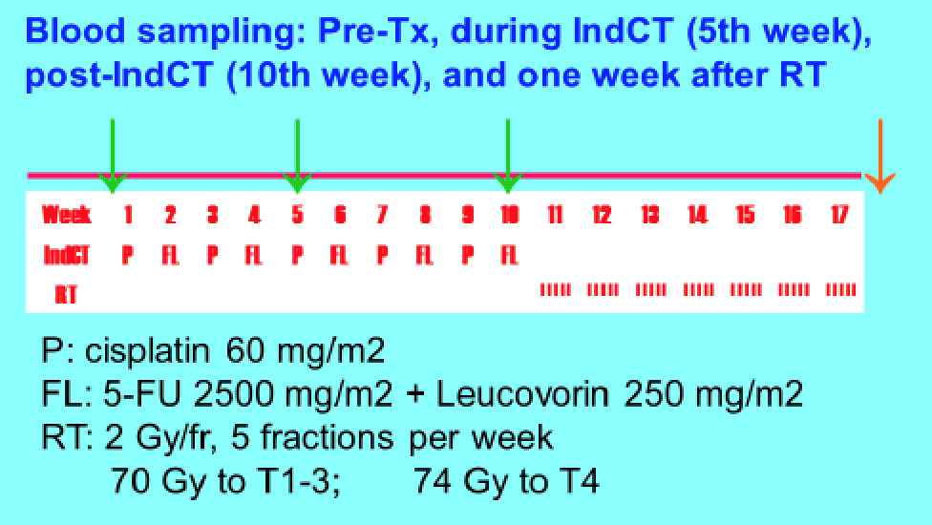
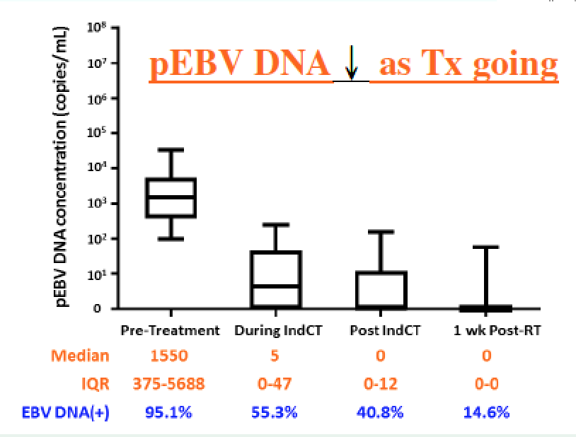
JC Lin et al. ASCO 2018

Slide 6
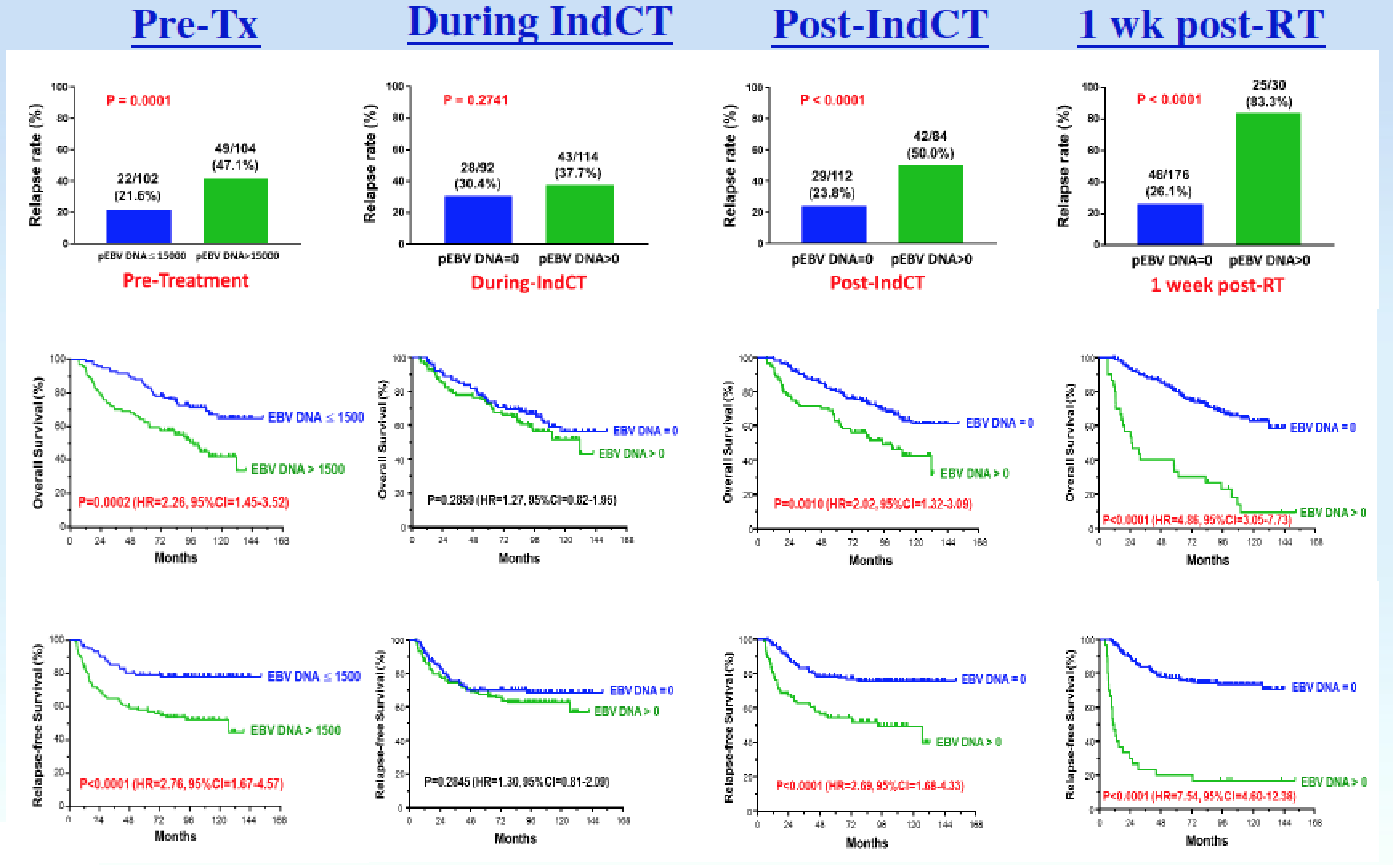

Slide 7
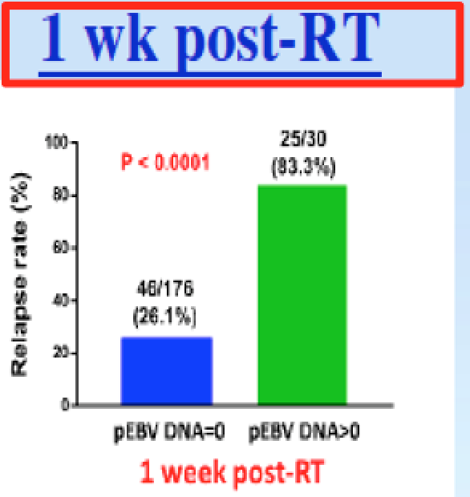
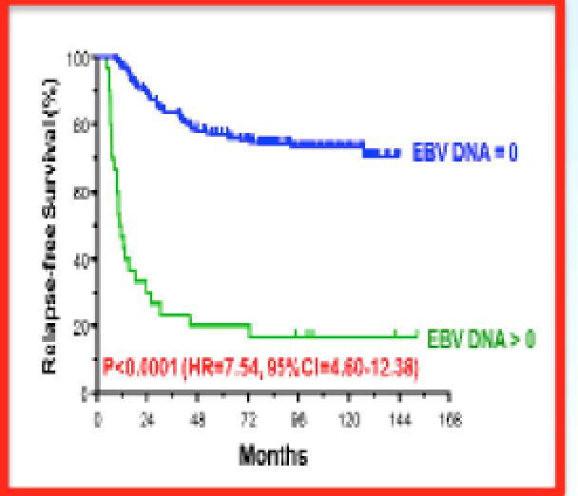
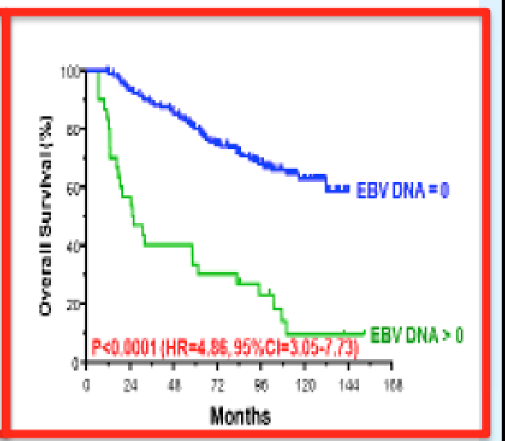
1 Week Post Treatment Plasma EBV DNA

Slide 8
KEYNOTE-028: ORR was impressive at 25.9% (95% CI: 11.1–46.3), with 26% of patients experiencing partial response (PR) and 52% of patients with stable disease (SD)
NCI-9742 (NCT02339558): ORR for heavily pre-treated NPC was 20.5% (CR = 1; PR = 8), 1-year OS rate was 59% (95% CI, 44.3 to 78.5%), and 1-year PFS rate was 19.3% (95% CI, 10.1 to 37.2%)
1 PCD4989g clinical trial: Objective response occurred in 22% with median of PFS 2.6 months (range 0.5–48.4), and median OS 6.0 months (0.5–51.6) in patients who received atezolizumab
Camrelizumab monotherapy: Objective response of 34% (95% CI: 24–44)
Camrelizumab + Gem/CDDP as first line: Objective response in 91% (95% CI: 72–97) with a median follow-up time of 10.2 months (IQR 9.7–10.8), but 3 or 4 toxicities is high at 87%.

Slide 9
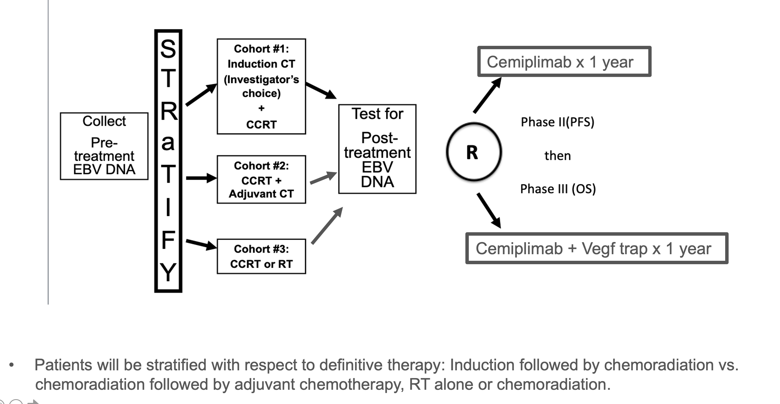
Study Design/Schema
PD1/PDL1 inhibitor
Placebo
Consider 2:1 randomization

Slide 10
Primary Objectives
Primary Objectives
Phase II: To determine whether adjuvant immunotherapy (anti-PD1 or anti-PDL1)
versus observation will result in superior progression-free survival in patients
with detectable EBV DNA after definitive treatment for non-metastatic
nasopharyngeal carcinoma.
Phase III: To determine whether adjuvant immunotherapy
(anti-PD1 or anti-PDL1) versus observation will result in superior overall survival in
patients with detectable EBV DNA after definitive treatment for non-metastatic
nasopharyngeal carcinoma.

Slide 11
Statistical Analysis
Phase II: The 2-yr PFS for the observation (control) arm is assumed to be 40%. It is hypothesized that the addition of 1 year of adjuvant immunotherapy (anti-PD1 or anti-PDL1) will improve the 2-year PFS from 40% to 45.7%, which is equivalent to a HR of 0.60 under the exponential distribution assumption (i.e. median PFS from 18.1 months to 30.2 months). With a 1-sided type I error rate of 0.15, 85% power, the logrank test requires 66 PFS events from 112 randomized patients.
Phase III: The 2-yr OS for the observation (control) arm is assumed to be 53%. It is hypothesized that the addition of 1 year of adjuvant immunotherapy (anti-PD1 or anti-PDL1) will improve the 2-year OS from 53% to 66%, which is equivalent to a HR of 0.65 under the exponential distribution assumption (i.e. median PFS from 26.2 months to 40.3 months. With a 1-sided type I error rate of 0.025, 90% power and two interim efficacy analyses based on the OF boundaries, the logrank test requires 231 OS events from 314 randomized patients.
1:2 (Placebo; Experiemental) randomization Ph II: 75 PFS events, 125 pts, 85% power, 1-sided alpha=0.15, HR=0.60 Ph III: 260 OS events, 349 pts, 90% power, 1-sided alpha=0.025, HR=0.65

Slide 12
Secondary Objectives
Major Secondary objective(s):
To compare the following between arms:
Progression-free survival (phase III);
Overall survival (phase II)
Locoregional progression;
Distant metastasis;
Quality of life (general and physical well-being) along with PRO’s
Acute and late toxicity profiles based on clinician-reported CTCAE, v. 5;
Death during or within 30 days of end of protocol treatment

Slide 13
Correlative Science [The Dream]
Correlate pre-treatment tissue (WES, EBV Sequencing, RNA Seq [Immune deconvolution → estimate immune cell fractions) with PFS and OS [Ideally, multiple biopsies if feasible]
Correlate serial plasma EBV DNA level with # of cycles of immunotherapy
Correlate serial plasma EBV DNA level with PFS and OS
Correlate PFS and OS with blood samples (EBV DNA, HLA type, TCR sequencing clonality and diversity)

