Slide 1
The Role of the Statistician in Protocol Development
Michael W. Sill
Clinical Trials Development Division
Department of Biostatistics and Bioinformatics
Roswell Park Comprehensive Cancer Center
NRG Semi-Annual Meetings
February 7th, 2018

Slide 2
Is the role of the statistician designed to block your research?

Slide 3
Some believe we are the naysayers of clinical research.
Rather than view NRG research as an “us versus them” perspective, it is helpful to see it from the statistician’s perspective.
A good statistician is not emotionally invested in your research. Instead, he/she guards the reputation of the office and considers all studies.

Slide 4
For example, statisticians are notorious for providing accurate or conservative estimates of accrual rates.
By gaining this reputation, proposed research (both now and future studies) will be taken more seriously by reviewers.
However, you may be frustrated thinking your particular study will have exceptional accrual.

Slide 5
Statisticians are often the bearer of bad news. When an investigator makes a proposal, they are hopeful that a study objective can be achieved with small sample sizes.
The investigator may get “sticker price shock” after the statistician shows the required sample size.
In addition, the study may require years (2 to 5) from activation to determine the drug’s activity.

Slide 6
Sometimes the statistician may determine that your study is not feasible.
For example, the accrual is too low or the required follow-up may be 10 to 20 years from now.
If your study is determined to have these features, you shouldn’t take it personally. The features are usually determined from the initial design and previous data. The statistician is not your enemy.

Slide 7
On the contrary, you will find most of the time that the statistician is willing to work with you to find alternative solutions to get a study running.

Slide 8
When Considering a Clinical Trial
Remember the essence of a trial is a scientific experiment. It involves human beings, so they must be conducted with great care, but they are experiments non-the-less.
The purpose of the clinical trial is to answer a question with some degree of confidence. For example, does adding drug “A” help? This forms a hypothesis.

Slide 9
Like many scientific experiments, we often form two mutually exclusive hypotheses.
The null hypothesis. This hypothesis states things like “Drug A is not effective.”
The alternative hypothesis. It states things like, “Drug A is effective.”
The goal of a clinical trial is to collect data to support the alternative hypothesis to a convincing degree.

Slide 10
Variability in responses to drugs (think blood pressure dropping) makes it more difficult to determine whether a drug is truly effective or not.
A person’s BP may drop due to chance or other factors when in fact drug A has no effect. (False positive)
Or a person’s BP may rise from stress even though drug A is active. (False negative).

Slide 13
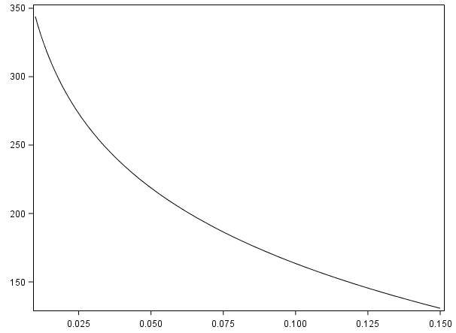
(0.01, 344)
(0.025, 274)
Sample Size
(0.05, 219)
(0.10, 164)
(0.15, 131)

Slide 15
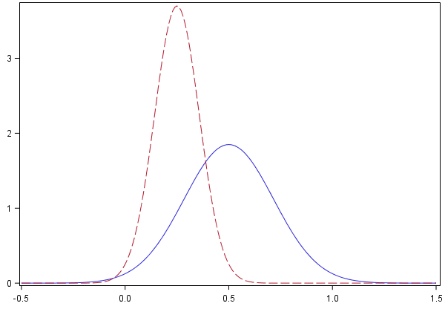
The smaller the effect size, the more sensitive the study; the larger the required sample size.
We have 2 distributions with 2 different minimal differences (red = 0.25; blue = 0.50).
In order to “squeeze” the red distn from 0, we need a sample size that is 4 x as large as the blue distribution – all else being equal.
Cutting the effect size by ½ requires 4 x the sample size.

Slide 16
The Study Endpoint
Determining the best endpoint can make the difference between a successful study and an unsuccessful one.
Common endpoints:
Tumor response (Phase II)
(2) PFS (Phase II, sometimes Phase III)
(3) OS (Phase III)

Slide 17
Tumor responses are most useful for single arm, phase 2 studies with cytotoxic agents. Small sample sizes and fast results.
PFS is useful for randomized phase II studies. Intermediate sample sizes and relatively fast results. Not always indicative of OS advantage.
OS is the gold standard for cancer trials. Results take time to mature. Studies require larger sample sizes.

Slide 18
One of the tasks of the statistician is to determine the length of the study. This requires assumed accrual rates and hazard rates for PFS or OS.
Accruing larger sample sizes shortens the time until the data mature. However, larger sample sizes are more expensive and labor intensive for the office.
A balance needs to be struck between the goals of the study and the resources available.

Slide 19
Contacting the Statistician
The above outline provides the basic concepts to writing a first draft of the study. The chair can take a stab at the design first and consult a mentor. The design does not have to be perfect.
Sometimes a study is rejected for reasons such as competing studies. For these reasons, the statistician is often discouraged from getting involved in designing the study until after it is approved by the relevant committees.

Slide 20
Once a study is approved for further development, it is assigned to a statistician through ordinary procedures.
If you created a design, the statistician may unilaterally make substantial changes to the design for various reasons, especially if the questions are more routine in nature.
If the questions being posed by the study are more complicated, contact should be made to let the statistician know.

Slide 21
If you feel that your study is unique, it is helpful to clue the statistician in on the special circumstances regarding your study.
You can contact the statistician at the meeting, find out who the likely statistician is through your committee chair, or by contacting the group leadership at the data center.
For Gyn studies, this would include Dr. Austin Miller (Director of Statistics) and Dr. Ginny Filiaci (Director of Operations).

Slide 22
Remember, the obstacle to the knowledge we seek is not the statistician. He/she is but another member of the team who wants to help you reach your goals.

Slide 23
Acknowledgements
Clinical Trials Development Division
Department of Biostatistics and Bioinformatics
Roswell Park Comprehensive Cancer Center
Grant/Sponsor Acknowledgements
NRG Oncology (1 U10 CA180822) and NRG Operations (U10CA180868)
Notes:
Last Slide

