Slide 1
NRG-LU006
Andreas Rimner, MD
Associate Attending
Director of Thoracic Radiation Oncology Research
Department of Radiation Oncology
Memorial Sloan Kettering Cancer Center
July 17, 2020

Slide 2
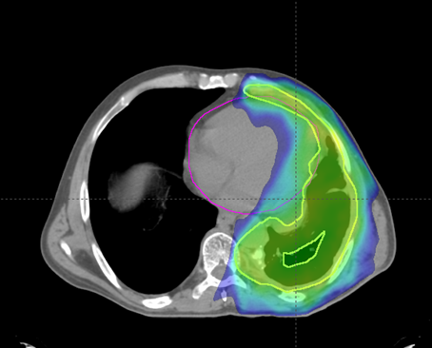
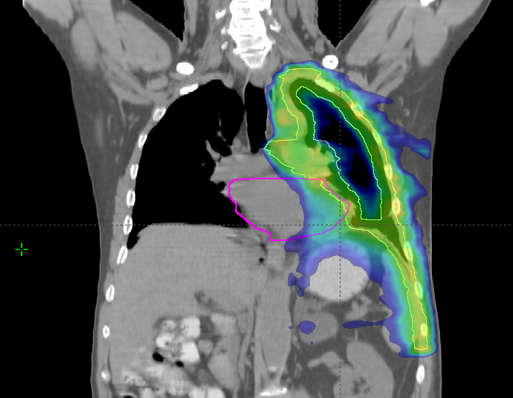
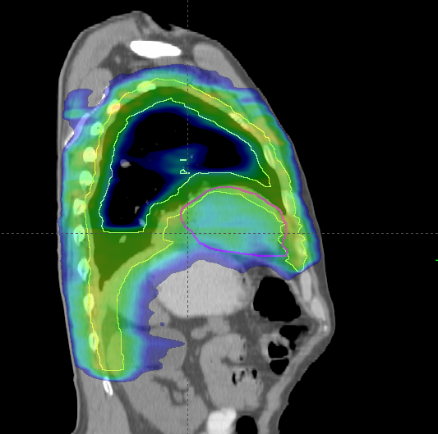
NRG-LU006
Phase III Randomized Trial of Pleurectomy/Decortication + Chemotherapy +/- Adjuvant Hemithoracic Intensity-Modulated Pleural Radiation Therapy (IMPRINT) for Malignant Pleural Mesothelioma (MPM)

Slide 3
Disclosures
NRG-LU006: Phase III Randomized Trial on IMPRINT for MPM
Grant support:
Varian Medical Systems
Boehringer Ingelheim
Pfizer
Astra Zeneca
Merck
Consulting:
Varian Medical Systems
Merck
Astra Zeneca
MoreHealth

Slide 4
NRG-LU006 Study Design
NRG-LU006: Phase III Randomized Trial on IMPRINT for MPM
IMPRINT
(50.4/60 Gy in 28 fractions)
Eligibility:
Stage I-III MPM
Resectable by lung-sparing P/D
Epithelioid or biphasic subtype
Age ≥18 and ≤80 years
KPS ≥80%
FEV1 ≥40%, DLCO ≥40% predicted
Pemetrexed (500mg/m2)
+ Cisplatin (or carboplatin) (75mg/m2)
q21 days
x4 cycles
P/D
(MCR)
R
1:1
n=150
No adjuvant IMPRINT
Neoadjuvant chemo → P/D is permitted
Stratification:
Cell type: Epithelioid vs biphasic
Macroscopic complete resection: R0/R1 vs R2
Center patient volume: ≤10 vs >10 pleurectomy/decortications/year

Slide 5
Objectives
NRG-LU006: Phase III Randomized Trial on IMPRINT for MPM
Hypothesis:
Adjuvant IMPRINT is associated with an overall survival benefit compared to surgery + adjuvant chemotherapy alone.
Primary Objective:
Improvement in median OS from 12 months (null hypothesis) to 20 months (alternative hypothesis) (calculated from the time of randomization)
Secondary Objectives:
Local Failure-Free Survival
Distant Metastases-Free Survival
Progression-Free Survival
Toxicities per CTCAE v5.0
QOL (QLQ-Q30 and LC13) (10-point change at 9 months)
Exploratory Objectives:
To build a multiparametric prognostic imaging model to improve clinical staging and target delineation
To identify genomic and immunologic predictive biomarkers of radiation sensitivity and potential future therapeutic targets

Slide 6
NRG-LU006: Phase III Randomized Trial on IMPRINT for MPM
Inclusion criteria
Pathologically confirmed stage I-IIIA MPM (epithelioid or biphasic)
Amenable to P/D as determined by a thoracic surgeon
Age ≥18 years and ≤80 years
Karnofsky performance status ≥80%
FEV1 ≥40%, DLCO ≥40% predicted
Adequate liver and renal function
Exclusion criteria
Sarcomatoid histology
Continuous oxygen use
Third space fluid that cannot be controlled by drainage
Serious unstable medical illness (e.g. concurrent active malignancy, active infection, or acute congestive heart failure)
Prior thoracic radiation therapy or chemotherapy
Pregnancy or lactating

Slide 7
Surgeon Credentialing
NRG-LU006: Phase III Randomized Trial on IMPRINT for MPM
MCR = goal of surgical resection in every patient
Resection definitions per IASLC/IMIG guidelines
Documentation of diaphragmatic, pericardial and chest wall invasion for accurate T-staging
Documentation of unresectable areas + clip placement
No intraoperative adjunctive therapies, i.e. heated chemotherapy, photodynamic therapy
Systematic nodal sampling
Number of MPM surgeries in the past 2 years (must be >5/year)
Number of grade 4-5 toxicities within 30 days postop in the past 2 years

Slide 8
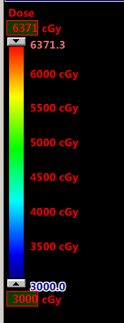
Central Radiation Oncology Review Process
NRG-LU006: Phase III Randomized Trial on IMPRINT for MPM
Central review of each individual patient assigned to IMPRINT arm
Review of target and OAR delineation
Review of radiation treatment plan
48-hour turnaround

Slide 9
NRG-LU006: Phase III Randomized Trial on IMPRINT for MPM
MSKCC Contouring Atlas
Detailed contouring atlas available on NRG website

Slide 10
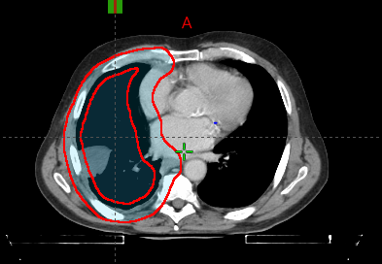
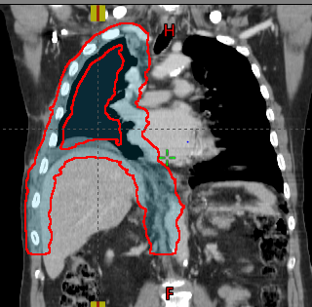
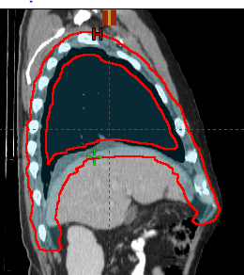
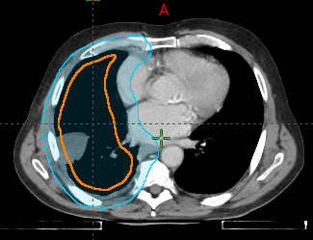
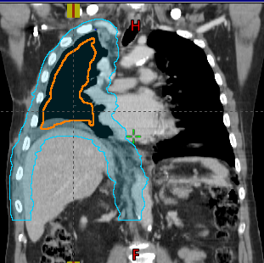
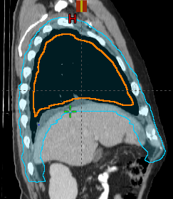
Treatment Planning Requirements
NRG-LU006: Phase III Randomized Trial on IMPRINT for MPM
Site should have passed IROC lung phantom
Photon or protons are permitted
PTV = Boolean of an ‘inner’ and ‘outer’ structure, allowing planner to reduce ipsilateral lung dose.
PET and 4DCT used for target definition
Slide courtesy of Dr. Ellen Yorke

Slide 11
Treatment Planning Guidelines
NRG-LU006: Phase III Randomized Trial on IMPRINT for MPM
Structure Name | Dosimetric Parameter | Per Protocol | Variation Acceptable | Deviation Unacceptable
GTV | D95%[%] | >=95 | >=90 | < 90
PTV | D95%[%] | >=94 | >=92 | < 92
 | V95%[%] | >=94 | >=92 | < 92
 | D5%[%] | <=115 | <=120 | >120
 | D0.03cc[%] | <= 130 | <=150 | >150
GTV_6000 * | D95%[Gy] | >= Rx Dose and <=60 Gy | N/A | < Rx Dose
Lungs-GTV | V20Gy[%] | <=37 | <=40 | >40
 | Mean[Gy] | <=20.5 | N/A | >20.5
Lung_R Lung_L (Ipsi-lateral) | V40Gy[%] | <=67 | <=90 | >90
Lung_R Lung_L (Contralateral) | V5% [%] | <=50 | <=80 | >80
 | Mean [Gy] | <=8 | <=10 | >10
 | V20Gy[%] | <=5 | <=7 | >7
Esophagus | Mean[Gy] | <=34 | <=38 | >38
SpinalCord | D0.03cc[Gy] | <=50 | N/A | >50
Kidney_R Kidney_L | V18Gy[%] | <=33 | <=50 | >50
Kidneys | V18Gy[%] | <=33 | <=50 | >50
Stomach-PTV | Mean[Gy] | <=30 | <=32 | >32
Spc_Bowel | D0.03cc[Gy] | <=55 | <=56 | >56
 | D5cc[Gy] | <=45 | <=50 | >50
BrachialPlexus_R BrachialPlexus_L | D0.03cc[Gy] | <=65 | N/A | >65
Liver-GTV | Mean[Gy] | <=30 | <=31 | >31
 | V30Gy [%] | <=45 | <=50 | >50
Heart (right meso) | V40Gy[%] | <=25 | <=35 | > 35
 | Mean [Gy] | <=30 | N/A | >30
Heart (left meso) | V40Gy[%] | <=35 | <=37 | >37
 | V30Gy[%] | <=50 | N/A | >50
 | Mean [Gy] | <=30 | N/A | >30
E-PTV | D0.03cc[%] | <=110 | <=115 | >115

Slide 12
Current Status
NRG-LU006: Phase III Randomized Trial on IMPRINT for MPM
Study Activation Date: 1/29/2020
Open to accrual at MSKCC
50+ centers undergoing local IRB approval

Slide 13
NRG-LU006: Phase III Randomized Trial on IMPRINT for MPM
NRG-LU006 Study Chairs/Leadership
Andreas Rimner, MD, Memorial Sloan Kettering Cancer Center | PI
Charles B. Simone, II, MD, New York Proton Center | Rad. Oncology
Valerie W. Rusch, MD, Memorial Sloan Kettering Cancer Center | Surg. Oncology
Marjorie G. Zauderer, MD, Memorial Sloan Kettering Cancer Center | Med. Oncology
Ritu R. Gill, MD, Beth Israel Deaconess Medical Center | Radiology
Ellen Yorke, PhD, Memorial Sloan Kettering Cancer Center | Med. Physics
Zuofeng Li, DSc, University of Florida College of Medicine | Proton Physics
Khinh Ranh Voong, MD MPH, Sidney Kimmel Cancer Center | Statistics
Tobias Peikert, MD Mayo Clinic Cancer Center | Translational
Ming S. Tao, MD, Princess Margaret Cancer Center | Pathology
Chen Hu, PhD, NRG Oncology Statistical and Data Management Center & John Hopkins University School of Medicine | Statistics

Slide 14
NRG-LU006: Phase III Randomized Trial on IMPRINT for MPM
NRG-LU006 NRG Operations and SDMC Study Team
For Contact Information see protocol cover page
Data Management | Sylvia Solakov Jeff Serianni
RTQA | Jennifer Presley
Protocol Development | Fran Bradley
Lung Committee Chair | Jeffrey D. Bradley

