Slide 1
Why I am on Twitter?
Jame Abraham, M.D, FACP
Director, Breast Oncology
Professor of Medicine
Lerner College of Medicine
Cleveland Clinic

Slide 2
I would like to know who you are?
I will use an audience response system to poll the group to understand
Age
Background
Social media usage

Slide 3
What I do?

Slide 4
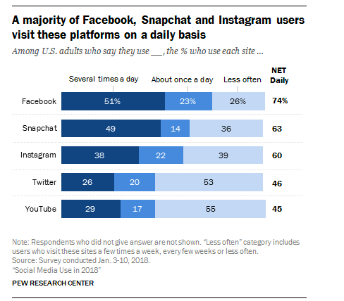

Slide 5
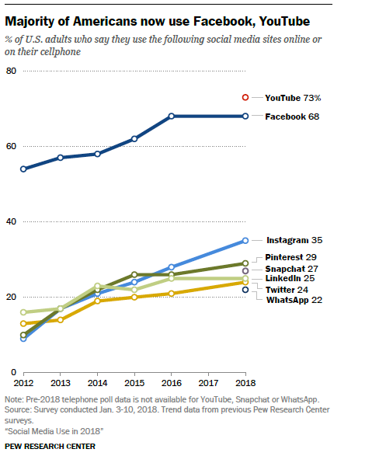

Slide 6
Four reasons why I focus on Twitter
To connect with the community who cares about cancer, particularly breast cancer
I learn what is new
I share what I think is new
Sometimes I promote my personal views on various topics (confession)

Slide 7
Do you think Twitter is
It is for kids ?
It is for politicians ?
It is too complicated ?
I am willing to try ?

Slide 8
Twitter
I don’t have an account
I have an account, but never used it
I am very active on twitter
I would like to learn and would like to be active

Slide 9
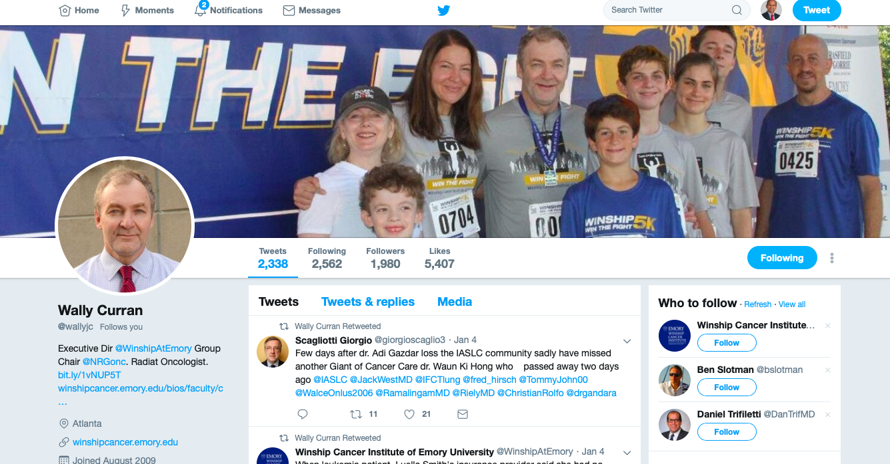
Anatomy of a twitter page

Slide 10
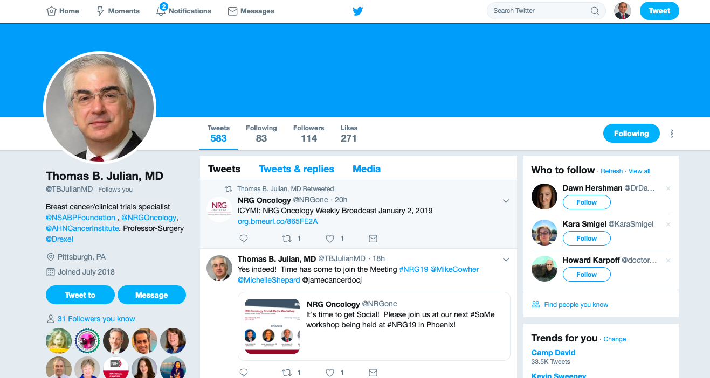
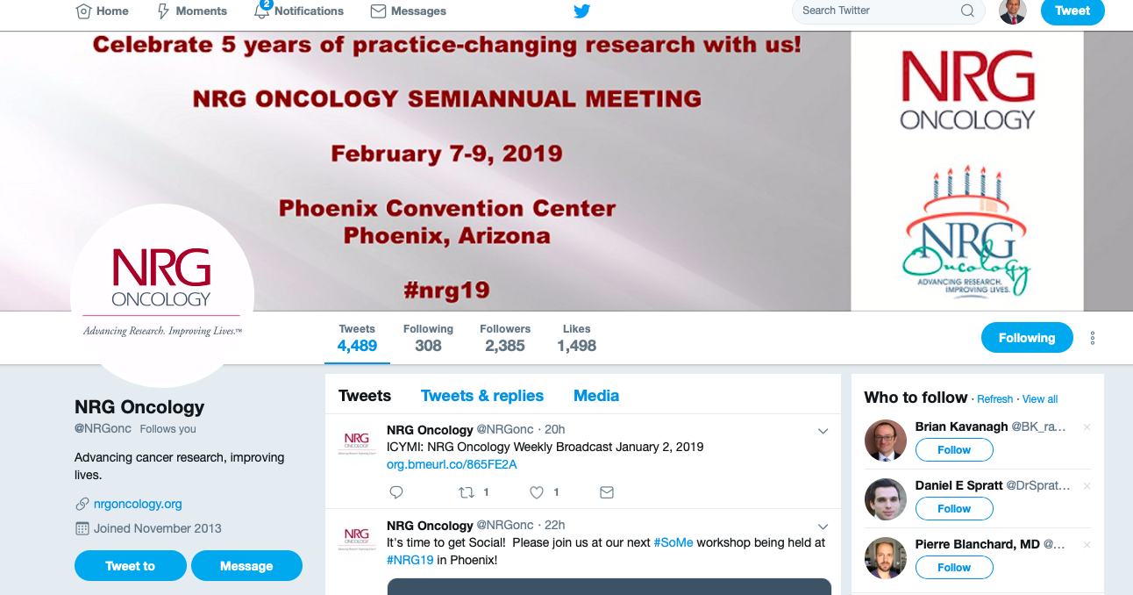
Anatomy of a twitter page

Slide 11
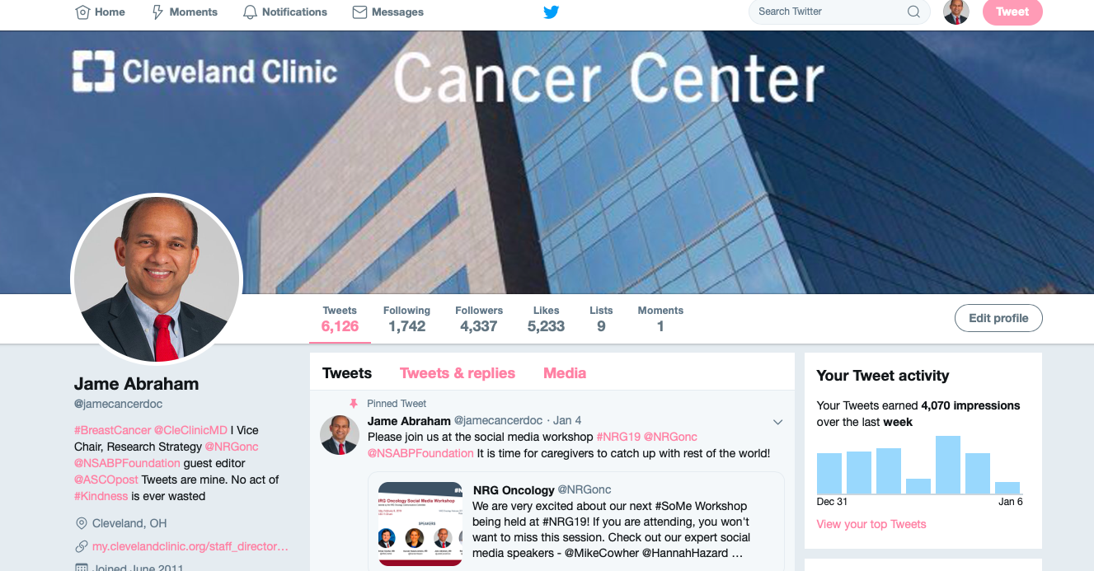
Anatomy of a twitter page

Slide 12
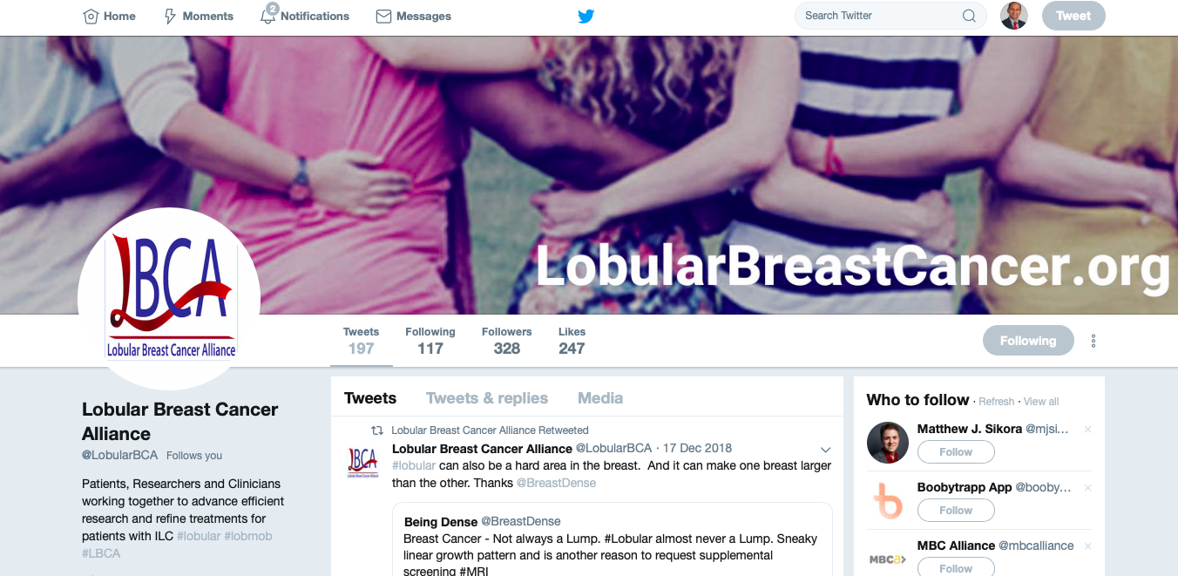
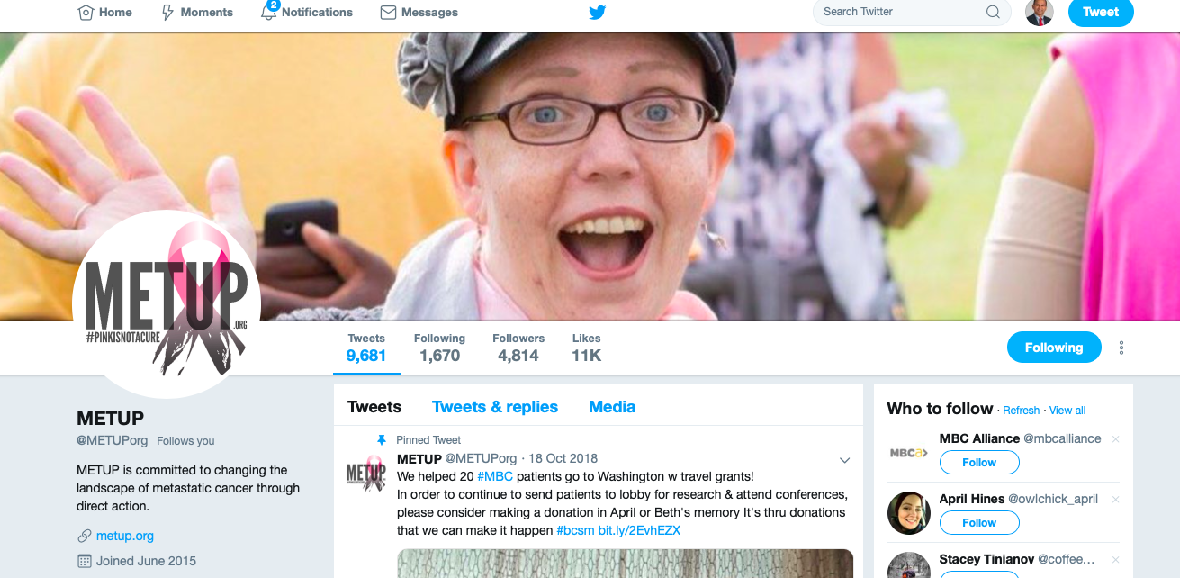
Patient advocates

Slide 13
Conclusion
I will try twitter
I will follow NRG and tweet using #NRG19
I still think it is not for me

