Slide 1
Gynecologic Cancer Committee Clinical Trial Development

Slide 2
Gynecologic Cancer Committee
Chair: Carol Aghajanian, MD
Co Chairs: Paul DiSilvestro, MD & William Small, MD
Translational Science Co-Chair: Heather Lankes, PhD
GYN Developmental Therapeutics Committee
Chair: Roisin O’Cearbhaill, MD
Co-Chair: Floortje Backes, MD
TS Co-Chair: Panagiotis Konstantinopoulos, MD, PhD
GYN Phase I Subcommittee
Chair: Russell Schilder, MD
Co-Chair: Stephanie Gaillard, MD, PhD
Cervix/Vulvar Cancer Subcommittee
Chair: Charles Leath, MD
Co-Chair: Jyoti Mayadev, MD
TS Co-Chair: Dmitriy Zamarin, MD, PhD
Ovarian Cancer Subcommittee
Chair: Kathleen Moore, MD
Co-Chair: Robert Burger, MD
TS Co-Chairs: Elizabeth Swisher, MD & Rebecca Arend, MD
Rare Tumor Subcommittee
Chair: Allan Covens, MD
Co-Chair: Jubilee Brown, MD
Uterine Corpus Cancer Subcommittee
Chair: Matthew Powell, MD
Co-Chair: Ann Klopp, MD
TS Co-Chair: Douglas Levine, MD
Translational Science
Michael Birrer, MD, PhD

Slide 3
Submitting LOIs/Concepts to NRG Oncology
Request for proposals broadcast prior to Semi-Annual Meetings
“Proposals are to be submitted on the CTEP LOI submission form for any proposal targeting 97 patients or less or the CTEP concept submission form if targeting 98 or more patients. Current versions of CTEP LOI submission form and concept submission form can be found at: https://ctep.cancer.gov/protocolDevelopment/lois_concepts.htm. Submit completed proposals to GYNconcepts@nrgoncology.org by *.”

Slide 4
Review of Submitted LOIs/Concepts
LOI (< 97 patients)
Concepts (> 98 patients)
NRG Oncology
Subcommittee
CTEP
LOI to PIO
GYN Cancer Committee
NRG Oncology Research Strategy Committee
Protocol Review Committee (PRC)
Industry Partner
NRG Oncology
Subcommittee
Scientific Steering Committee (SSC)*
Task Force
GYN Cancer Committee
NRG Oncology Research Strategy Committee
Gynecologic Cancer Steering Committee (GCSC)
Concept to PIO
Industry Partner
*https://www.cancer.gov/about-nci/organization/ccct/steering-committees
Notes:
Submission to RSC requires: LOI/concept, Accrual Checklist Form, NRG Review Form for dev concepts

Slide 5
Types of Trials
CTEP Supported NCTN Intervention Trials
CTEP IND Agents (https://ctep.cancer.gov/protocolDevelopment/agents_drugs.htm)
Study team prepares LOI (for trials with 97 or less patients) or concept submission form (for trials with 98 or more patients) https://ctep.cancer.gov/protocolDevelopment/lois_concepts.htm
Protocol Administrator (PA) submits LOI or concept submission form to PIO
CTEP holds the IND
CTEP (PMB) supplies and distributes experimental agent(s)
Non-CTEP IND Agents
Either the pharmaceutical company or NRG Oncology can hold the IND. If NRG Oncology holds the IND, they cross file on the pharmaceutical company's IND.
The pharmaceutical company is responsible for supply and distribution of the experimental agent(s). They can supply/distribute themselves or contract with a 3rd party. NRG Oncology does NOT have the infrastructure to distribute drugs.
CTEP has to scientifically approve these studies. This requires submission of LOI or concept submission form and IB for the agent(s). Review of LOI or concept is the same as process for #1 above.

Slide 6
Letter of Intent (LOI) Types
Project Team Member Applications (PTMA)
-CrD PTMA
-Replaced mass solicitation in March 2014
Unsolicited LOI
-CrDL LOI
CrDL = Career Development LOI

Slide 7
Career Development LOI (CrDL)*
Eligibility
Study chair (PI) should have a major interest in clinical research and the intention to develop a career in that field
He/she should be within 7 years of completion of fellowship training
He/she must be a faculty member (fellows may not serve as PIs on studies) at an institution with a successful track record in conducting cancer clinical trials
Requirements
Letter of commitment – NRG Oncology Group Chairs
Letter of commitment from mentor
Biosketch mentee (study chair/PI) AND mentor
CrDL is for LOI only (NOT concepts)

Slide 8
PTMA replaces Mass Solicitation March 2014
PTMA | Mass Solicitation
Application by individuals for membership to project team | LOI
Drug development plan by project team occurs during CRADA negotiations | Mass solicitation issued after CRADA negotiations completed
Career Development PTMA (CrD PTMA) Applicant’s and Mentor’s NIH Biosketch Mentor Letter of Commitment NRG Oncology Letter of Commitment (Group Chair Letter)
CRADA – Cooperative Research and Development Agreement
Notes:
Only one mentor may be listed
The mentor does not need to submit a separate PTMA
If selected BOTH the CrD PTMA team member AND mentor will be required to attend all team meetings

Slide 9
Request for PTMA
Team members – Apply as
Trials conducted in the ETCTN, CTEP brain tumor consortia, CITN or NCTN
Clinical Scientist (Part A)
Translational Scientist (biomarker development expert) (Part B)
Basic Scientist (expert in mechanism of action of agent) (Part C)
Notes:
ETCTN – Experimental Therapeutics Clinical Trials Network
CITN – Cancer Immunotherapy Trials Network

Slide 10
Project Team
8-12 weeks
Intramural and extramural co-chairs
WebEx (no in person meetings)
Attendance mandatory
Non-participating members will be dropped
for CrD applicants this includes your mentor
Non-participating clinicians should not expect to have leadership roles in studies

Slide 11
NRG Oncology PTMA Process
Project Team Announcements are broadcasted electronically by NCI CTEP PIO
NRG Oncology (Protocol Development) in turn electronically broadcasts Project Team Announcements to entire membership
Interested applicants should notify NRG Oncology leadership
Research Strategy Committee Chair
Disease Site Committee Chair and/or Non-Disease Site Scientific Committee Chair (DT and/or Translational Science)
Copy Protocol Development Office (Francy Fonzi, Kia Neff, Nancy Soto)
PTMA for individuals planning on conducting trials in NRG Oncology must be submitted by NRG Oncology
Application is for individual (not LOI or concept submission form), so the usual Research Strategy Committee requirement of concept approval is not applicable
Project team members leave process with requirement to submit LOI or Concept Submission Form (triggers OEWG deadline) and generate protocol
LOI/Concept and protocol development is per usual NRG Oncology processes
All correspondence with NCI must be submitted by NRG Oncology Protocol Development Office (LOI/Concept submission, protocol submission, etc.)

Slide 12
Unsolicited LOIs
Before submitting unsolicited LOI (including CrDL), contact the IDB monitor(s) for the intended CTEP agent(s) to schedule a preliminary teleconference (TC)
TC must be set up by NRG Oncology Protocol Administrator (PA)
Sub-Committee/Committee Chair contact Kia Neff to set up TC (NeffK@nrgoncology.org)
For CrDL LOI, both the mentor and mentee MUST participate in TC
TC attendees:
Study Chair/PI (mentee)
Mentor
Sub-Committee/Committee Chair +/- Co-Chair(s) +/- Translational Science representative(s)
Representative from Protocol Administration (PA)
NOTE: Statistician/SDC should NOT be included (statistician gets involved once go ahead is given by CTEP to develop and submit LOI)
Unsolicited LOIs without a preliminary teleconference will be refused by CTEP

Slide 13
Review of LOIs/Concepts
LOIs
Reviewed by CTEP Protocol Review Committee (PRC)*
CTEP approved LOIs are sent to the pharmaceutical collaborator for review and agent commitment (if applicable)
Concepts
Reviewed by NCI Scientific Steering Committee (Gynecologic Cancer Steering Committee [GCSC]**)
GCSC approved concepts are sent to the pharmaceutical collaborator (if applicable) for review and agent commitment
*Reviewed by Biomarker Review Committee (BRC) if applicable
**Review by Task force (Cervical Cancer, Ovarian Cancer, Uterine Cancer) prior to GCSC submission is recommended (although not required)

Slide 14
Integral & Integrated Biomarkers
Integral Studies
Assays/tests that must be performed in order for the trial to proceed or to support the primary analysis. Integral studies are inherent to the design of the trial and must be performed on all participants, usually in real time. The assay/test must support one of the trial’s primary hypotheses.
This includes:
Tests to establish eligibility, randomization, stratification, or treatment assignment in a treatment, imaging, prevention or symptom science trial
Functional imaging or molecular characterization linked to execution of primary analysis, such as non-reimbursable PET scans or biomarker evaluation
Integrated Studies
Intended to validate markers, imaging tests or tools, or QOL/PRO instruments for possible use as an integral biomarker in future trials or in clinical practice. Integrated studies should test a specific hypothesis with a preplanned statistical design, and are not hypothesis generating or exploratory. Integrated studies must be included in the protocol as a secondary objective.
Real time (RT) integrated studies
Non-real time (NRT) integrated studies

Slide 15
Biomarker Review Committee (BRC)
LOIs require BRC review/approval if they include any of the following:
Integral and/or integrated markers
Requests for NCI funding for biomarker assays
Requests for NCI funding for sample acquisition
NOTE: Exploratory biomarkers that will not be funded by NCI will not undergo BRC review
Notes:
For LOI (NOT concepts)

Slide 16
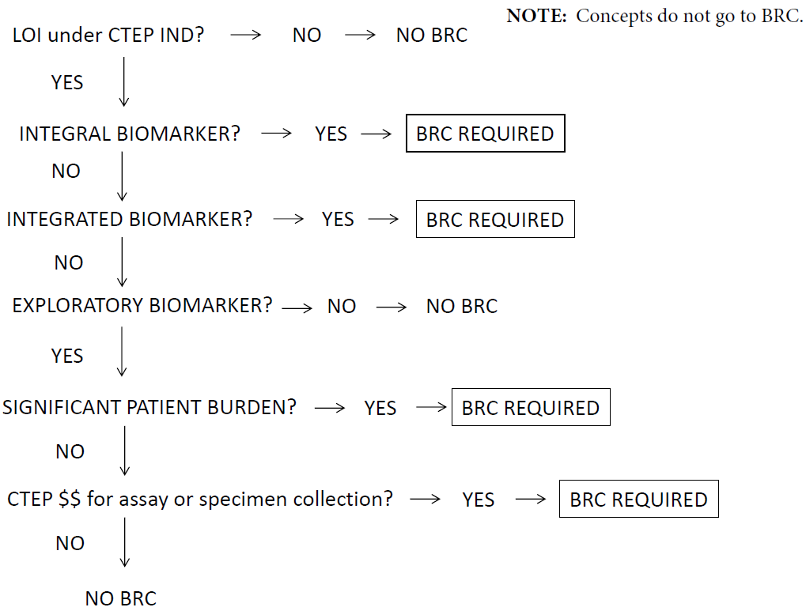
Notes:
For LOI (not concepts)

Slide 17
Biomarker, Imaging and Quality of Life Studies Funding Program BIQSFP
BIQSFP Funding (NCTN/NCORP)
Eligible trials are those conducted by NCTN Groups and NCORP Research Bases AND reviewed by NCI Steering committees:
Randomized Phase 2 and Phase 3 NCTN treatment trials
Randomized Phase 2 and Phase 3 NCORP cancer prevention clinical trials
Randomized symptom science/supportive care clinical trials with efficacy endpoints
Cost effectiveness analysis (CEA) proposals (if part of randomized phase III trial)
Application materials and instructions can be found at:
https://www.cancer.gov/about-nci/organization/ccct/funding/biqsfp
Notes:
For concepts (NOT LOI)

Slide 18
Biomarker, Imaging and Quality of Life Studies Funding Program BIQSFP
BIQSFP Funding (NCTN/NCORP)
Integral Studies
Submit with concept (review is concurrent)
Real Time (RT) Integrated Studies
Submit after concept approval
Non-Real Time (NRT) Integrated Studies
Submit between > 75% accrual to < 6 months after publication (abstract or manuscript) of primary endpoint (whichever occurs first)
Application materials and instructions can be found at:
https://www.cancer.gov/about-nci/organization/ccct/funding/biqsfp
Notes:
For concepts (NOT LOI)

Slide 19
Abbreviations
AOH- Approval on Hold
BIQSFP – Biomarker, Imaging, Quality of Life Studies Funding Program
BRC – CTEP Biomarker Review Committee
CIRB – NCI Central Investigational Review Board
CRM – CTEP Concept Review Meeting
CRR – Consensus Review Response
CTEP – NCI Cancer Therapy Evaluation Program
DCP – NCI Division of Cancer Prevention
GCSC – Gynecologic Cancer Steering Committee
HRC – Human Research Committee
IDB – CTEP Investigational Drug Branch
LOI – Letter of Intent
NCI – National Cancer Institute
NCORP – NCI Community Oncology Research Program
NCTN – NCI National Clinical Trials Network
OEWG – Operational Efficiency Working Group
PIO – CTEP Protocol and Information Office
PRC – CTEP Protocol Review Committee
PRO – Patient Reported Outcomes/Quality of Life
PSC – NRG Oncology Protocol Support Committee
PTMA – Project Team Member Application
RSC – NRG Oncology Research Strategy Committee
Task Forces – Cervical Cancer (CTF), Ovarian Cancer (OTF), Uterine Cancer (UTF)
TC – Teleconference
TS –Translational Science

